Slide 1
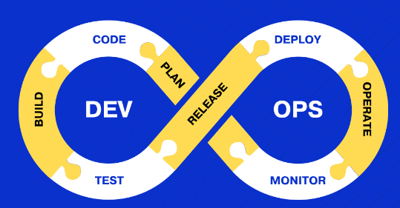
Mastering the DevOps Lifecycle: A Comprehensive Guide for Professionals
What is DevOps Lifecycle?
The DevOps lifecycle is a continuous process that integrates software development (Dev) and IT operations (Ops) to enhance the collaboration between these traditionally siloed teams. This integration aims to improve the efficiency, speed, and quality of software delivery.

Slide 2
Mastering the DevOps Lifecycle: A Comprehensive Guide for Professionals
1. Planning:
Description: This phase involves defining the vision and goals of the software project. It includes requirements gathering, project management, and roadmap creation.
Tools: JIRA, Confluence, Trello.

Slide 3
Mastering the DevOps Lifecycle: A Comprehensive Guide for Professionals
2. Coding:
Description: Developers write code based on the requirements and plans. This phase emphasizes coding standards, peer reviews, and version control.
Tools: Git, GitHub, GitLab, Bitbucket.

Slide 4
Mastering the DevOps Lifecycle: A Comprehensive Guide for Professionals
3. Building:
Description: The code is compiled and packaged into executable files. This phase includes integrating all the code changes and dependencies into a build.
Tools: Jenkins, Maven, Gradle, Bamboo.

Slide 5
Mastering the DevOps Lifecycle: A Comprehensive Guide for Professionals
4. Testing:
Description: Automated and manual tests are conducted to ensure code quality and functionality. This phase aims to identify bugs and issues before deployment.
Tools: Selenium, JUnit, TestNG, NUnit.

Slide 6
Mastering the DevOps Lifecycle: A Comprehensive Guide for Professionals
5. Release:
Description: The tested build is deployed to a staging or production environment. This phase ensures that the deployment process is smooth and minimizes downtime.
Tools: Jenkins, Travis CI, CircleCI, Spinnaker.

Slide 7
Mastering the DevOps Lifecycle: A Comprehensive Guide for Professionals
6. Deployment:
Description: The software is deployed to the production environment. This phase involves monitoring the deployment process and ensuring that the software runs as expected.
Tools: Kubernetes, Docker, OpenShift, AWS CodeDeploy

Slide 8
Mastering the DevOps Lifecycle: A Comprehensive Guide for Professionals
7. Operations:
Description: The deployed software is continuously monitored for performance, availability, and security. This phase focuses on maintaining the health of the system.
Tools: Nagios, Prometheus, Grafana, ELK Stack.

Slide 9
Mastering the DevOps Lifecycle: A Comprehensive Guide for Professionals
8. Monitoring:
Description: Continuous monitoring and logging provide insights into the system's performance and user behavior. This phase helps in proactive issue resolution and system improvements.
Tools: Splunk, Dynatrace, New Relic, Datadog.

Slide 10
Mastering the DevOps Lifecycle: A Comprehensive Guide for Professionals
Benefits of the DevOps Lifecycle
Enhanced Collaboration: By breaking down silos, DevOps fosters a culture of collaboration between development and operations teams.
Faster Time to Market: Continuous integration and continuous deployment (CI/CD) practices streamline the development and deployment processes, leading to quicker releases.
Improved Quality: Automated testing and continuous monitoring ensure that issues are identified and resolved early, leading to higher-quality software.
Increased Efficiency: Automation of repetitive tasks reduces manual effort and increases efficiency.
Scalability: DevOps practices support scalable environments, making it easier to manage large-scale deployments.

Slide 11
Mastering the DevOps Lifecycle: A Comprehensive Guide for Professionals
Conclusion
The DevOps lifecycle is an iterative process that emphasizes collaboration, automation, and continuous improvement.
By integrating development and operations, organizations can achieve faster delivery, higher quality, and improved efficiency in software development and deployment.
Adopting the right tools and practices at each stage of the lifecycle is crucial for maximizing the benefits of DevOps.

