Slide 1
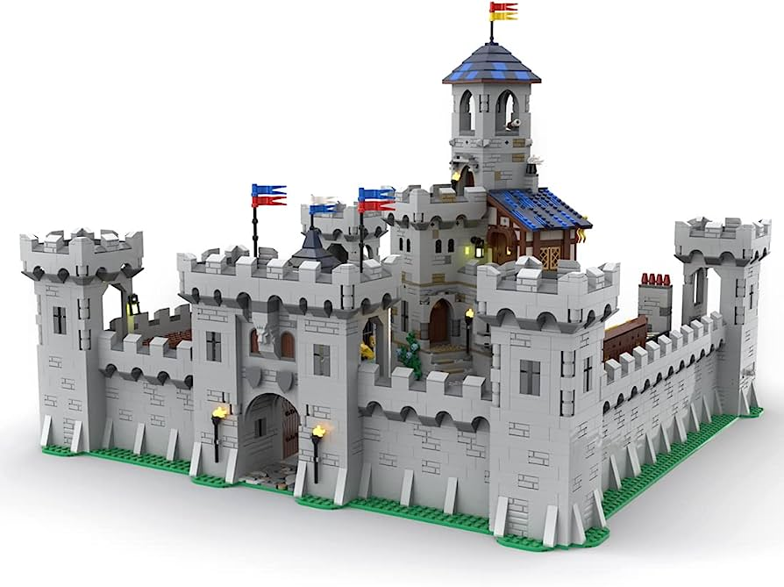
What are Microservices?
Imagine you have a big, complex task to complete, like building a huge LEGO castle. If you were to do it all by yourself, it might take a very long time, and if anything goes wrong, fixing it could be quite challenging.
Now, let's think of the LEGO castle as a large software application. Traditionally, developers would try to build the entire application as one big piece, just like constructing the entire castle at once. This approach can be difficult to manage, and if something breaks, it can affect the whole system.
Software Application
User Service
Product Service
Payment Service
Order Service

Slide 2
What are Microservices?
Microservices, on the other hand, is a different way of building software, and it's like having a team of friends helping you build the LEGO castle. Instead of creating one massive castle, each friend works on building their own smaller part. One friend might work on the tower, another on the drawbridge, and so on.
In the same way, with microservices, a large software application is broken down into many smaller, individual services. Each service handles a specific task or function, like handling user accounts, managing product inventory, or processing payments. These individual services can work independently and communicate with each other when needed.
Software Application
User Service
Product Service
Payment Service
Order Service

Slide 3
What are Microservices?
The beauty of microservices is that if something goes wrong with one service, it doesn't affect the whole application. It's like if one friend's tower falls, the rest of the castle remains standing. Plus, because each service is small and focused, developers can work on them separately, making it easier and faster to build and maintain the entire software system.
So, in simple terms, microservices is like building a big software application with the help of small, specialized teams (services) that work together independently to create a more flexible, manageable, and robust system.
Software Application
User Service
Product Service
Payment Service
Order Service

