Slide 1
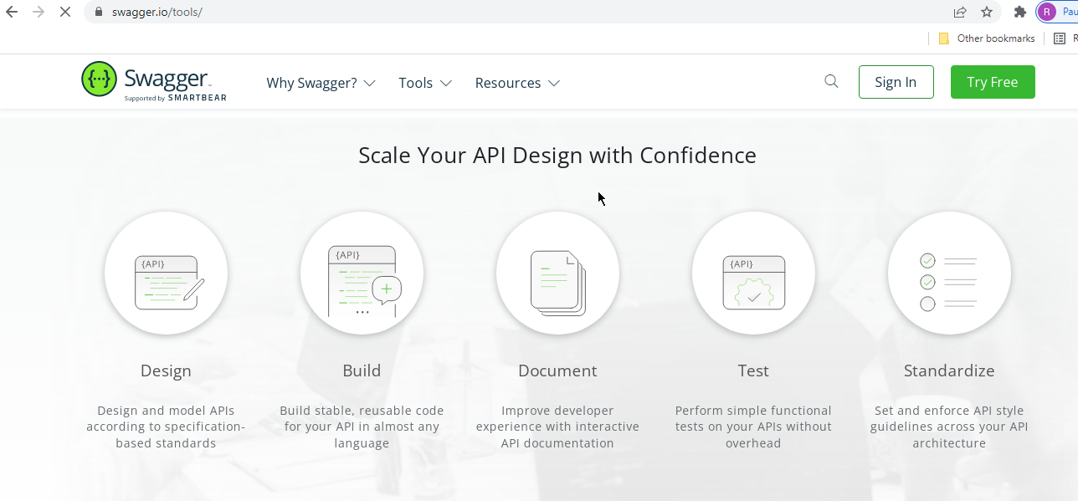
Spring Boot - Create Interactive Documentation for your REST API with Swagger
https://swagger.io/tools/

Slide 2
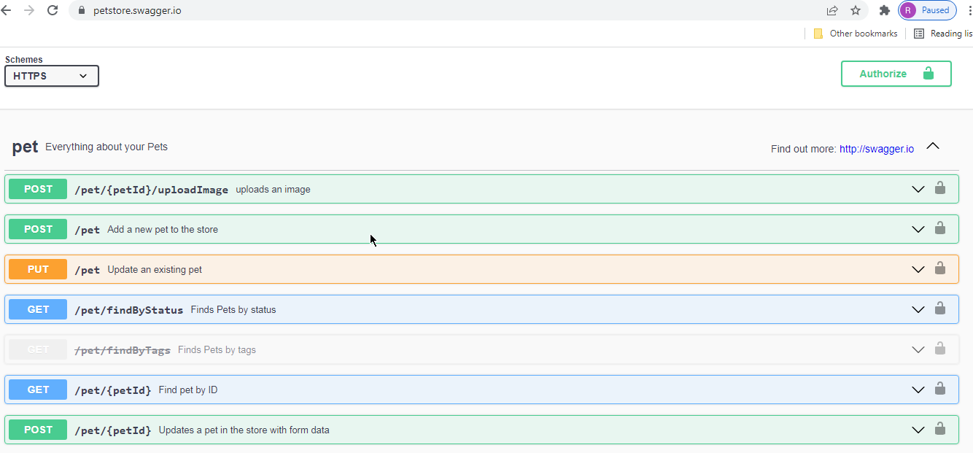
Spring Boot - Create Interactive Documentation for your REST API with Swagger
https://petstore.swagger.io/

Slide 3
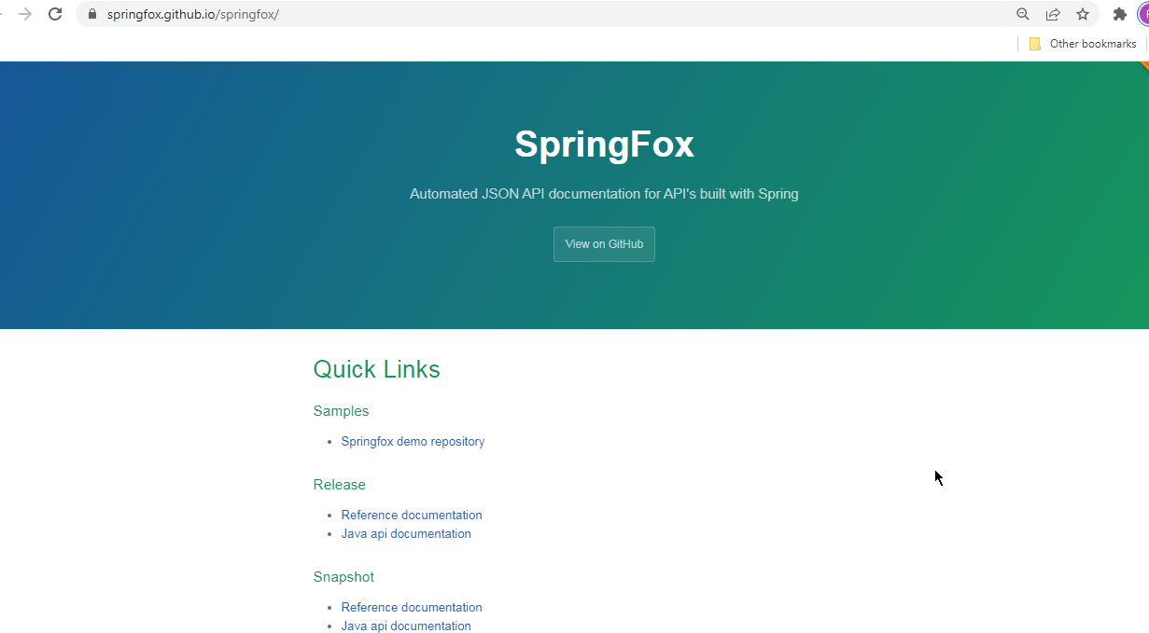
Spring Boot - Create Interactive Documentation for your REST API with Swagger
https://springfox.github.io/springfox/
SpringFox project is the implementation of Swagger Specification

Slide 4
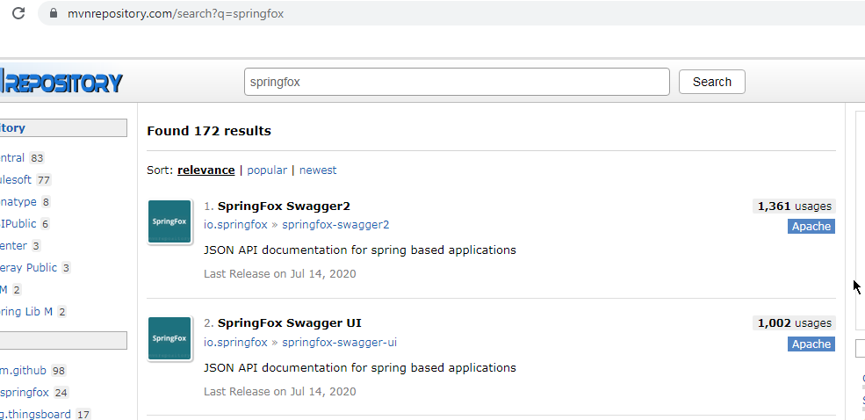
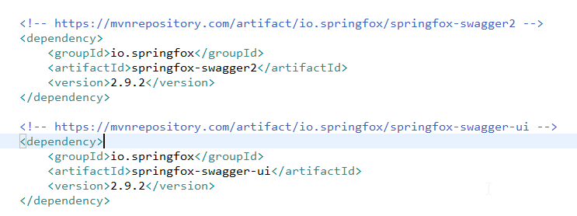
Spring Boot - Create Interactive Documentation for your REST API with Swagger
https://mvnrepository.com/search?q=springfox

Slide 5
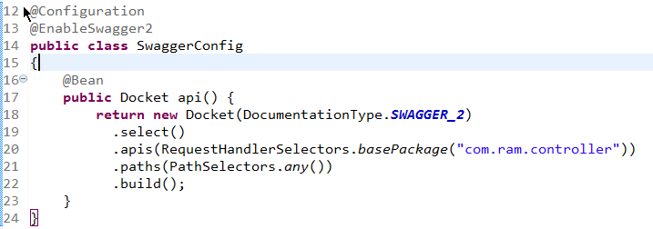
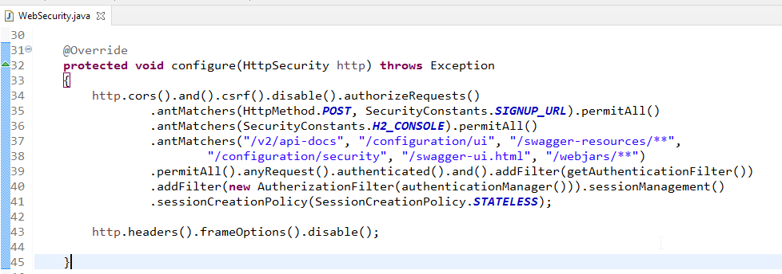
Spring Boot - Create Interactive Documentation for your REST API with Swagger
Create Swagger Configuration File
Enable Swagger URLs and View JSON Documentation

Slide 6
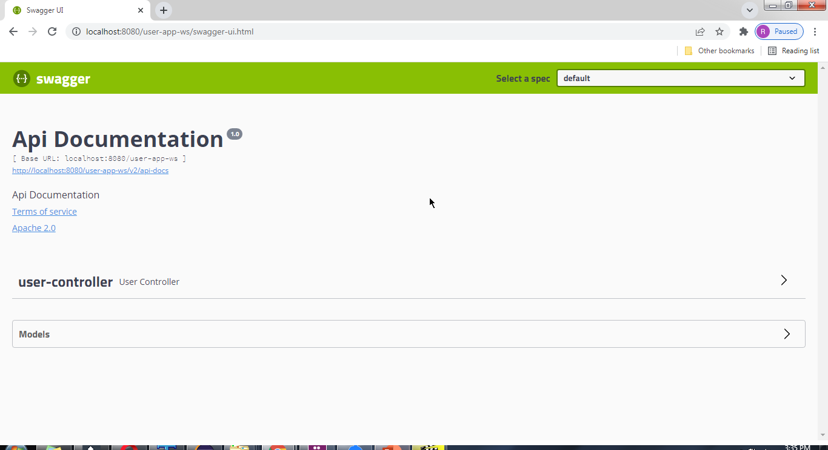
Spring Boot - Create Interactive Documentation for your REST API with Swagger
http://localhost:8080/user-app-ws/swagger-ui.html

Slide 7
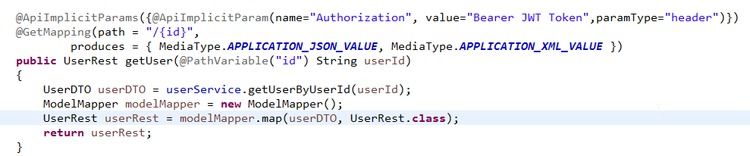
Spring Boot - Create Interactive Documentation for your REST API with Swagger
Add Authorization Header

Slide 8
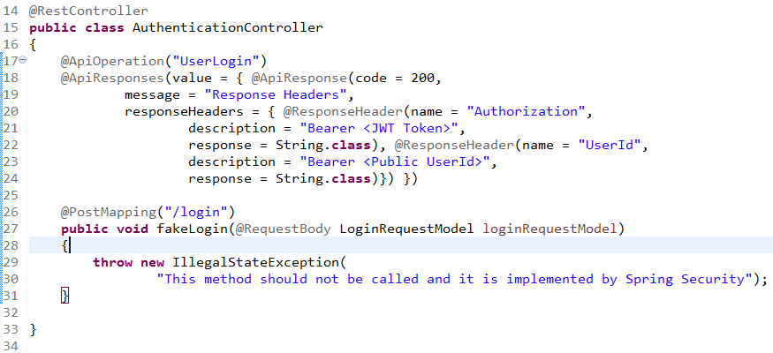
Spring Boot - Create Interactive Documentation for your REST API with Swagger
Add login endpoint

Slide 9
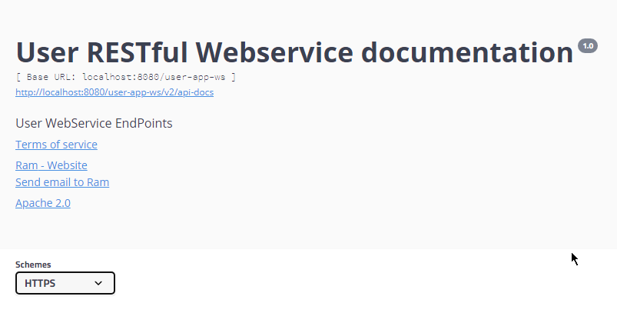
Spring Boot - Create Interactive Documentation for your REST API with Swagger
Updating API Documentation Information

Slide 10
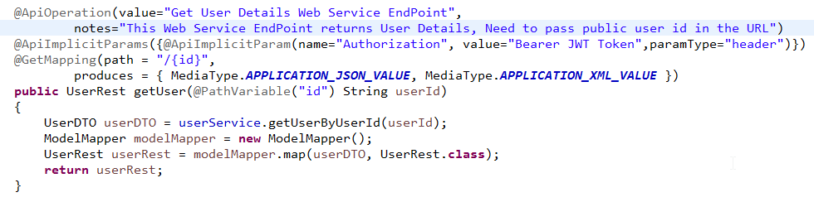
Spring Boot - Create Interactive Documentation for your REST API with Swagger
Web Service Endpoints Additional Information

