Slide 1
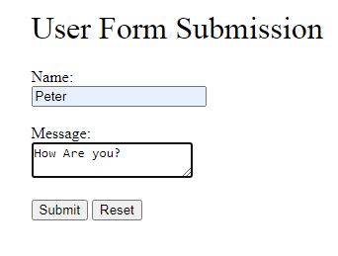
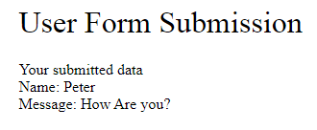
Spring Boot FreeMarker Form Submission Example
FreeMarker is a Java-based template engine to generate text outputs such as HTML web pages and emails
When user hits the Submit button, send input data to Spring Boot server and show the submitted data to user

Slide 2
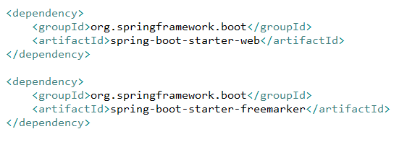
Spring Boot FreeMarker Form Submission Example
spring-boot-starter-web provides all the dependencies and auto-configuration we need to develop a web application in Spring Boot, including the Tomcat embedded servlet container
spring-boot-starter-freemarker provides the support for compiling FreeMarker template files
The library versions can be omitted as it is resolved by the parent pom provided by Spring Boot

Slide 3
https://hellokoding.com/handling-form-submission-example-with-java-spring-boot-and-freemarker/

