Slide 1
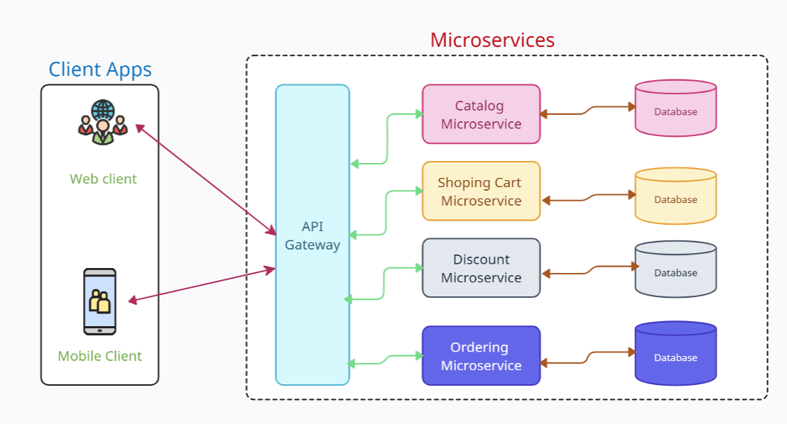
What is API gateway?
API Gateway is a service that acts as a single entry point for clients to access multiple backend services or APIs.
API Gateway provides a way to create, manage, and secure APIs by handling requests from clients and routing them to the appropriate backend services.

Slide 2
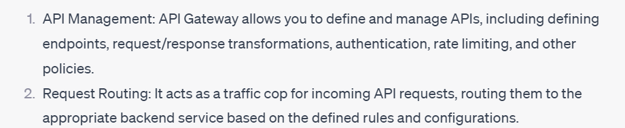
What is API gateway?
The primary functions of an API Gateway

Slide 3
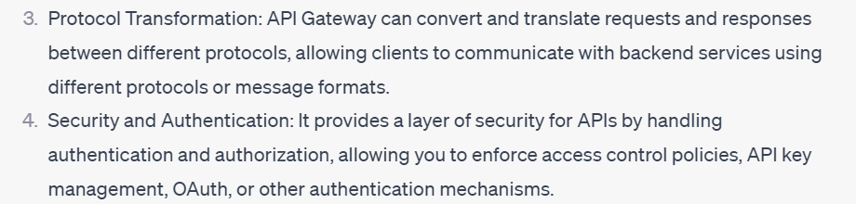
What is API gateway?
The primary functions of an API Gateway

Slide 4
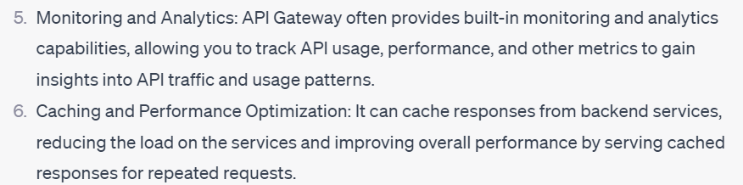
What is API gateway?
The primary functions of an API Gateway

Slide 5
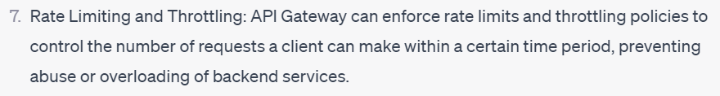
What is API gateway?
The primary functions of an API Gateway

Slide 6
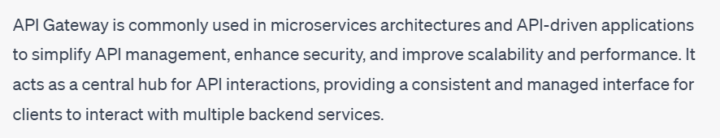
What is API gateway?

