Slide 1
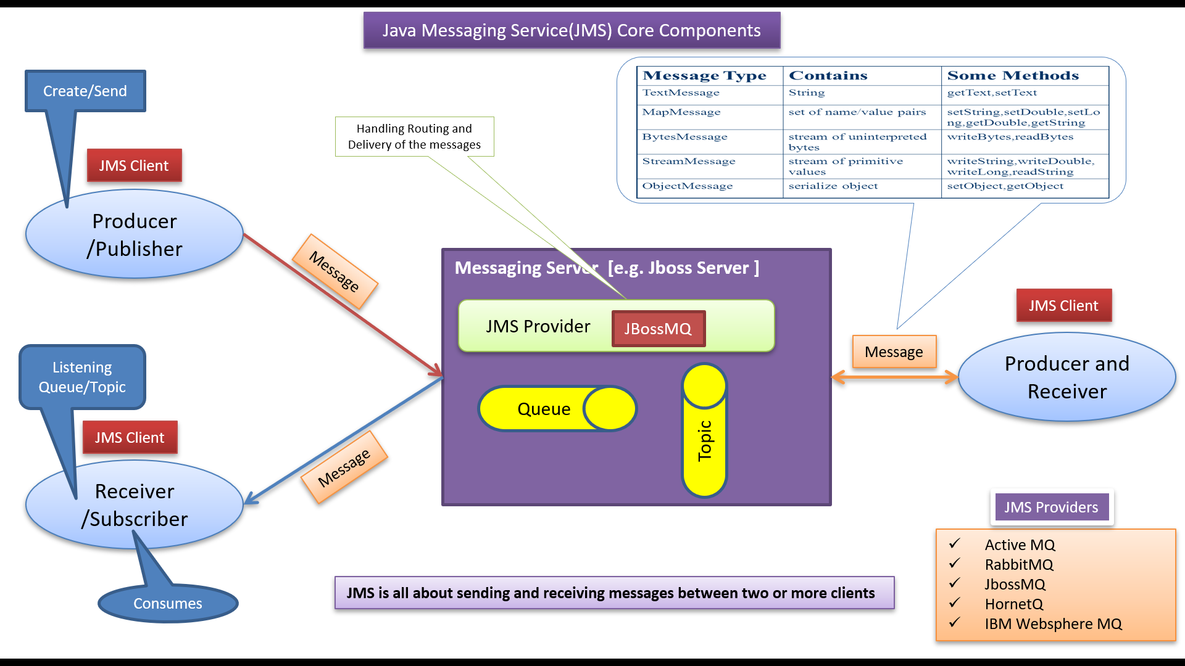
JMS Explained: Java Message Service for Beginners
"JMS" stands for Java Message Service, and it's a Java-based messaging standard that allows different software components to communicate with each other through messages.
Think of it like sending messages between different parts of a program or even between different applications, just like sending emails or text messages between people.

Slide 2



JMS Explained: Java Message Service for Beginners
Imagine you have a team of workers in a big office building. These workers need to communicate with each other to get their tasks done. Instead of shouting across the room or walking to each other's desks every time they need something, they use a message board. This message board is like the JMS system.
When a worker has a task or information to share, they write a message on a sticky note and attach it to the message board. Other workers can see the message, read it, and take action accordingly. This way, everyone stays updated on what's happening, and they can work together efficiently without interrupting each other.

Slide 3
JMS Explained: Java Message Service for Beginners
In the context of software development, JMS works in a similar way. Different parts of a program or different software applications can send and receive messages through a messaging system.
This is extremely useful for building complex systems where different components need to exchange information without knowing the details of how the other parts work.

Slide 4
JMS Explained: Java Message Service for Beginners
JMS provides a standard way for sending, receiving, and processing messages, which makes it easier to integrate different parts of an application or different applications altogether.
It's commonly used in scenarios like financial transactions, order processing, and any situation where timely and reliable communication is crucial.

Slide 5
JMS Explained: Java Message Service for Beginners
So, in short, JMS is a messaging system in the Java world that allows software components to communicate by sending and receiving messages, just like people communicating through messages on a message board.

