Slide 1
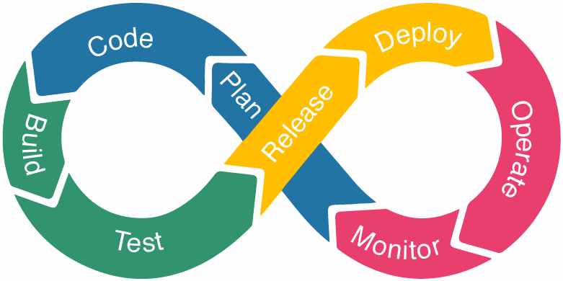
Understanding the DevOps Lifecycle: A Simple Guide for Everyone
What is DevOps Lifecycle?
The DevOps lifecycle is a process that helps teams develop, test, deploy, and manage software more efficiently and reliably. It's like a series of steps or stages that developers and IT teams follow to ensure that their software is always improving and running smoothly.

Slide 2
Understanding the DevOps Lifecycle: A Simple Guide for Everyone
1. Plan
Imagine you’re building a house. First, you need a plan or blueprint. In the DevOps lifecycle, this stage involves planning what features or fixes the software needs. Teams discuss what needs to be done, set goals, and prioritize tasks.

Slide 3
Understanding the DevOps Lifecycle: A Simple Guide for Everyone
2. Code
Once the plan is ready, it’s time to start building. This is where developers write the code for the software. Just like using tools to build a house, developers use programming languages and tools to create the software.

Slide 4
Understanding the DevOps Lifecycle: A Simple Guide for Everyone
3. Build
After the code is written, it’s assembled into a working program, much like putting together the pieces of a house. This stage ensures that the code written by different developers works together as a single application.

Slide 5
Understanding the DevOps Lifecycle: A Simple Guide for Everyone
4. Test
Before you move into a new house, you check that everything works correctly. In the DevOps lifecycle, testing is done to find and fix any issues or bugs in the software. Automated tests run to make sure everything is functioning as expected.

Slide 6
Understanding the DevOps Lifecycle: A Simple Guide for Everyone
5. Release
Once the software is tested and ready, it’s time to release it to the users. This is like getting the house inspected and approved before you move in. The software is packaged and prepared for deployment.

Slide 7
Understanding the DevOps Lifecycle: A Simple Guide for Everyone
6. Deploy
Deployment is like moving into the new house. The software is installed on servers or cloud platforms where users can access it. This process is often automated to ensure it’s done quickly and correctly.

Slide 8
Understanding the DevOps Lifecycle: A Simple Guide for Everyone
7. Operate
After moving into the house, you live in it and make sure everything runs smoothly. Similarly, in the operate stage, the software is run and managed on the servers. This includes monitoring performance and ensuring it’s always available for users.

Slide 9
Understanding the DevOps Lifecycle: A Simple Guide for Everyone
8. Monitor
Just like you keep an eye on your house to fix any issues (like a leaky roof or broken window), the software is continuously monitored. This helps teams identify and fix any problems that arise, ensuring the software runs smoothly.

Slide 10
Understanding the DevOps Lifecycle: A Simple Guide for Everyone
Feedback
Finally, you gather feedback from the people living in the house (or using the software). This feedback helps you understand what’s working well and what needs improvement. It’s like asking residents if they’re happy with the house or if any changes are needed.

Slide 11
Understanding the DevOps Lifecycle: A Simple Guide for Everyone
Repeat
The DevOps lifecycle is a continuous process. After gathering feedback, the cycle starts again with planning new features or improvements. It’s a loop that ensures the software is always getting better.

Slide 12
Understanding the DevOps Lifecycle: A Simple Guide for Everyone
Summary
The DevOps lifecycle is a series of steps that help teams plan, build, test, deploy, and manage software efficiently. It’s like building and maintaining a house, where each stage ensures the final product is reliable, efficient, and meets users’ needs. This continuous process helps in delivering high-quality software quickly and effectively.

