Slide 1
What is replication in Kafka | Replication Factor in Kafka
Kafka is fault tolerant (i.e. Ability of the system to continue operating without interruption when one or more of its components fail)
Each partition is replicated across multiple servers for fault tolerance
Only one partition will be active at a time and can be called Leader
Other partitions will only replicate messages and called followers
The leader handles all read and write requests for the partition while followers passively replicate the leader

Slide 2
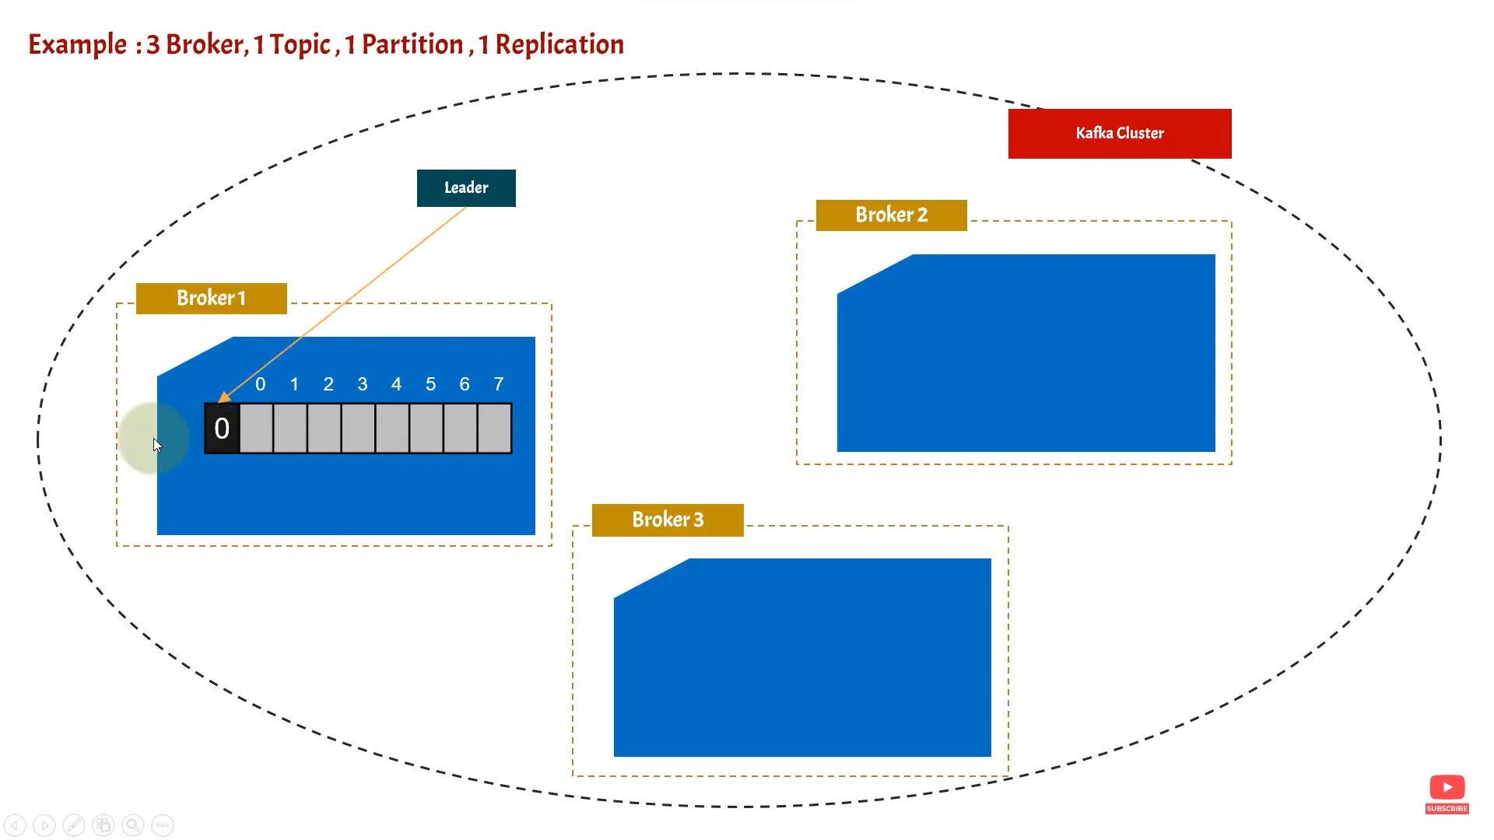
What is replication in Kafka | Replication Factor in Kafka
USA
India
Topic
Topic
UK
Topic

Slide 3
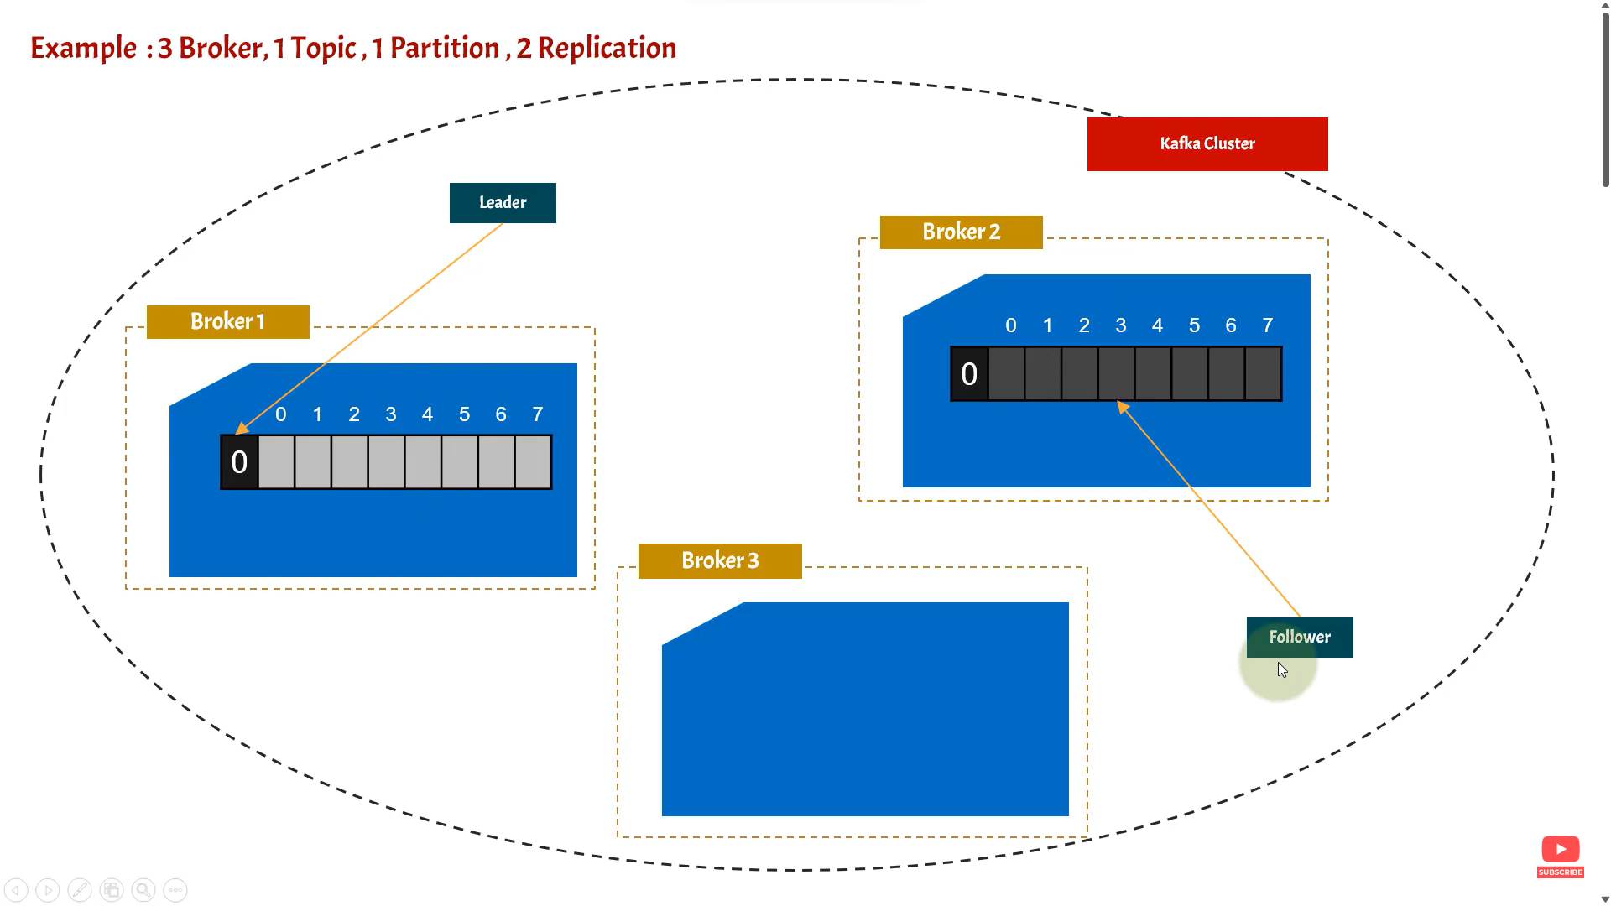
What is replication in Kafka | Replication Factor in Kafka
USA
Topic
India
Topic
UK
Topic

Slide 4
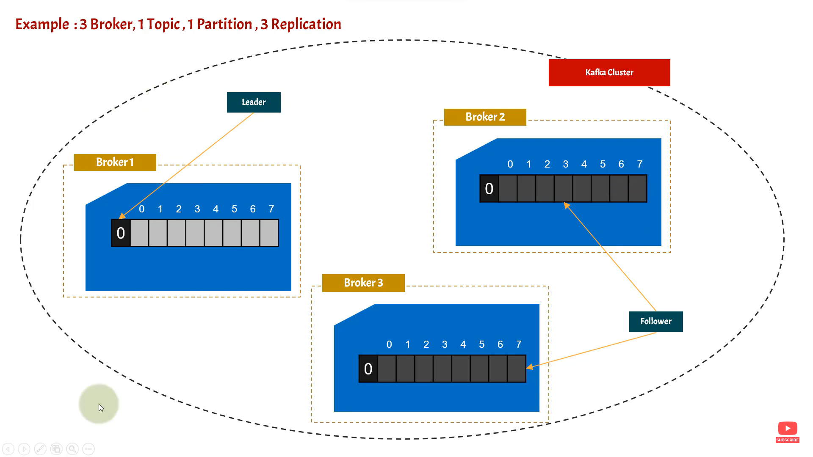

What is replication in Kafka | Replication Factor in Kafka
Consumer
Producer
USA
India
Topic
Topic
UK
Topic

