Slide 1
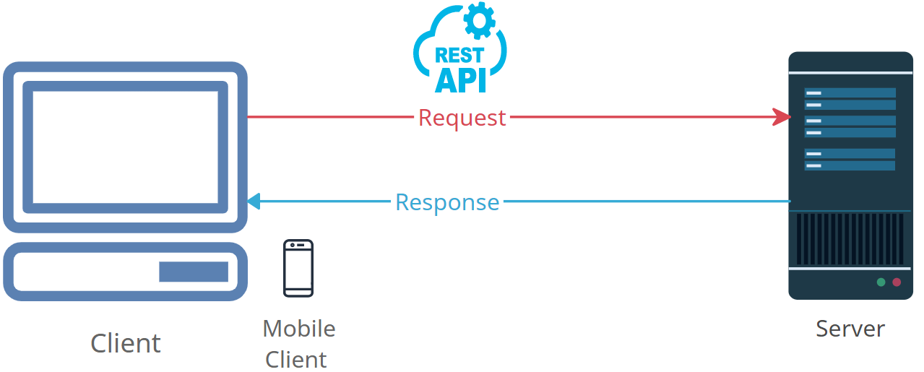


Demystifying HTTP Response: What Happens When You Request Something Online
HTTP: It stands for "Hypertext Transfer Protocol," which is like a set of rules for how computers on the internet communicate with each other. It's the language they use to exchange information.
Response: Think of it as an answer or a reply. When you ask a question or make a request on the internet, like clicking a link or opening a webpage, the computer on the other end sends back a reply with the information you wanted.

Slide 2
Demystifying HTTP Response: What Happens When You Request Something Online
HTTP Response: This is the reply or answer that your computer receives from another computer, typically a web server, after making a request. It contains the information you asked for, such as a web page, an image, or data.
For example, when you enter a web address in your browser and hit Enter, your browser sends a request (like asking a question) to the website's server. The server then sends back an HTTP Response, which is the web page you see on your screen.
In simple terms, an "HTTP Response" is like the internet's way of answering your questions and giving you the information you want, whether it's a webpage, an image, or something else.

