Slide 1
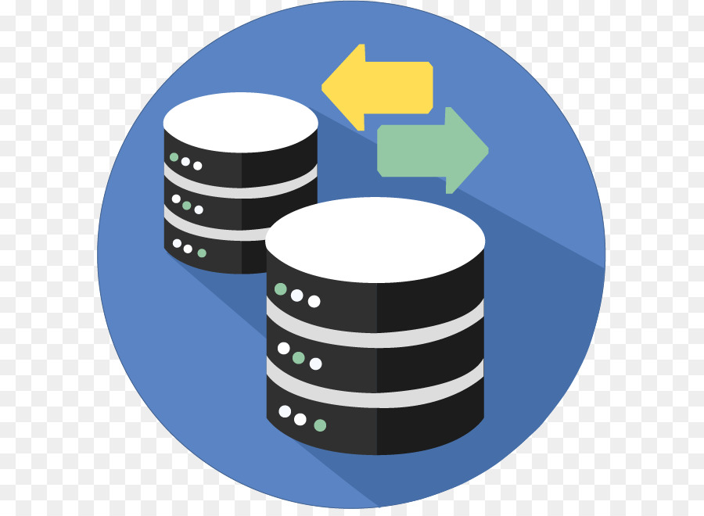
Beginner's Introduction to CRUD: Create, Read, Update, Delete
CRUD" stands for Create, Read, Update, and Delete. It's a set of basic operations used in computer programming and database management. Let's break down what each operation entails:
Create: This operation involves creating new data or records. In database terms, it means adding new entries to a database or system. For instance, when a user signs up for a website, a new record containing their information (username, email, password, etc.) is created in the database.
Read: This operation is about retrieving or reading existing data from a database or system. It could involve fetching a specific record, a list of records, or information based on certain criteria. For example, when a user logs into a website, the system reads and retrieves their profile information from the database to display on the screen.

Slide 2
Beginner's Introduction to CRUD: Create, Read, Update, Delete
Update: This operation involves modifying or updating existing data. In database terms, it means changing the values of specific fields within a record or altering existing records. For instance, if a user updates their profile picture or changes their email address, the system updates that particular information in the database.
Delete: This operation is about removing or deleting existing data. It could involve deleting a single record or multiple records from a database or system. For example, when a user decides to delete their account from a platform, the system removes all their associated information from the database.

Slide 3
Beginner's Introduction to CRUD: Create, Read, Update, Delete
CRUD operations form the backbone of most applications and systems that interact with databases. They are essential in handling data and managing the information flow within a system.
Understanding CRUD operations is fundamental for anyone getting started with programming or working with databases.

