Slide 1
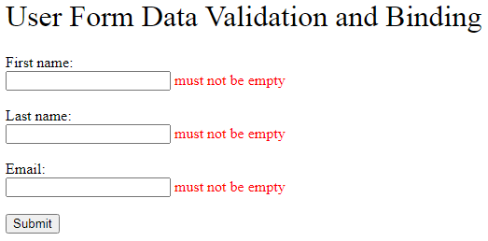
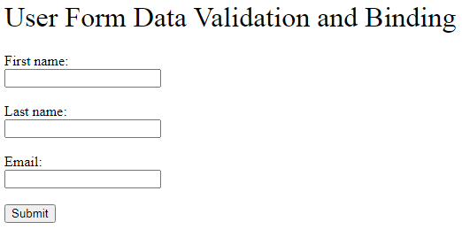
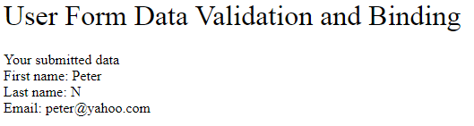
Spring Boot FreeMarker Form Validation and Data Binding Example
FreeMarker is a Java-based template engine to generate text outputs such as HTML web pages and emails
An HTML form to receive user input data, and show error messages if the data is invalid when user hits submit button
Show the submitted data if all of it is valid

Slide 2
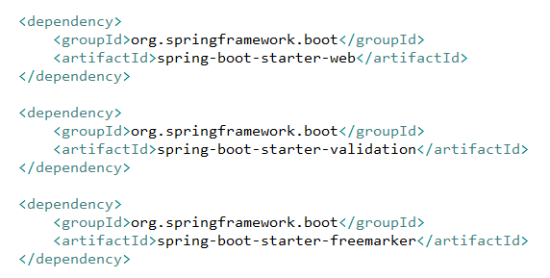
Spring Boot FreeMarker Form Validation and Data Binding Example
spring-boot-starter-web provides all the dependencies and auto-configuration we need to develop a web application in Spring Boot, including the Tomcat embedded servlet container
spring-boot-starter-freemarker provides the support for compiling FreeMarker template files
We also need spring-boot-starter-validation for validating the custom data model. Data model validation in Spring Boot can be achieved by using Jakarta Validation API which is included in the Spring Boot Validation Starter dependency
The library versions can be omitted as it is resolved by the parent pom provided by Spring Boot

Slide 3
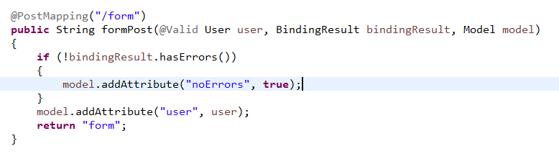
Spring Boot FreeMarker Form Validation and Data Binding Example
@Valid is an annotation of Jakarta Validation API to trigger the data model validation
BindingResult is a Spring validation API to provide the validation results
Model is a Spring UI API to share the data to view template files

Slide 4


Spring Boot FreeMarker Form Validation and Data Binding Example
In the template file, we imported Spring Form Macros to provide form validation and data binding to the FreeMarker view template
@spring.formInput will generate a 2 ways data binding HTML input text: pull value from and push value to the data model
@spring.showErrors will show validation error messages of the immediately preceding data binding property

Slide 5
https://hellokoding.com/form-data-binding-and-validation-example-with-java-spring-boot-and-freemarker/

