Slide 1
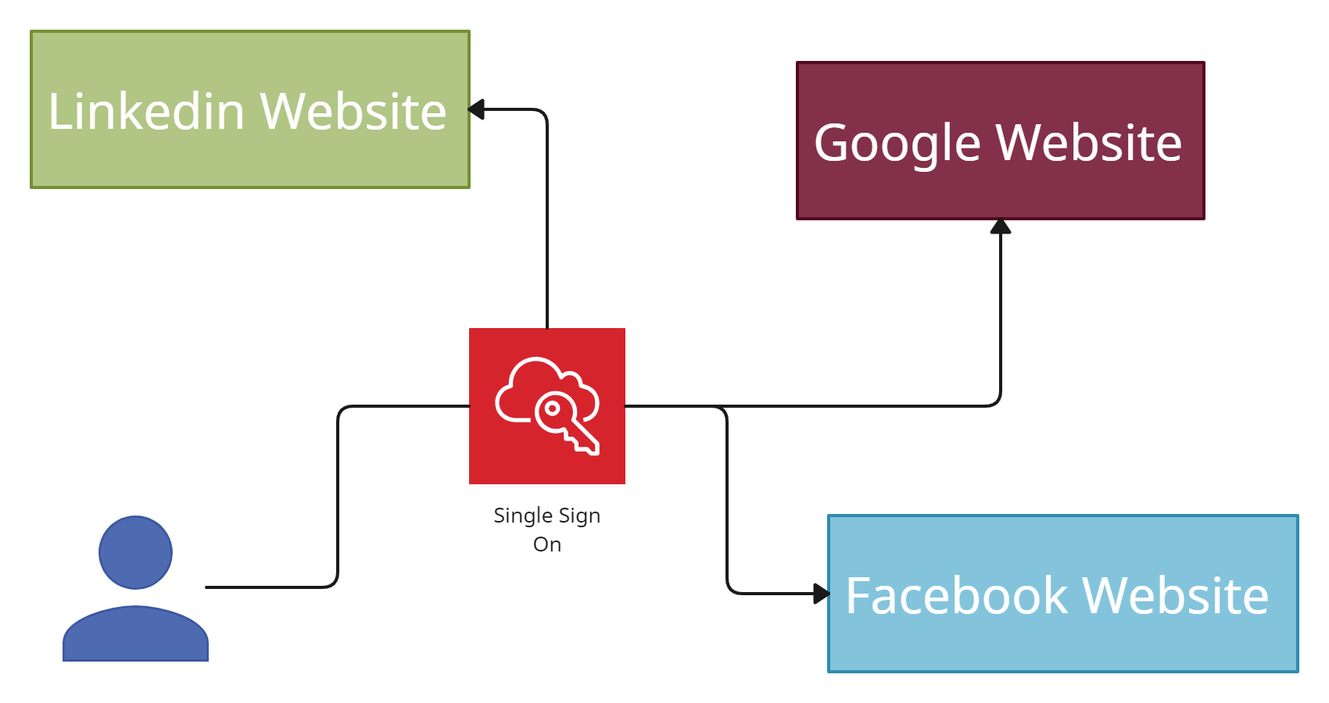
What is Single Sign-On (SSO) and SAML?
Single Sign-On (SSO) allows an end user to access multiple web applications using just the one set of credentials.
This saves the user from needing to remember multiple usernames and passwords, while still providing strong authentication.
Once they have logged in, an end user can access other connected web apps without logging in again, until their authenticated session expires.

Slide 2
What is Single Sign-On (SSO) and SAML?
What is SAML?
Security Assertion Markup Language (SAML) is a popular, industry-standard, XML-based data exchange format used for SSO. It is an open standard, which means that you can develop your own SAML integration without additional licencing or access costs.
There are a number of open source SAML toolkits available for different programming languages.
Applications such as CRM systems will usually include the ability to manage SAML authentication.
SAML Roles
Below entities are involved in a SAML interaction:
Principle — normally an end user, which is the term we prefer to use.
Client — the end user's browser.
Identity Provider (IdP) — The system in charge of authenticating the end user.
Service Provider (SP) — the application the end users is accessing.

Slide 3
What is Single Sign-On (SSO) and SAML?
How does SAML work?
SAML requires the SP and IdP to first establish a trusted relationship with one another. They do this during integration by providing each other with relevant metadata and certificates.
IDP &SP also agree on some configuration settings that determine what information is sent in SAML messages. One of these settings is the value that the two systems will use to identity the end user. This is called the Federation ID, and is often the end user's email address.
Once integrated, the IdP can begin authenticating users on behalf of the SP
Types of messages are sent between the SP and the IdP as part of the SAML process
AuthnRequest (SP to IdP): This is a request to authenticate a user. It is embedded within a redirect.
SAML Assertion (IdP to SP): This is a signed XML document, containing the authentication details for the end user.

Slide 4
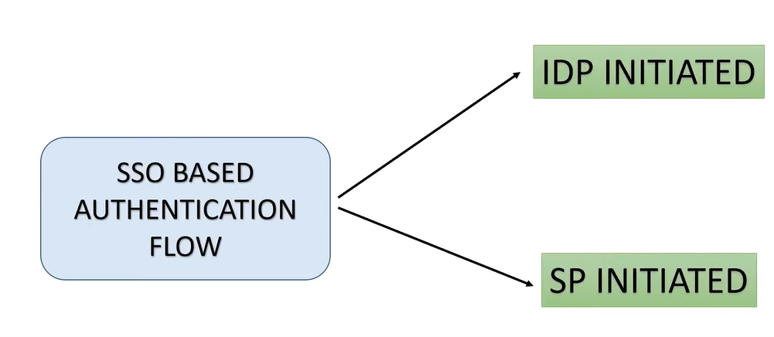
What is Single Sign-On (SSO) and SAML?
IdP initiated: If an end user interacts with the IdP initially, then the IdP sends a SAML assertion to the SP when the user accesses the SP site. No AuthnRequest is required.
SP initiated: If an end user interacts with the SP initially, the SP needs to send an AuthnRequest to the IdP. The IdP authenticates the user and then returns a SAML assertion.

Slide 5
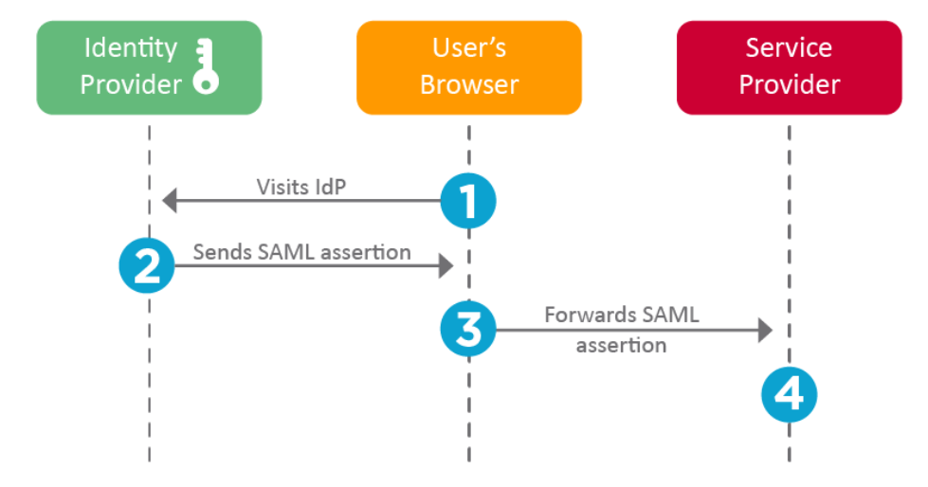
IdP initiated Flow
What is Single Sign-On (SSO) and SAML?
The SP examines the assertion, validating the IdP's X509 certificate public key. The SP then gives the end user access to their services, using the Federation ID as the identifier for the end user.
The user's Federation ID
Additional data about the user
Data about how and when the user authenticated
The X509 certificate public key of the IdP

Slide 6
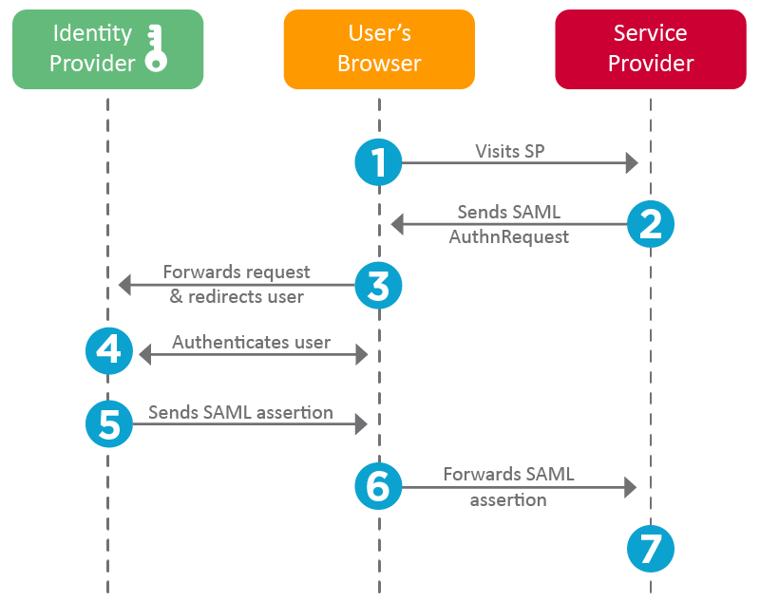
SP initiated Flow
What is Single Sign-On (SSO) and SAML?
The IdP checks whether the user has a currently authenticated session open. If not, the IdP provides the end user with a login screen.
An X509 certificate public key can optionally be included to authenticate the request
The SP examines the assertion, validating the IdP's X509 certificate public key. The SP then gives the end user access to their services, using the Federation ID as the identifier for the end user.
The user's Federation ID
Additional data about the user
Data about how and when the user authenticated
The X509 certificate public key of the IdP

Slide 7
What is Single Sign-On (SSO) and SAML?
What happens when a user logs out?
There are two options that can occur based on the behavior the IdP and SP have agreed upon:
Independent logout: The user is logged out of the session that they currently have with either the IdP or SP only.
Single logout: The user is logged out of all sessions with the SP and IdP that are using the same single
sign-on. The IdP also updates any other third-party SP sessions that support single logout.

