Slide 1



Understanding Proxies: A Beginner's Guide to Forward and Reverse Proxy Servers
Understanding Proxies: The Middlemen of the Web
The internet connects us to a vast amount of information, but sometimes a middleman is needed to facilitate communication. This is where proxies come in. A proxy server acts as an intermediary between a client (your computer or device) and a server (the website or online resource you're trying to access). It essentially relays requests and responses between the two, offering various benefits depending on its configuration.
You
Internet

Slide 2
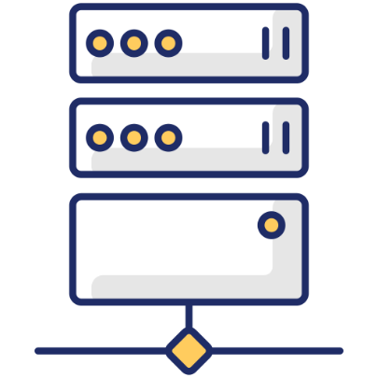
Understanding Proxies: A Beginner's Guide to Forward and Reverse Proxy Servers
Forward Proxy
A forward proxy sits in front of the client, acting on its behalf. Here's how it works:
Client Request: You, the client, send a request to access a website (e.g., www.google.com).
Forward Proxy: Instead of connecting directly to the website, your request is directed to the forward proxy server.
Proxy Fetches Data: The forward proxy acts as your go-between. It retrieves the requested information from the website.
Delivery to Client: Finally, the forward proxy delivers the website data back to you.
Internet
You
Forward Proxy Server

Slide 3
Understanding Proxies: A Beginner's Guide to Forward and Reverse Proxy Servers
Benefits of Forward Proxies
Privacy: The website only sees the IP address of the forward proxy, not your own, potentially enhancing anonymity.
Security: Some forward proxies offer added security features like malware filtering.
Content Access: In some cases, a forward proxy can bypass geo-restrictions, allowing access to content unavailable in your location (note: legality may vary).
Internet
You
Forward Proxy Server

Slide 4
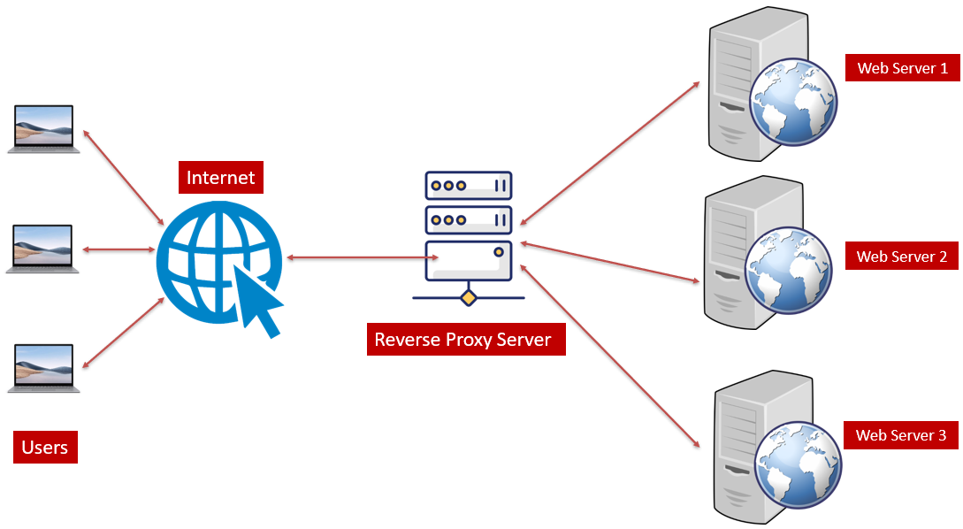
Understanding Proxies: A Beginner's Guide to Forward and Reverse Proxy Servers
Reverse Proxy
A reverse proxy sits in front of one or more web servers, acting as a gatekeeper. Here's its workflow:
Client Request: A client sends a request to access a website (e.g., www.amazon.com).
Reverse Proxy: The request first reaches the reverse proxy server.
Traffic Distribution: The reverse proxy can distribute traffic among multiple web servers behind it (load balancing).
Server Selection: It selects the most appropriate server to handle the request based on factors like workload or server specialization.
Data Delivery: The chosen web server fulfills the request and sends the data back to the reverse proxy.
Response to Client: Finally, the reverse proxy delivers the response to the client.

Slide 5
Understanding Proxies: A Beginner's Guide to Forward and Reverse Proxy Servers
Benefits of Reverse Proxies:
Security: By shielding the actual web servers from direct client interaction, a reverse proxy acts as a security layer.
Performance: It can cache frequently accessed content, improving website loading speed for users.
Scalability: A reverse proxy can handle a high volume of traffic by distributing it among multiple servers.

Slide 6
Understanding Proxies: A Beginner's Guide to Forward and Reverse Proxy Servers
Summary
Forward Proxy: Works for the client, providing privacy, security, and potentially bypassing restrictions.
Reverse Proxy: Works for the website owner, enhancing security, performance, and scalability.

Slide 7
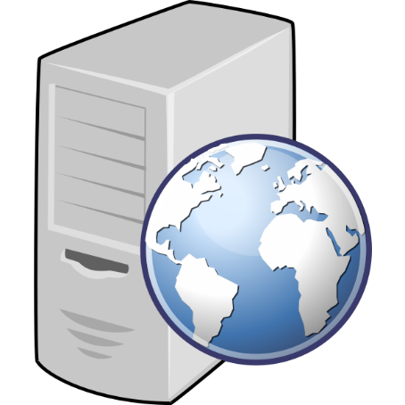


Web Server 1
Internet
Web Server 2
Reverse Proxy Server
Users
Web Server 3

