Slide 1
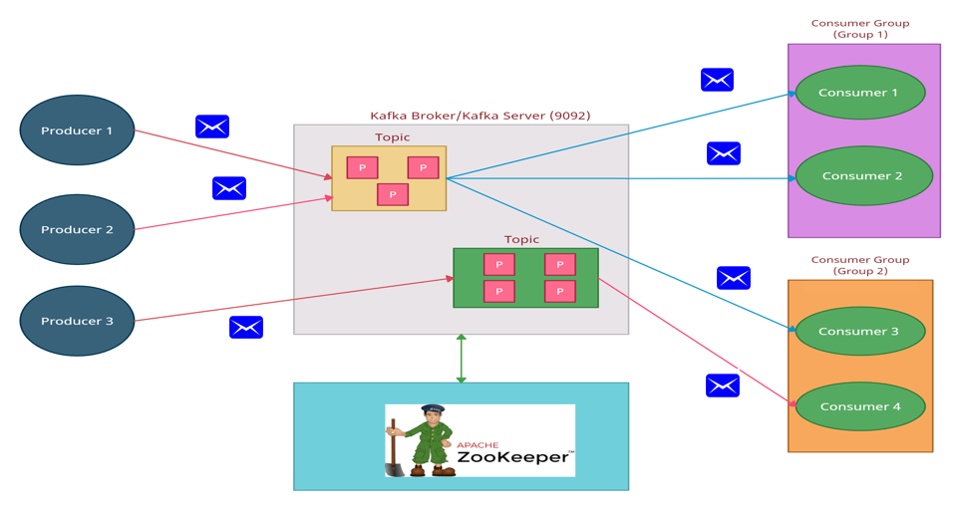
What is Kafka topic?
The topic is the Kafka component where producers are connected.
Producers publish messages in Kafka topic
Topics in Kafka is multi subscribers
The topic can be considered a logical entity.

Slide 2
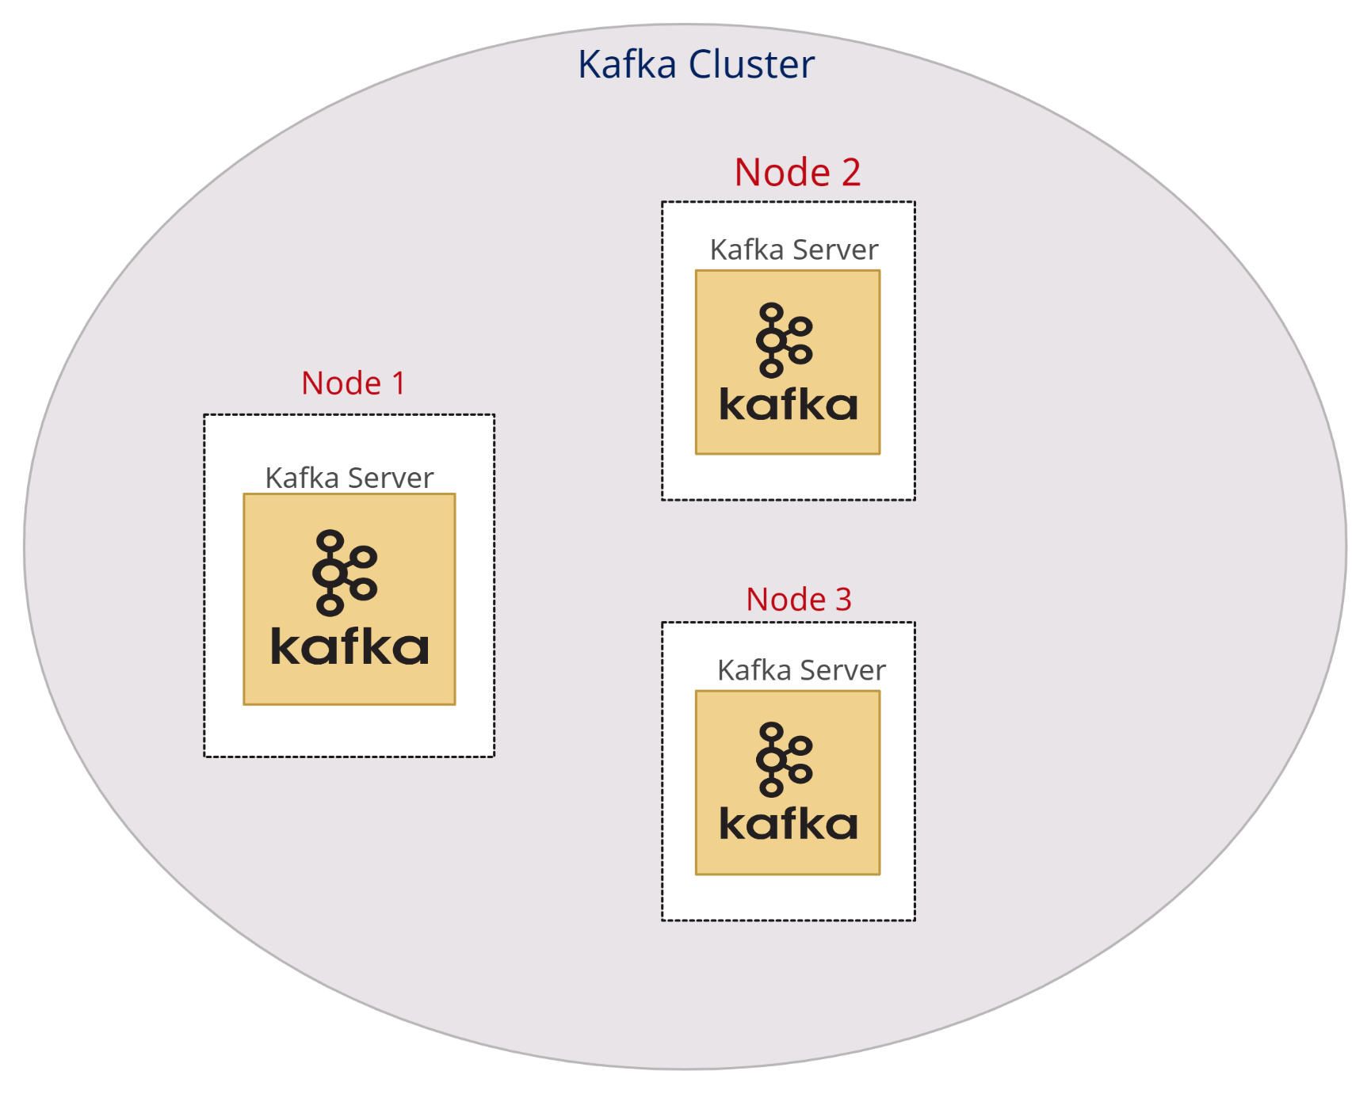
What is Kafka topic?
In Kafka cluster each topic is present in every cluster node
Topic 1
Topic 1
Topic 1

