Slide 1
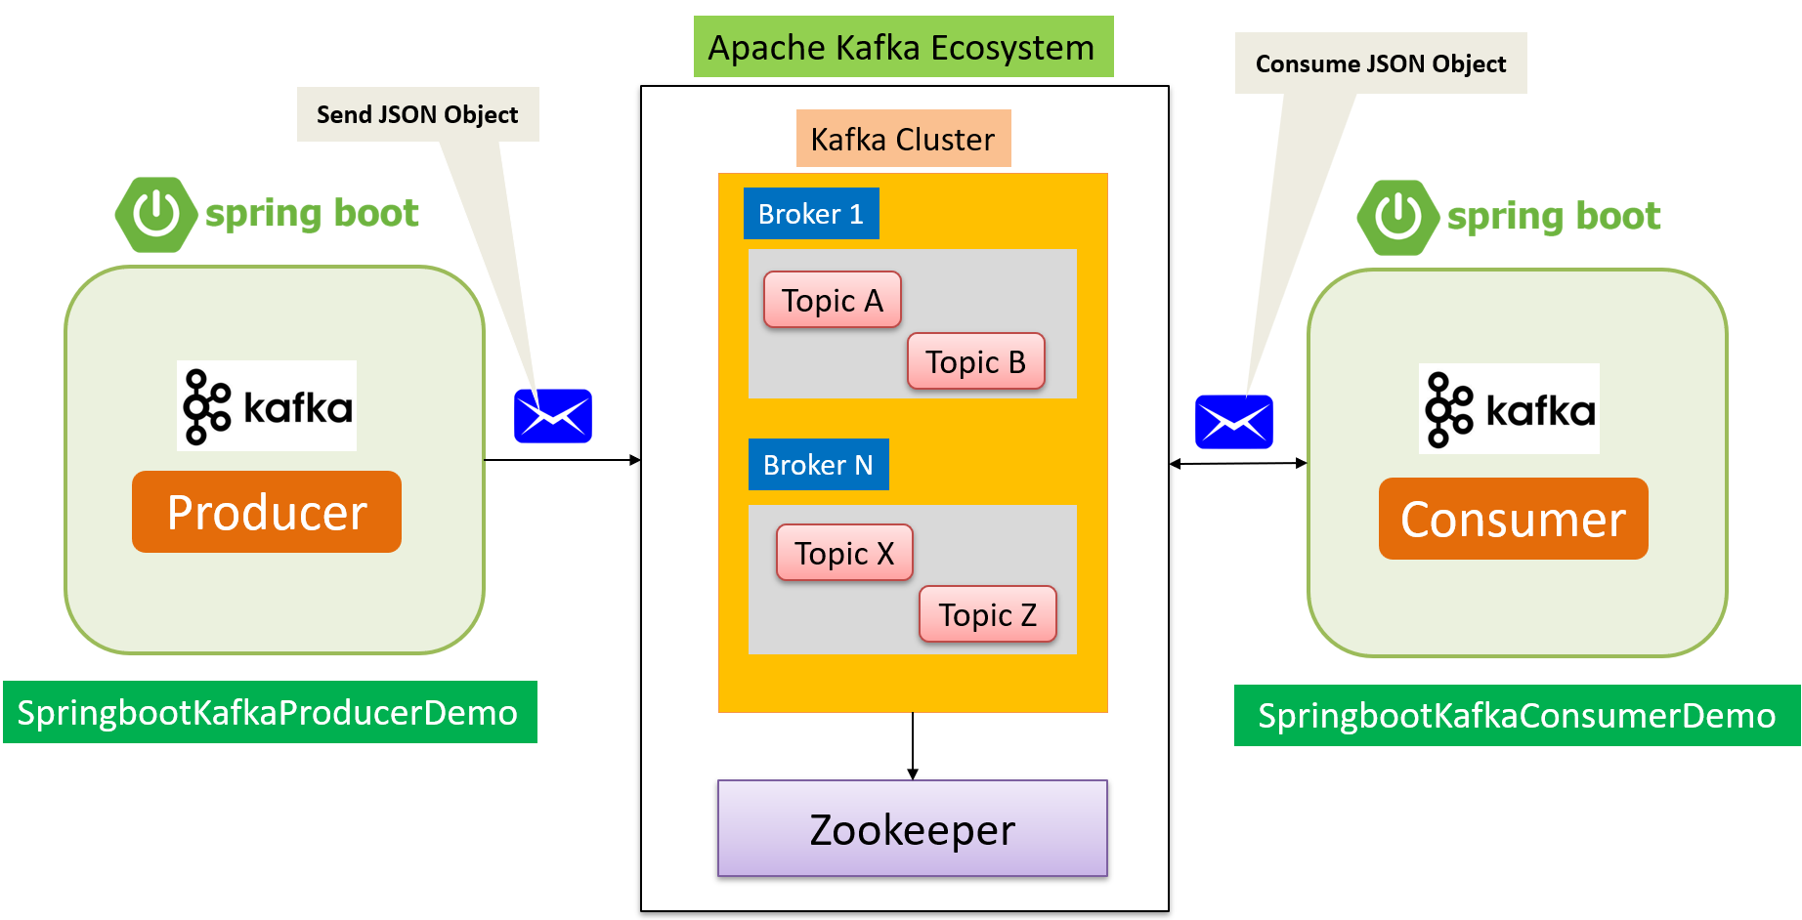



Spring Boot – Send JSON Object into Kafka Topic & Consume JSON Object From Kafka Topic
Apache Kafka Server is running on Amazon EC2 Instance
Send JSON Object

Slide 2
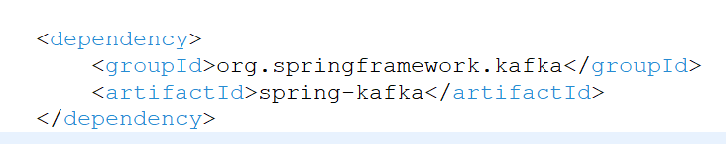
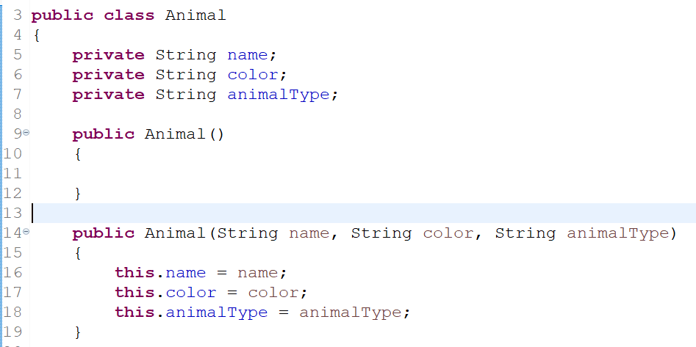
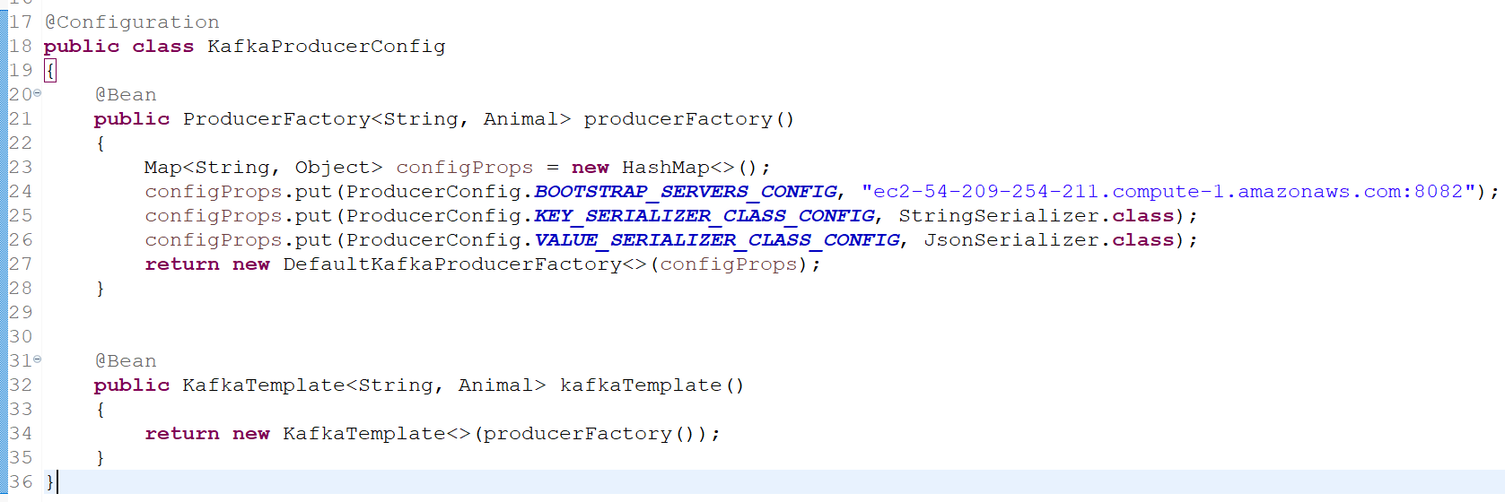
Spring Boot – Send JSON Object into Kafka Topic & Consume JSON Object From Kafka Topic

Slide 3
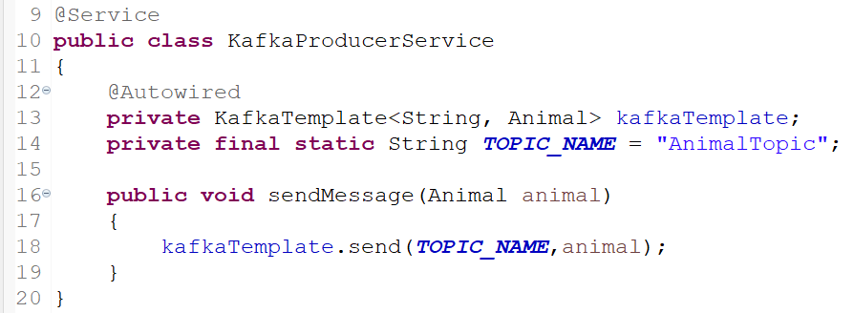
Spring Boot – Send JSON Object into Kafka Topic & Consume JSON Object From Kafka Topic
To publish a message, auto wire the Kafka Template object and produce the message

Slide 4
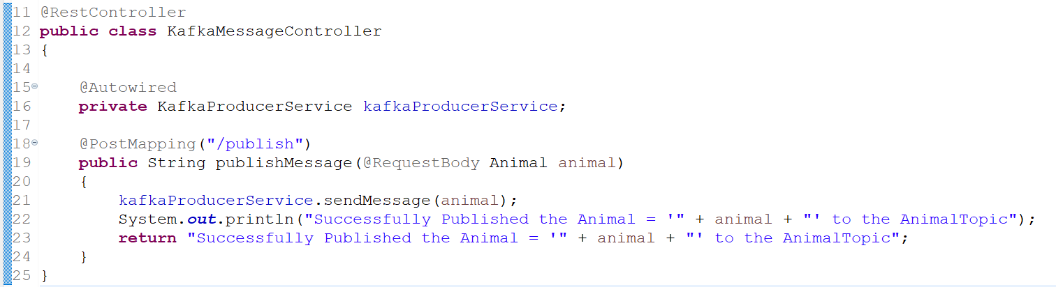
Spring Boot – Send JSON Object into Kafka Topic & Consume JSON Object From Kafka Topic
This controller expose the end point to send the Animal Object.

Slide 5
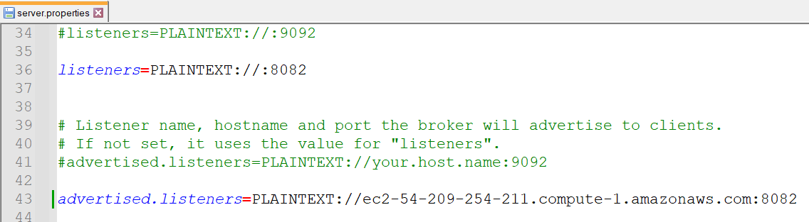
Spring Boot – Send JSON Object into Kafka Topic & Consume JSON Object From Kafka Topic

Slide 6
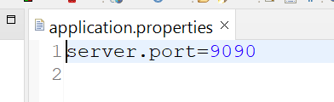
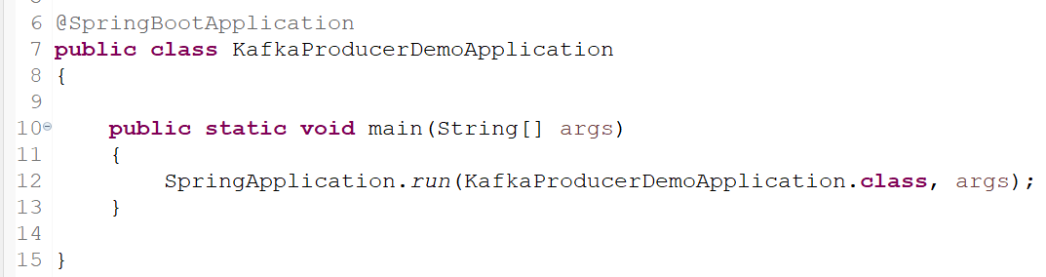
Spring Boot – Send JSON Object into Kafka Topic & Consume JSON Object From Kafka Topic

Slide 7
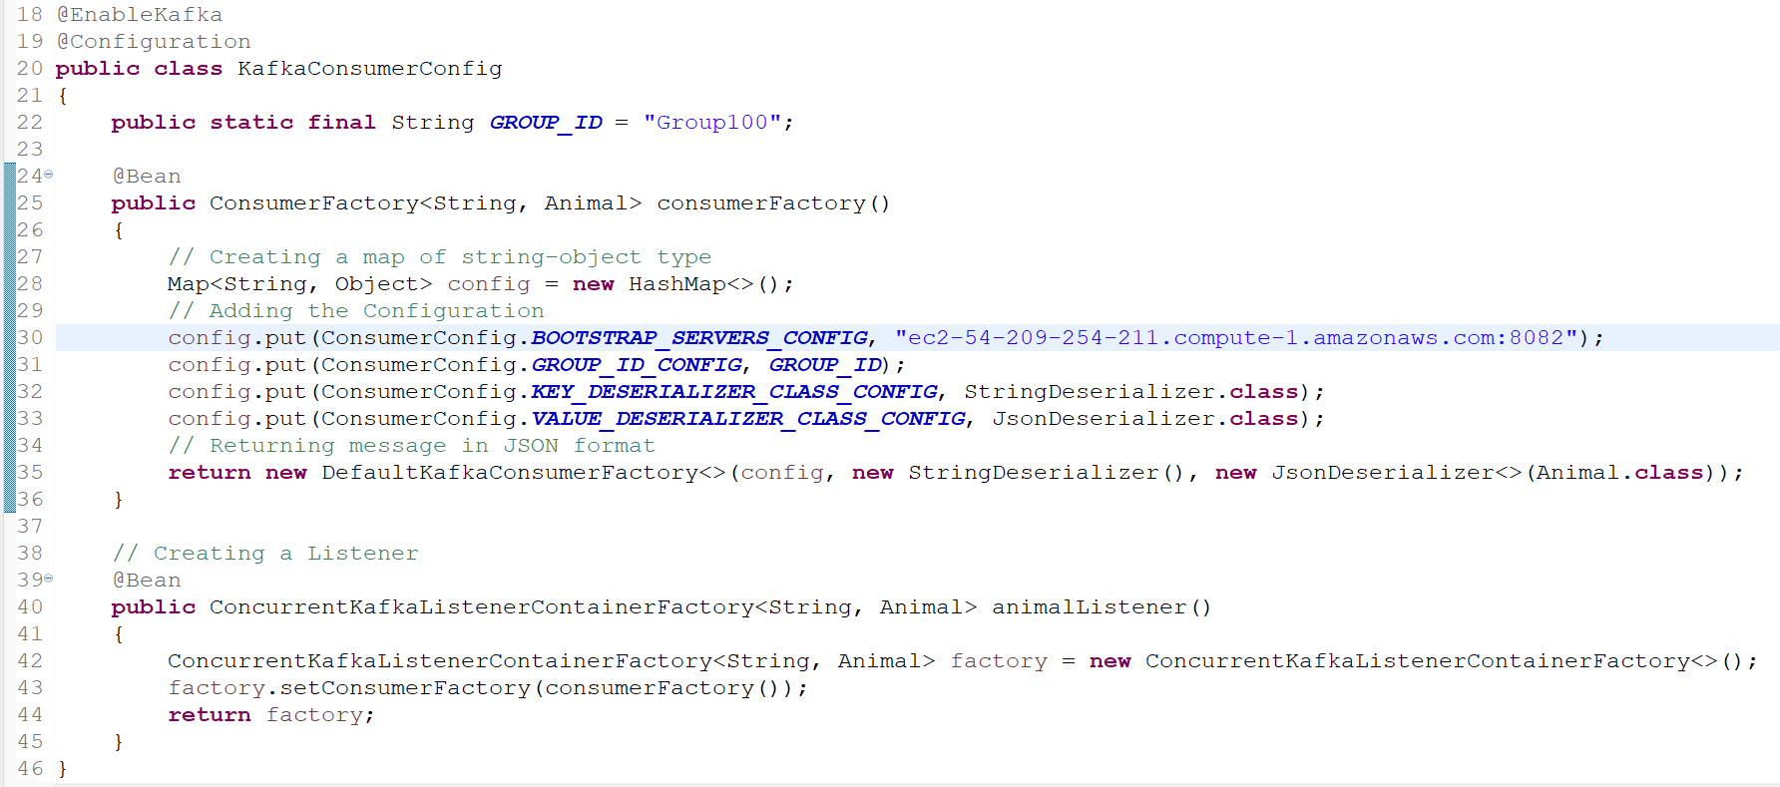
Spring Boot – Send JSON Object into Kafka Topic & Consume JSON Object From Kafka Topic
To consume messages, we need to write a Consumer configuration class file like this.

Slide 8
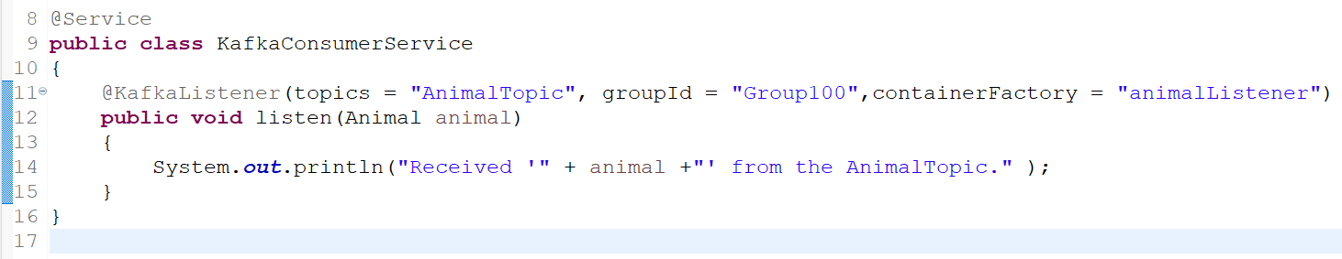
Spring Boot – Send JSON Object into Kafka Topic & Consume JSON Object From Kafka Topic
Next, write a Listener to listen to the messages.

Slide 9
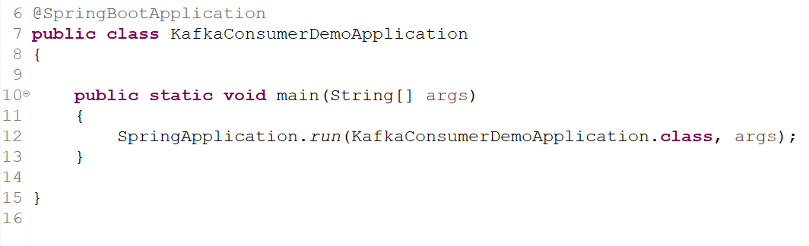
Spring Boot – Send JSON Object into Kafka Topic & Consume JSON Object From Kafka Topic

Slide 10
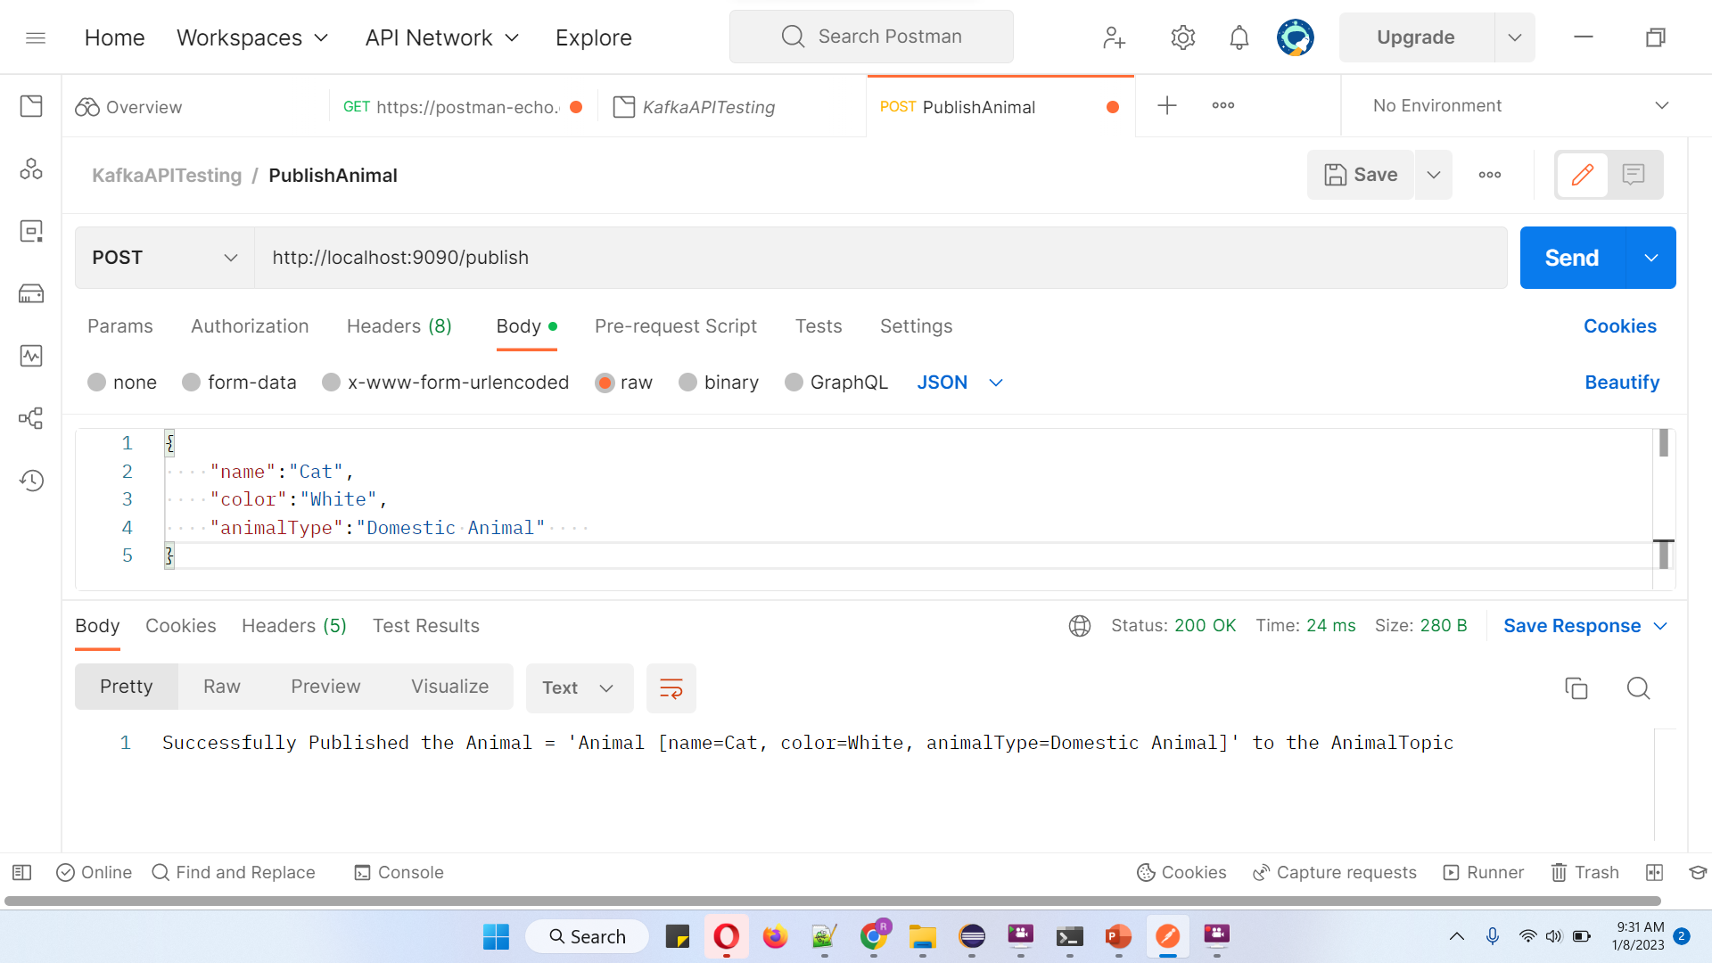
Spring Boot – Send JSON Object into Kafka Topic & Consume JSON Object From Kafka Topic
http://localhost:9090/publish

