Slide 1
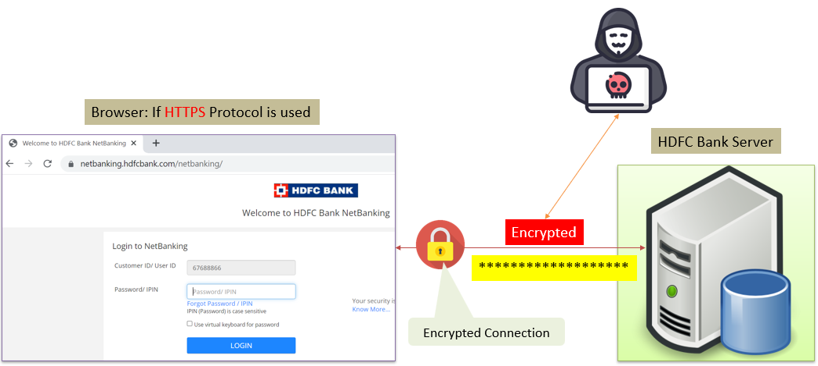
SSL, TLS, HTTPS Explained
SSL (Secure Sockets Layer):
Think of SSL as a special, protective layer that keeps your conversations with websites secure. When you visit a website that uses SSL, it's like having a private and encrypted phone call with that website. This means that any information you send or receive while browsing, like your passwords, credit card details, or personal messages, is scrambled into a secret code that only you and the website can understand. SSL helps ensure that your data remains confidential and can't be easily intercepted by bad actors.

Slide 2
SSL, TLS, HTTPS Explained
TLS (Transport Layer Security):
TLS is like an upgraded version of SSL. It does the same job as SSL, but it's newer and more secure. Just imagine that TLS is the latest and safest way to have that private, encrypted conversation with a website. Even though the term TLS is used now, people often still refer to it as SSL out of habit.

Slide 3
SSL, TLS, HTTPS Explained
HTTPS (Hypertext Transfer Protocol Secure):
Now, imagine that "HTTPS" is a special tag on a website's address that tells you the website is using either SSL or TLS to keep your connection secure. Whenever you see "HTTPS" in the address bar of your browser, it means that the website has that extra layer of protection, like a secure lock, to keep your data safe. So, it's important to look for "HTTPS" when you're entering sensitive information online, like passwords or payment details, because it helps ensure that your data is being sent and received securely.
In summary, SSL and TLS are like security guards that make sure your conversations with websites are private and secure, and HTTPS is the sign that shows you the guard is in place. Always look for "HTTPS" when sharing sensitive information online!

