Slide 1
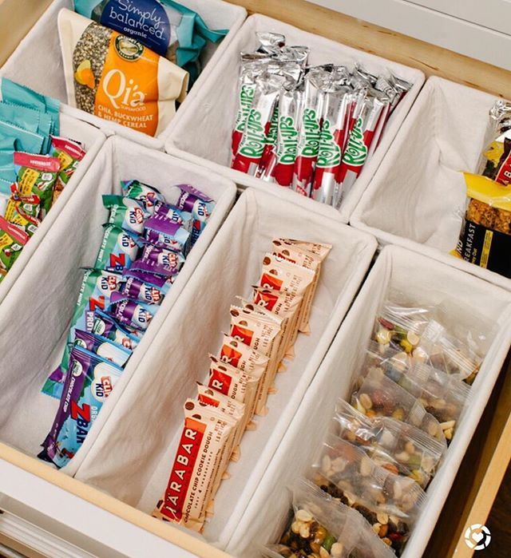
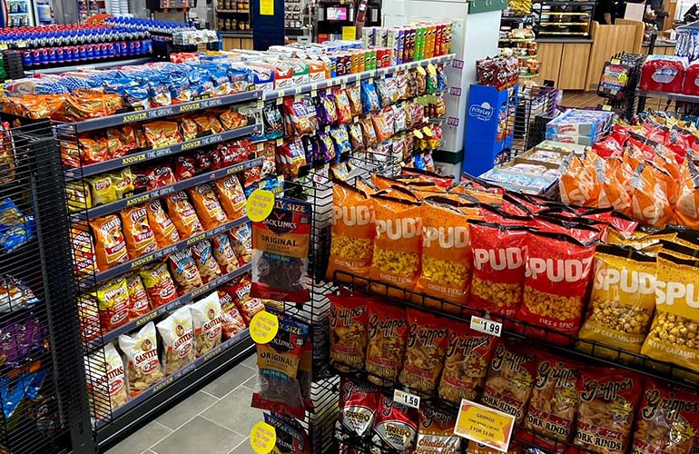

Caching Simplified: Your Quick Data Shortcut
Imagine you have a favorite snack, like cookies, that you enjoy eating regularly. Now, instead of going all the way to the store every time you want some cookies, you decide to keep a small supply of them in a special drawer in your kitchen.
Kitchen Drawer with Snacks
Store

Slide 2
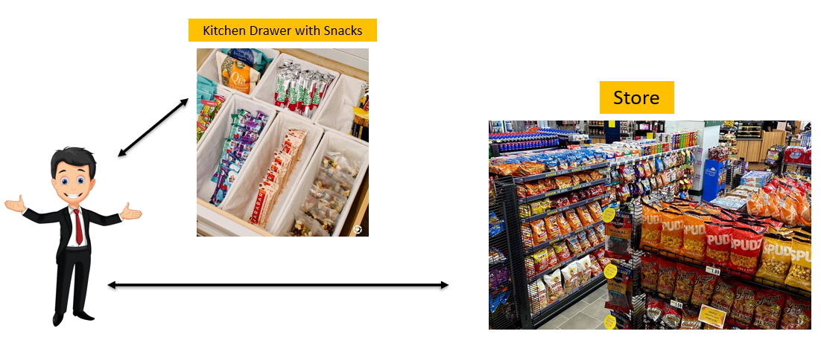
Caching Simplified: Your Quick Data Shortcut
Cookies: These are like pieces of information or data that your computer or device uses. It could be a webpage you visit often, images, videos, or anything else your device needs from the internet.
Your Kitchen Drawer: This is the "cache." It's a special place where your computer stores a copy of the data it frequently uses.
Going to the Store: Think of this as fetching data from the internet. It takes time because your computer has to reach out to a distant place (like a website's server) to get the data.
Having Cookies in the Drawer: When you've got cookies in your kitchen drawer, you can quickly grab them without going to the store. Similarly, when your computer has data in its cache, it can quickly access that data without going to the internet.

Slide 3
Caching Simplified: Your Quick Data Shortcut
So, a cache is like a handy drawer where your computer keeps frequently used information to save time and make things work faster. Just as having cookies in your kitchen drawer means you can satisfy your snack craving faster, having a cache means your computer can access information more quickly when you need it.

