Slide 1
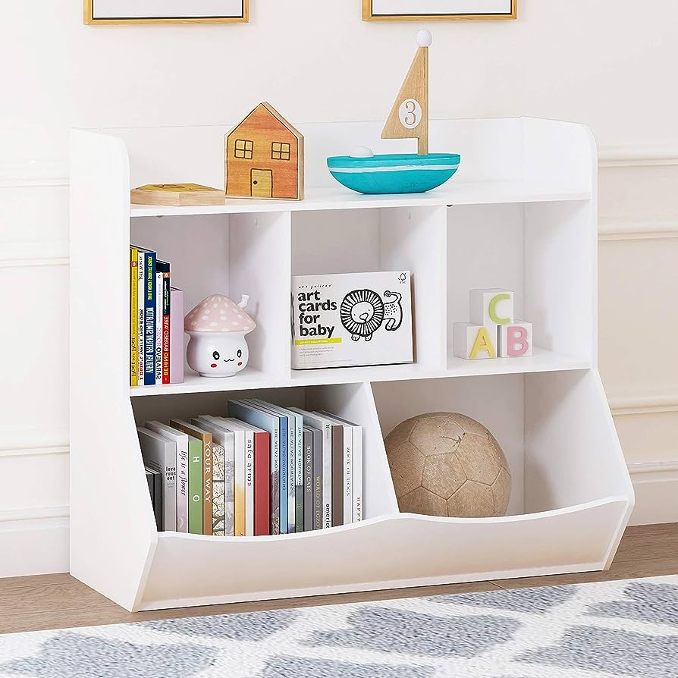
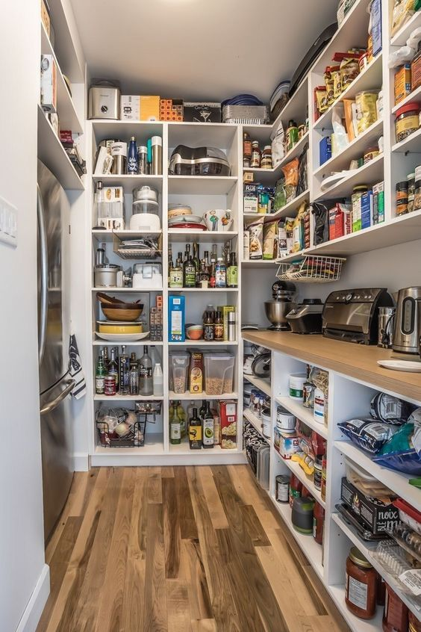

Caching Simplified: Your Quick Data Shortcut
Imagine a cache like a super-fast storage place for things you use often. It's like having a small shelf right next to your desk where you keep your most frequently used items.
Big Storage Room
Small Shelf with books and Toys

Slide 2
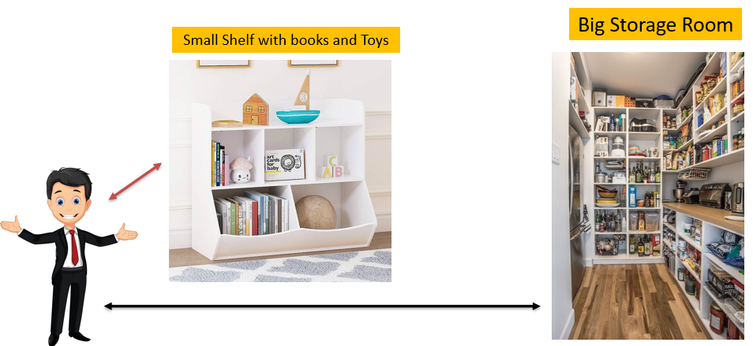
Caching Simplified: Your Quick Data Shortcut
Faster Access: When you need something, like a book or a toy, instead of going to your big storage room (which is slower), you check your little shelf first. If it's there, great! You can grab it quickly.
Limited Space: But, here's the catch: your shelf is quite small, so you can't keep everything there. You have to choose only the most important or commonly used stuff to put on it.
Regular Updates: You also need to pay attention to what's on your shelf. If you stop using something or if you get a new favorite, you should replace items on the shelf accordingly.

Slide 3
Caching Simplified: Your Quick Data Shortcut
In the tech world, a cache is similar. It's a super-fast storage area on your computer or a server that keeps frequently used information handy. It helps your computer run faster because it doesn't have to search through big storage places every time it needs something. But, just like your shelf, it has limited space, so it can't keep everything, and it needs regular updates to stay useful.

