Slide 1


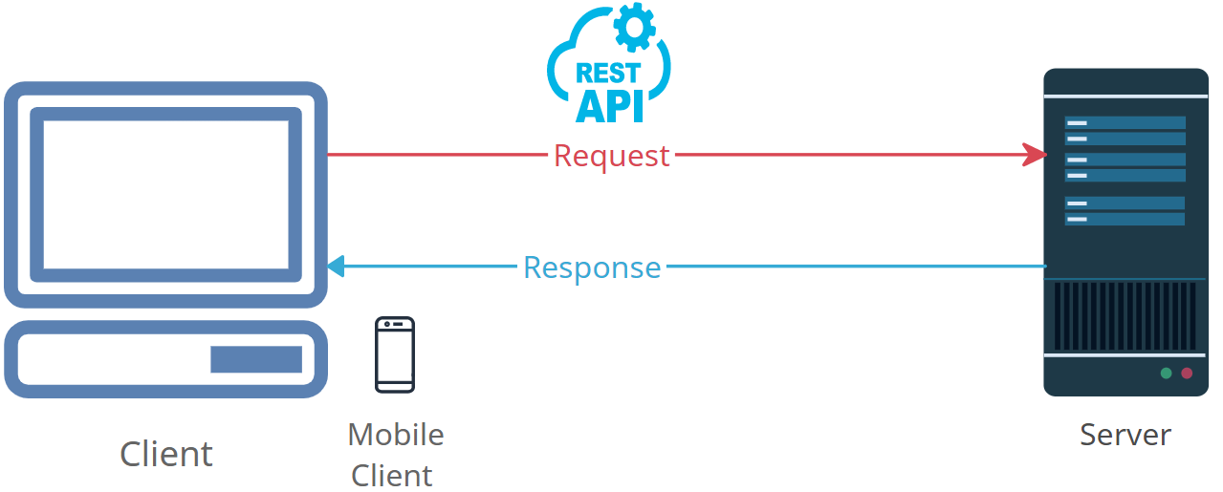

Demystifying HTTP Headers: How the Internet Talks to You
HTTP headers are like messages that you and a website send to each other when you communicate over the internet. Imagine you're sending a letter to a friend.
Request Headers: When you send a letter, you write your return address and other details on the envelope. In the same way, when your computer asks a website for a web page or information, it includes some headers in the request to tell the website what it needs or what it can understand. For example, it might say, "I can read English and I want the latest news.“
Response Headers: When your friend receives your letter, they might write their address and some extra information on their reply. Similarly, when the website sends a response back to your computer, it includes headers to provide details about what's inside. It might say, "Here's the web page you asked for, and it's in English."

Slide 2
Demystifying HTTP Headers: How the Internet Talks to You
Cookies: Think of cookies as little notes that you and your friend exchange to remember certain things. Websites use cookies to remember who you are, so when you visit again, they can say, "Oh, it's you! Welcome back!" Cookies help personalize your experience on the web.
Security: Some headers are like security measures. They ensure that your communication is private and secure, like a secret code that only you and your friend understand. These headers make sure that your data is protected when you send it to a website.
In short, HTTP headers are like information tags that you and websites use to understand each other better when you're surfing the internet. They help ensure that the right information is sent and received, and they play a crucial role in making the web work smoothly.

