Slide 1
What is DevOps? An Easy Explanation
What is DevOps?
DevOps is a combination of the words "Development" and "Operations."
DevOps refers to a set of practices and tools that help software development teams and IT operations teams work together more effectively. The main goal is to create and deliver software more quickly and reliably.

Slide 2
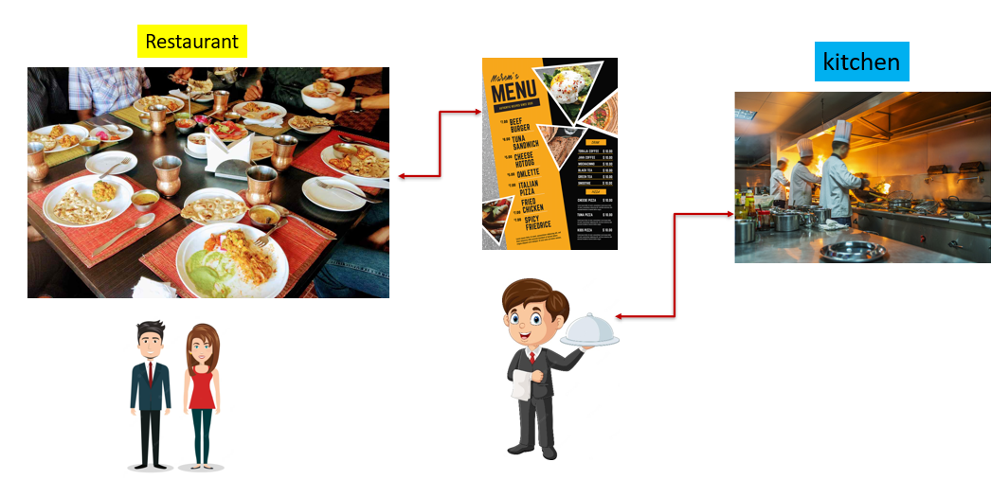
What is DevOps? An Easy Explanation
Why Does DevOps Matter?
Imagine you have a restaurant. In a restaurant, you have two main groups of people: the chefs in the kitchen who cook the food (developers), and the waitstaff who serve the food to customers and make sure they are happy (operations).
Now, think of a situation where the chefs and the waitstaff don't talk to each other much. The chefs might cook amazing food, but if the waitstaff doesn't know what dishes are ready or how to serve them, customers won't get their food on time or might get the wrong orders. This can lead to unhappy customers and a chaotic restaurant.

Slide 3
What is DevOps? An Easy Explanation
Why Does DevOps Matter?
DevOps is like creating a strong teamwork system between the chefs (developers) and the waitstaff (operations). It's a set of practices that helps them communicate better, work together more efficiently, and understand each other's needs and challenges.
In more technical terms, DevOps is a combination of "development" (creating software) and "operations" (deploying and managing software). It aims to shorten the time it takes to deliver high-quality software to users by improving collaboration and automating many processes.

Slide 4
What is DevOps? An Easy Explanation
Key Concepts of DevOps
Collaboration
Automation
Continuous Integration and Continuous Delivery (CI/CD)
Monitoring and Feedback

Slide 5
What is DevOps? An Easy Explanation
Key Concepts of DevOps
Collaboration:
  Development and operations teams work closely together.
  Breaking down silos (barriers) between teams to improve communication and collaboration.
Automation:
  Repetitive tasks are automated to save time and reduce errors.
  For example, instead of manually testing the software every time there's a change, automated tests can be run.

Slide 6
What is DevOps? An Easy Explanation
Key Concepts of DevOps
Continuous Integration and Continuous Delivery (CI/CD):
  Continuous Integration: Developers frequently merge their code changes into a shared repository where automated tests are run.
  Continuous Delivery: Code changes are automatically prepared for a release to production, making it easier to deploy updates quickly and safely.
Monitoring and Feedback:
  Constantly monitoring the software and systems to catch issues early.
  Gathering feedback from users to make continuous improvements.

Slide 7
What is DevOps? An Easy Explanation
Real-World Example
Imagine you use a popular app on your phone. The app is regularly updated with new features and bug fixes. Behind the scenes, there's a DevOps team ensuring that these updates are developed, tested, and released quickly and smoothly without causing the app to crash or behave unpredictably.

Slide 8
What is DevOps? An Easy Explanation
Benefits of DevOps
Faster Delivery: Software is developed and released more quickly.
Higher Quality: Automated testing and continuous monitoring catch problems early.
Better Reliability: Continuous delivery ensures updates are less likely to cause issues.
Happier Teams: Developers and operations teams work together, reducing friction and improving job satisfaction.

Slide 9
What is DevOps? An Easy Explanation
Key Components of DevOps:
Continuous Integration (CI): Developers frequently merge their code changes into a shared repository, where automated tests ensure everything works correctly.
Continuous Delivery (CD): Once the code is tested, it's automatically prepared for release, making it easy to deploy new features quickly.
Monitoring and Logging: Keeping an eye on the software in real-time helps teams spot and fix issues before they affect users.
Collaboration Tools: Just like a kitchen might use a shared whiteboard to track orders, DevOps uses tools like Slack or Jira to help teams communicate and manage their work.

Slide 10
What is DevOps? An Easy Explanation
Conclusion
DevOps is all about making the process of developing and delivering software more efficient and reliable. By fostering better collaboration between development and operations teams, automating repetitive tasks, and continuously monitoring and improving the process, DevOps ensures that users get better software faster and more reliably.

