Slide 1
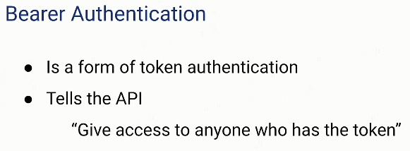

Bearer Token Authentication
Bearer Authentication. ... The name “Bearer authentication” can be understood as “give access to the bearer of this token.” The bearer token is a cryptic string, usually generated by the server in response to a login request.

