Slide 1
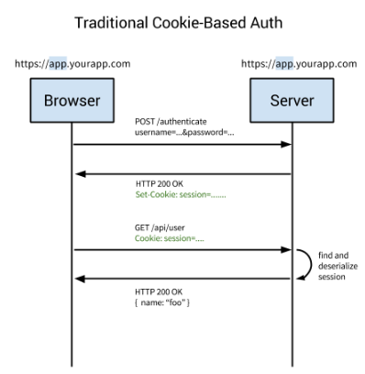
Cookie vs. Token Authentication
Cookie-based authentication is stateful. This means that an authentication record or session must be kept both server and client-side. The server needs to keep track of active sessions in a database, while on the front-end a cookie is created that holds a session identifier, thus the name cookie based authentication. Let's look at the flow of traditional cookie-based authentication:
User enters their login credentials.
Server verifies the credentials are correct and creates a session which is then stored in a database.
A cookie with the session ID is placed in the users browser.
On subsequent requests, the session ID is verified against the database and if valid the request processed.
Once a user logs out of the app, the session is destroyed both client-side and server-side.

Slide 2
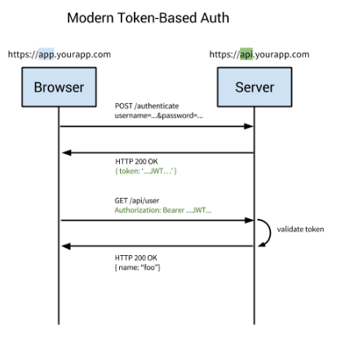
Cookie vs. Token Authentication
Token-based authentication has gained prevalence over the last few years due to the rise of single page applications, web APIs, and the Internet of Things (IoT). When we talk about authentication with tokens, we generally talk about authentication with JSON Web Tokens (JWTs). While there are different ways to implement tokens, JWTs have become the de-facto standard.
Token-based authentication is stateless. The server does not keep a record of which users are logged in or which JWTs have been issued. Instead, every request to the server is accompanied by a token which the server uses to verify the authenticity of the request. The token is generally sent as an addition Authorization header in the form of Bearer {JWT}, but can additionally be sent in the body of a POST request or even as a query parameter.
User enters their login credentials.
Server verifies the credentials are correct and returns a signed token.
This token is stored client-side, most commonly in local storage - but can be stored in session storage or a cookie as well.
Subsequent requests to the server include this token as an additional Authorization header or through one of the other methods mentioned above.
The server decodes the JWT and if the token is valid processes the request.
Once a user logs out, the token is destroyed client-side, no interaction with the server is necessary.

