Slide 1
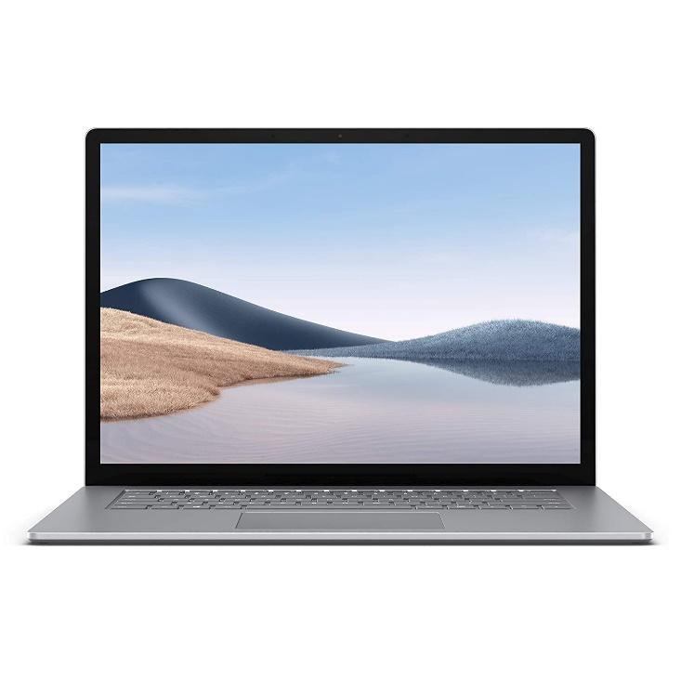


Proxy Explained Simply: Forward and Reverse Proxies Unveiled
Imagine you are browsing the web on your computer. Normally, your computer directly connects to the websites you visit. But a proxy server acts like an intermediary between you and the internet.
There are two main types of proxies: forward proxies and reverse proxies.
You
Internet

Slide 2
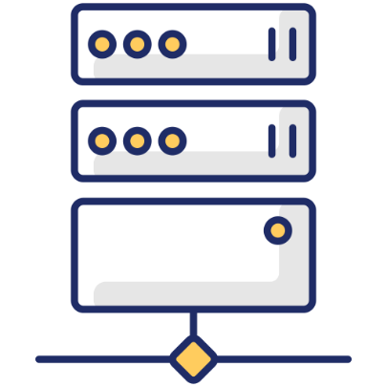



Proxy Explained Simply: Forward and Reverse Proxies Unveiled
Forward Proxy: Think of a forward proxy like a friend who helps you borrow a book from the library. You tell your friend (the proxy) which book (website) you want, and they go to the library (the internet) and get it for you. The library (the internet) only sees your friend (the proxy), not you.
Internet
You
Forward Proxy Server
Book == Website

Slide 3
Proxy Explained Simply: Forward and Reverse Proxies Unveiled
Here are some reasons why people use forward proxies:
Anonymity: A forward proxy can hide your computer's IP address from the websites you visit. This can make it more difficult for websites to track your browsing activity.
Security: Some forward proxies can filter out malicious websites or content.
Access: A forward proxy can be used to bypass website restrictions. For example, if your school or workplace blocks certain websites, you might be able to use a forward proxy to access them.
You
Internet
Forward Proxy Server

Slide 4



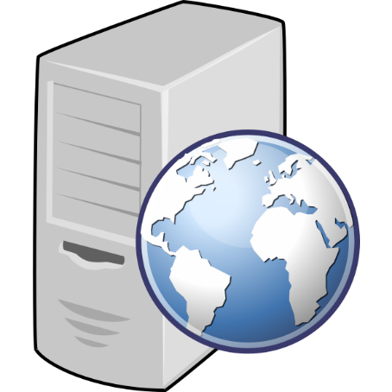
Proxy Explained Simply: Forward and Reverse Proxies Unveiled
Reverse Proxy: Now imagine you're the librarian at a popular library with many branches (web servers). A reverse proxy acts like a receptionist who directs incoming requests (customers) to the appropriate branch (web server). The customers (website visitors) only see the receptionist (reverse proxy), not the individual branches (web servers).
Client 1
Web Server 1
Reverse Proxy Server
Web Server 2
Client 2

Slide 5
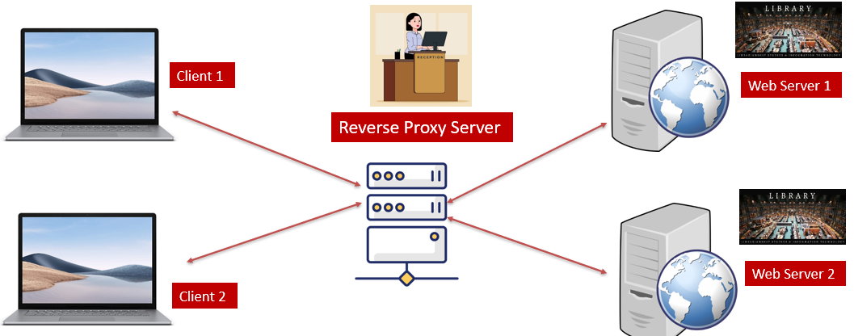
Proxy Explained Simply: Forward and Reverse Proxies Unveiled
Here are some reasons why websites use reverse proxies:
Security: A reverse proxy can help to protect web servers from denial-of-service attacks by distributing traffic among multiple servers.
Performance: A reverse proxy can cache frequently requested content, which can improve website performance.
Load balancing: A reverse proxy can distribute traffic among multiple web servers, which can help to prevent any one server from becoming overloaded.

Slide 6
Proxy Explained Simply: Forward and Reverse Proxies Unveiled
In short, forward proxies act on behalf of clients, while reverse proxies act on behalf of servers. Both types of proxies can provide security and performance benefits.

