Slide 1


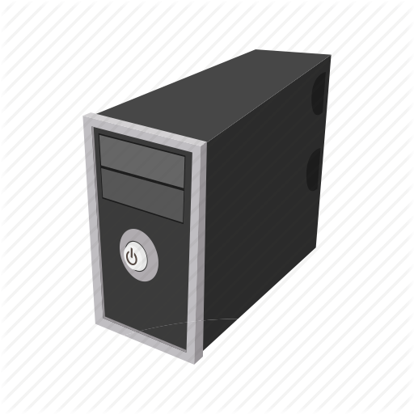




How HTTP Basic Access Authentication Works?
1. Browser (Client) requests URL end point which requires basic access authentication. Example /login/
2. Server sends HTTP status code 401 along with an additional http header WWW-Authenticate with value Basic indicating that client should initiate Basic Access Authentication.
WWW-Authenticate : Basic
1
2
3
4

Slide 2
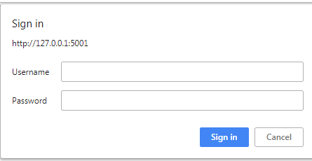
How HTTP Basic Access Authentication Works?
3. When client browser encounters above header it renders login pop up having an input field for username and password like below.
1
2
3
4

Slide 3

How HTTP Basic Access Authentication Works?
4. Client provides value for username and password in popup and submits the form. Here browser encodes entered username and password separated by colon using base64 encoding. For example let's say you entered username as john and password as hunter2 then browser will encode it like below.
1
2
3
4

Slide 4

How HTTP Basic Access Authentication Works?
5.Client browser then sends encoded username and password value inside Authorization header. Note that it also prepend string Basic before encoded value like below.
1
2
3
4

Slide 5
How HTTP Basic Access Authentication Works?
6.Server decodes an username and password sent by client in an Authorization header and compares it with valid username and password as configured on server. If both values match then it sends HTTP status code 200 along with requested data.
But if details are incorrect then server sends 401 with WWW-Authenticate as mentioned in step 2
1
2
3
4

Slide 6
How HTTP Basic Access Authentication Works?
Security Considerations
Note that username and password passed by client is base64 encoded and not encrypted. Which means that anybody listening on the network can easily decode credentials hence it is highly advisable to use basic auth with HTTPS connection and not over HTTP.
Accessing API
If your web server API implements basic authentication and if you want to access it via script or some other tool then you should make HTTP GET request to API endpoint and pass Authorization header with base64 encoded credentials as discussed earlier

