Slide 1
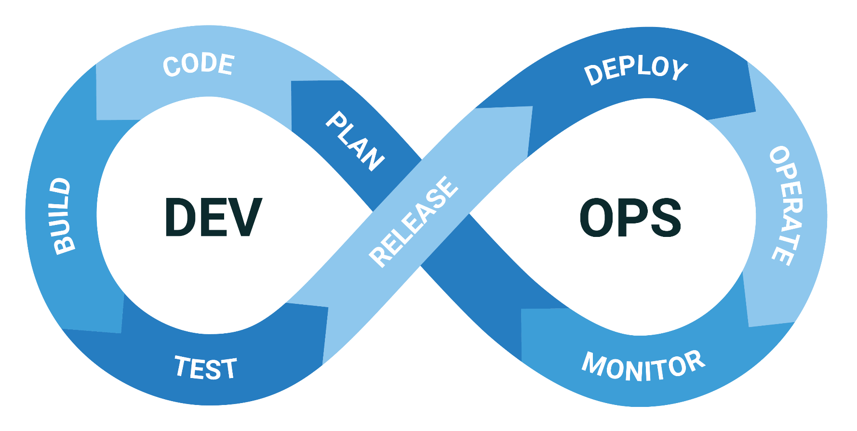
What is the DevOps Lifecycle? Easy Guide for Everyone
What is DevOps Lifecycle?
Imagine you’re running a kitchen in a busy restaurant. To keep things running smoothly, you need good communication, efficient processes, and the right tools. The DevOps lifecycle in software development is a lot like running that kitchen.

Slide 2

What is the DevOps Lifecycle? Easy Guide for Everyone
1. Plan:
What it is: Like planning your menu and deciding what dishes you’ll serve.
In software: Developers and operations teams plan the features and updates needed for the software.

Slide 3
What is the DevOps Lifecycle? Easy Guide for Everyone
2. Code:
What it is: Similar to writing down recipes and instructions for each dish.
In software: Developers write the code for the new features or updates.

Slide 4
What is the DevOps Lifecycle? Easy Guide for Everyone
3. Build:
What it is: Like gathering all the ingredients and preparing them for cooking.
In software: The code is compiled and assembled into a build (a version of the software that can be tested and used).

Slide 5
What is the DevOps Lifecycle? Easy Guide for Everyone
4. Test:
What it is: Similar to taste-testing dishes to ensure they’re good before serving them to customers.
In software: The build is tested to find and fix bugs and ensure it works correctly.

Slide 6
What is the DevOps Lifecycle? Easy Guide for Everyone
5. Release:
What it is: Like putting the finished dishes on the serving line, ready to be taken to customers.
In software: The tested build is deployed to a production environment where it can be used by end-users.

Slide 7
What is the DevOps Lifecycle? Easy Guide for Everyone
6. Deploy:
What it is: Serving the dishes to customers.
In software: The new release is made available to users, and the software is updated.

Slide 8
What is the DevOps Lifecycle? Easy Guide for Everyone
7. Operate:
What it is: Managing the kitchen during service, making sure everything runs smoothly.
In software: The software is monitored to ensure it’s running smoothly, and any issues are addressed quickly.

Slide 9
What is the DevOps Lifecycle? Easy Guide for Everyone
8. Monitor:
What it is: Keeping an eye on the dining area, listening to customer feedback, and ensuring they’re happy.
In software: Continuous monitoring of the software’s performance and user feedback to identify any issues or areas for improvement.

Slide 10
What is the DevOps Lifecycle? Easy Guide for Everyone
Why DevOps?
Just like in a busy restaurant, where chefs, waitstaff, and managers need to work together seamlessly, DevOps ensures that software development and operations teams collaborate effectively. This collaboration helps in delivering high-quality software quickly and reliably.
By following the DevOps lifecycle, companies can:
  Deliver updates and new features faster.
  Improve the quality and reliability of their software.
  Respond quickly to user feedback and issues.
  Ensure better communication and collaboration between teams.
So, the DevOps lifecycle is all about continuous improvement and efficient teamwork, just like running a successful kitchen in a restaurant.

