Slide 1
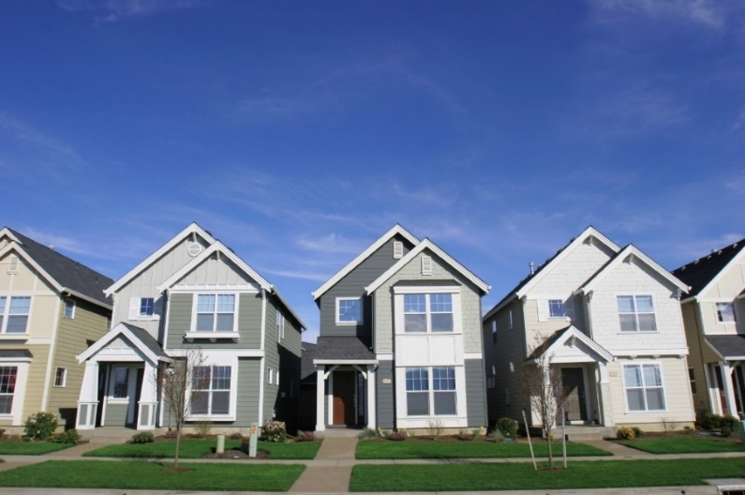
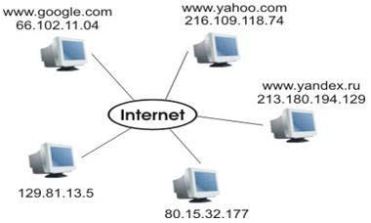
Internet Addresses Demystified: What is an IP Address and Port, Explained Simply
IP Address (Internet Protocol Address):
An IP address is like a unique home address for every device on the internet. It's a series of numbers that helps computers find and communicate with each other.
Just as every house has a distinct street address, every device connected to the internet, like your computer or smartphone, has a unique IP address.
IP addresses are used to identify and locate devices on the internet, ensuring that data and information reach the correct destination.
IP addresses come in two main types: IPv4 (Internet Protocol version 4) and IPv6 (Internet Protocol version 6). IPv4 addresses look like this: 192.168.1.1, while IPv6 addresses are longer and look like this: 2001:0db8:85a3:0000:0000:8a2e:0370:7334.
House == Computer
Address of the House == IP Address

Slide 2

Internet Addresses Demystified: What is an IP Address and Port, Explained Simply
Port:
Think of a port like a specific entrance or door in a large building. In the computer world, it's a designated number that helps data find the right "entrance" on a device.
Devices have multiple ports, much like a building may have many entrances. Each port is used for different types of communication or services.
For example, web browsing often uses port 80, while email may use port 25. Each port is like a "room" where a specific type of information or service is handled.
House == Computer
Address of the House == IP Address
Port == Room or Entrance

Slide 3

Internet Addresses Demystified: What is an IP Address and Port, Explained Simply
So, in simple terms, IP addresses are like unique addresses for devices on the internet, and ports are like different doors or entrances on those devices, each serving a specific purpose. Together, they ensure that data gets to the right place on the internet and is handled by the right service or application.
House == Computer
Address of the House == IP Address
Port == Room or Entrance

