Slide 1
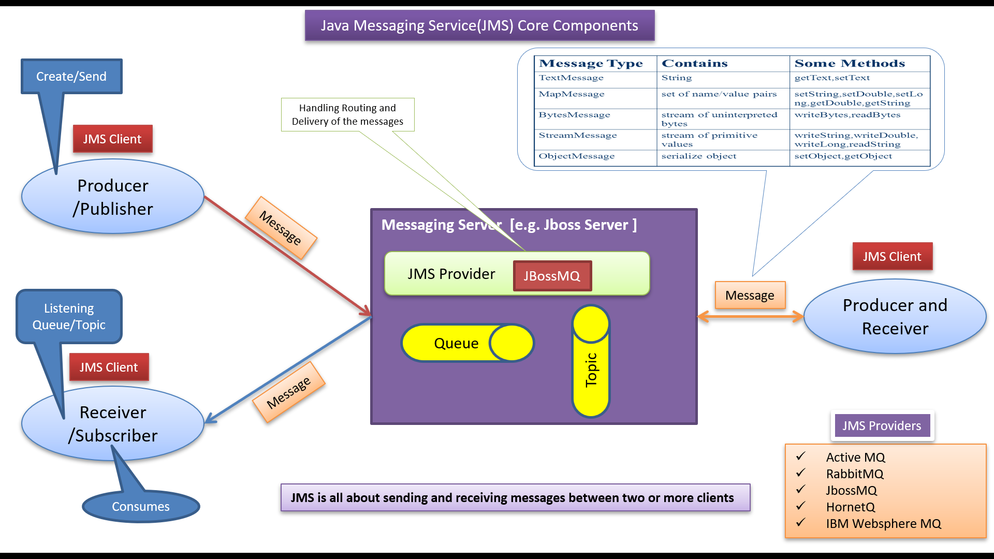
JMS Explained: Java Message Service for Beginners
JMS (Java Message Service): JMS stands for Java Message Service, and it's a Java-based messaging standard that allows different software applications to communicate by sending and receiving messages. Just like you send text messages or emails to communicate with friends, JMS enables software components to exchange information in a reliable and structured way.

Slide 2




JMS Explained: Java Message Service for Beginners
Messaging: Imagine you have two friends who want to share information without being online at the same time. One friend writes a note, puts it in an envelope, and drops it in a mailbox. The other friend later checks the mailbox, finds the note, and reads the message. Similarly, JMS provides a way for software components to send and receive messages, even if they are not running simultaneously.

Slide 3
JMS Explained: Java Message Service for Beginners
Components: In the software world, different applications or parts of an application might need to communicate with each other. For example, an online shopping website needs to notify the inventory system when a product is ordered. JMS provides a reliable way for these different components to exchange information, ensuring that messages are delivered properly and in the right order.
Publish-Subscribe and Point-to-Point: JMS supports two main communication models.
One is called "Publish-Subscribe," which is like a radio station broadcasting to many listeners. When a message is sent, multiple subscribers can receive it.
The other model is "Point-to-Point," where messages are sent directly to a specific recipient, just like sending a letter to a specific address.

Slide 4
JMS Explained: Java Message Service for Beginners
Benefits of JMS:
Reliability: JMS ensures that messages are delivered safely, even if there are network issues or the receiving application is temporarily unavailable.
Asynchronous Communication: Just like you don't have to be online all the time to receive a message, JMS allows components to communicate without needing to be active simultaneously.
Scalability: JMS helps manage communication in complex systems, making it easier to add or replace components without disrupting the entire system.
Decoupling: Just as your friends can send messages without knowing each other's schedules, JMS allows components to communicate without needing deep knowledge of each other.

Slide 5
JMS Explained: Java Message Service for Beginners
In Summary: JMS is like a reliable postal service for software applications. It helps different parts of an application or even different applications altogether communicate in a structured and efficient way, enhancing the reliability and scalability of modern software systems.

