Slide 1
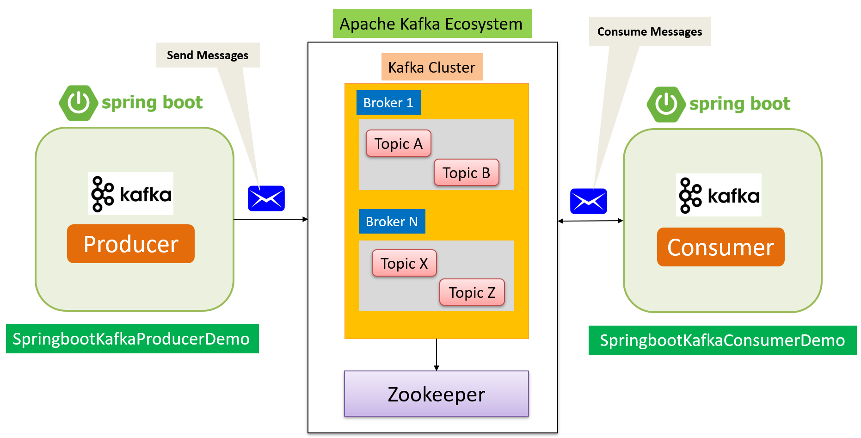
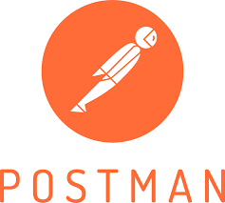


Spring Boot Kafka Producer & Consumer Example with REST Client
Apache Kafka Server is running on Amazon EC2 Instance
Send Messages

Slide 2
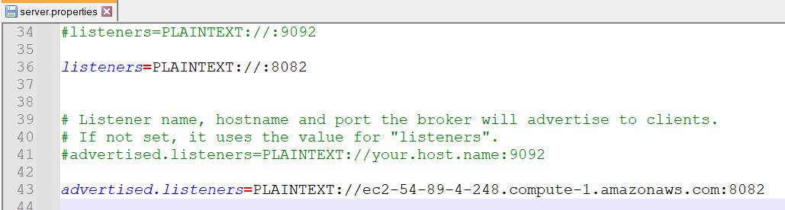
Spring Boot Kafka Producer Example

Slide 3
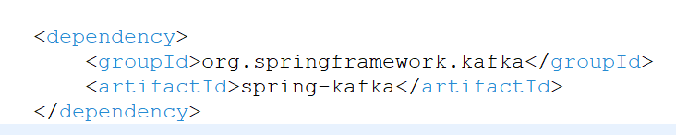
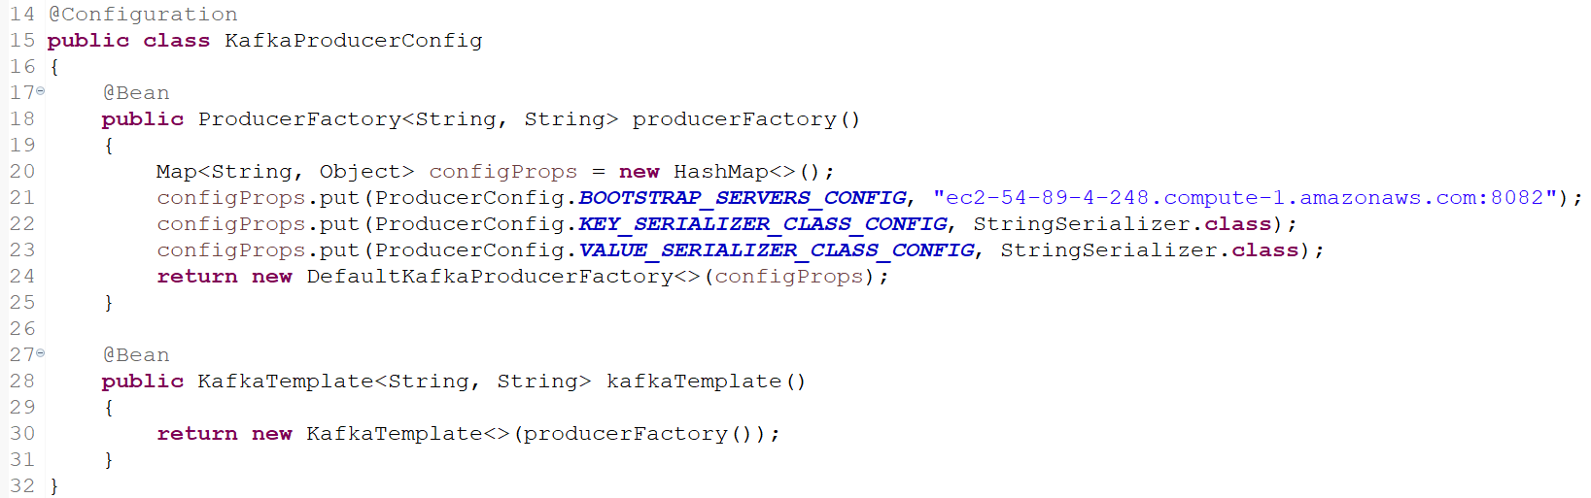
Spring Boot Kafka Producer & Consumer Example with REST Client

Slide 4
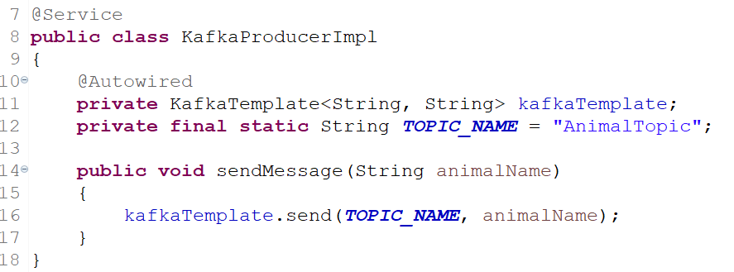
Spring Boot Kafka Producer & Consumer Example with REST Client
To publish a message, auto wire the Kafka Template object and produce the message

Slide 5
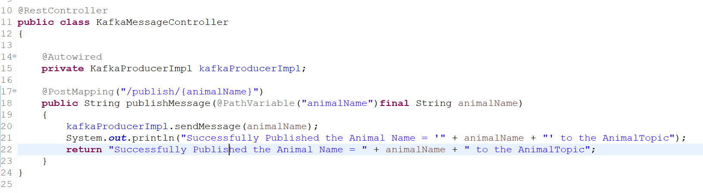
Spring Boot Kafka Producer & Consumer Example with REST Client
This controller expose the end point to send the Animal Name.

Slide 6
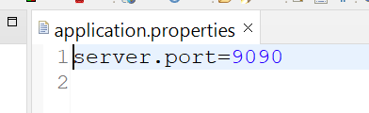
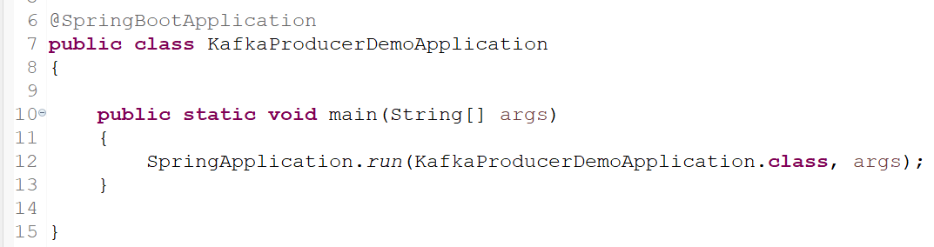
Spring Boot Kafka Producer & Consumer Example with REST Client

Slide 7
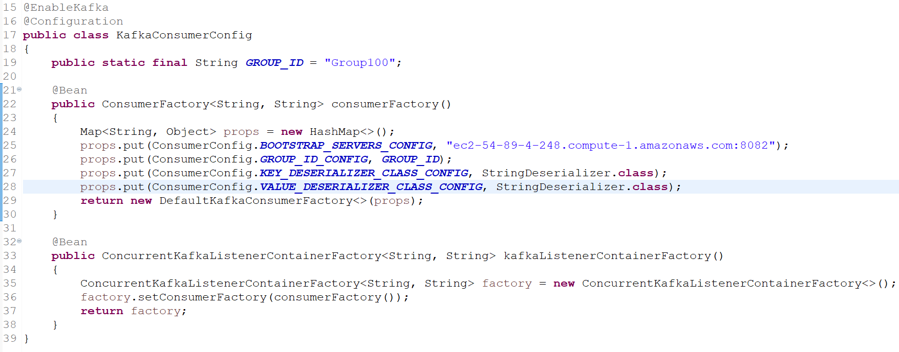
Spring Boot Kafka Producer & Consumer Example with REST Client
To consume messages, we need to write a Consumer configuration class file like this.

Slide 8
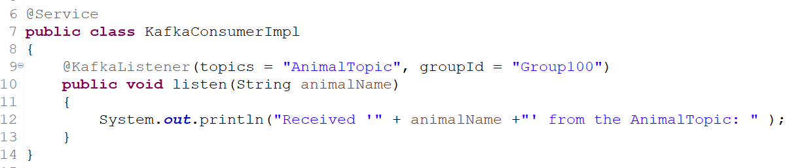
Spring Boot Kafka Producer & Consumer Example with REST Client
Next, write a Listener to listen to the messages.

Slide 9
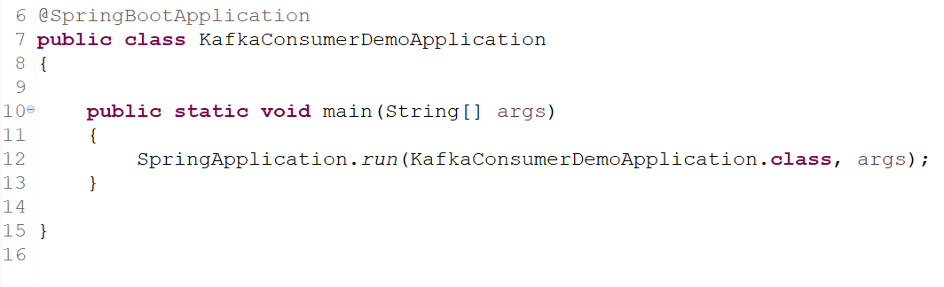
Spring Boot Kafka Producer & Consumer Example with REST Client

Slide 10
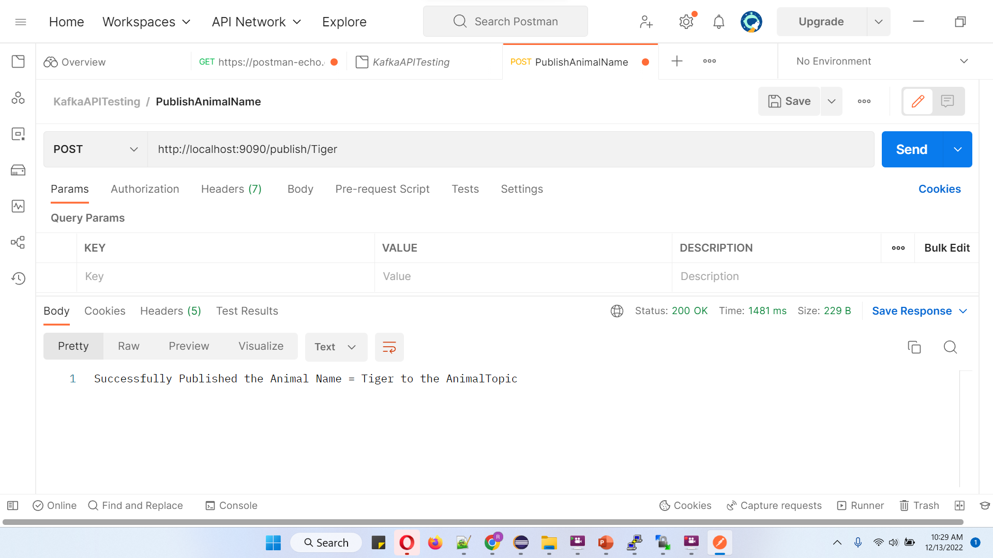
Spring Boot Kafka Producer & Consumer Example with REST Client
http://localhost:9090/publish/Tiger

