Slide 1
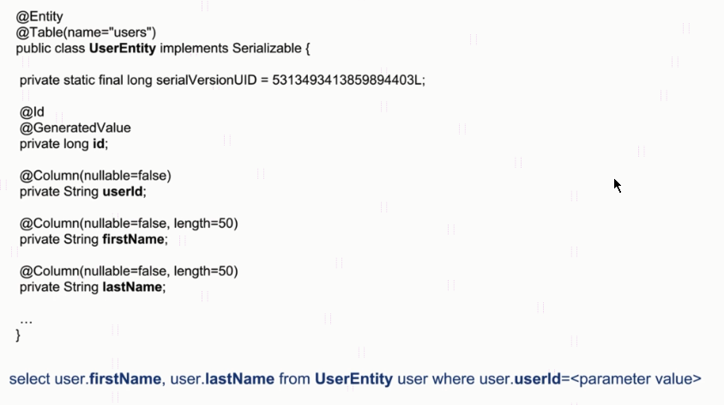
Spring Boot - Using Java Persistence Query Language(JPQL)
JPQL is Platform Independent. Today in your project you are using MySQL Database and after 3 months you want to
Change it to Oracle Database in this case you no need to do any code change if you are using JPQL.

Slide 2

Spring Boot - Using Java Persistence Query Language(JPQL)
JPQL Select SQL Query
JPQL Query to Select Specific Fields Only

Slide 3

Spring Boot - Using Java Persistence Query Language(JPQL)
JPQL Update SQL Query

