Slide 1
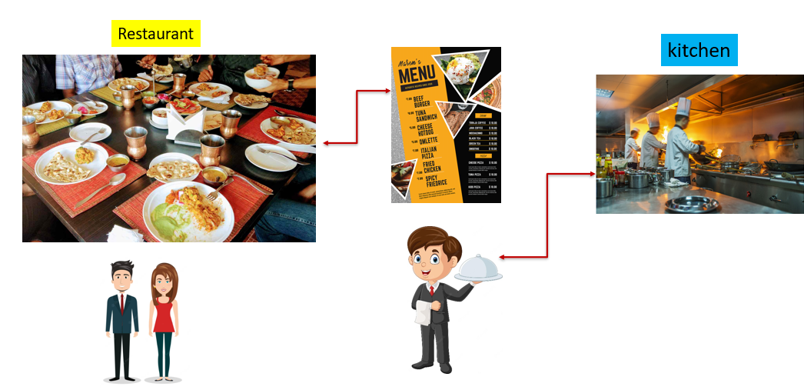
What is a REST API?
Imagine you're at a fancy restaurant, and you want to order some food. You don't go into the kitchen to cook the meal yourself; instead, you sit at your table and tell the waiter what you want. The waiter takes your order, goes to the kitchen, gets your food prepared, and brings it back to your table. You get to enjoy your meal without worrying about all the cooking details.

Slide 2
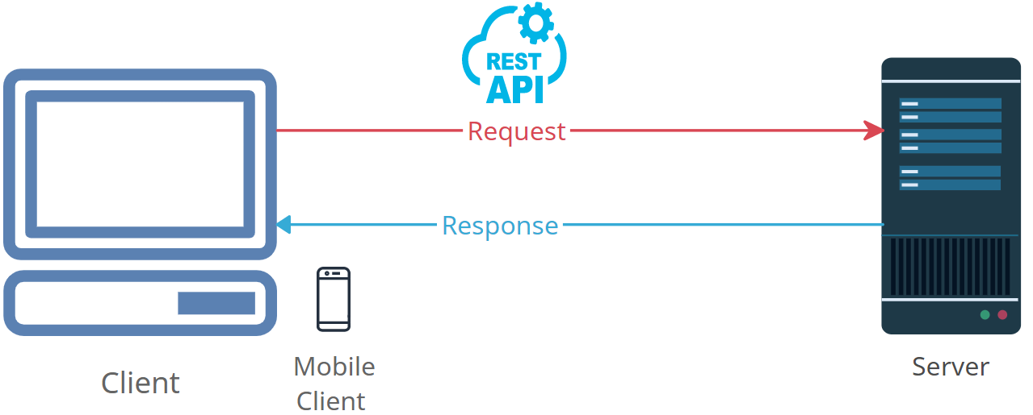
What is a REST API?
Now, think of restaurant process in terms of computers and the internet. When you use a website or an app on your phone, your device wants to get certain information from a computer somewhere out there on the internet. Just like you ordered food at the restaurant, your device sends a request to that remote computer, saying, "Hey, I need this information."

Slide 3
What is a REST API?
A REST API is like the waiter in the restaurant. It's a set of rules and tools that lets your device communicate with that remote computer and ask for specific information or perform certain actions. You don't need to know how the computer works or where the information comes from – you just send your request, and the API takes care of getting the right data or doing the right thing.

Slide 4
What is a REST API?
So, next time you're using an app on your phone to get weather updates, search for a video, or even buy something online, you're actually using a REST API behind the scenes. It's like having a digital waiter that helps your device talk to other computers and get the information you need without you having to worry about all the technical details.

