Slide 1

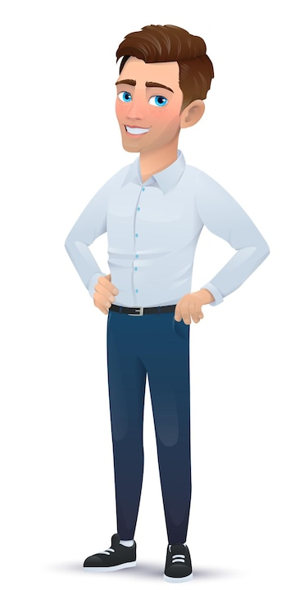

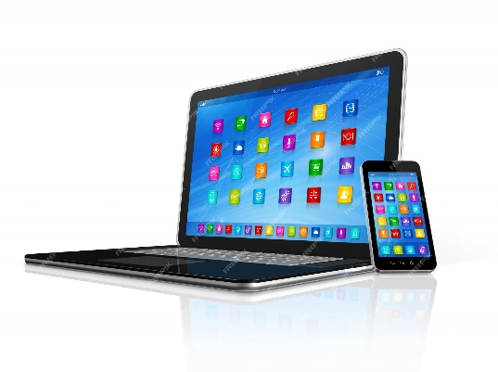
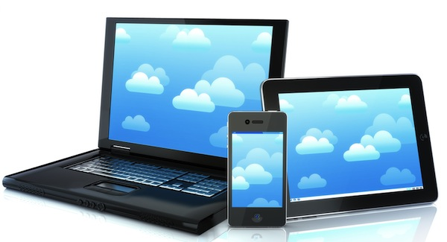
Email Basics: A Beginner's Guide to Electronic Messaging
Email, short for electronic mail, is a method of exchanging digital messages over the internet. It's like sending letters, but you use your computer or smartphone to do it.

Slide 2
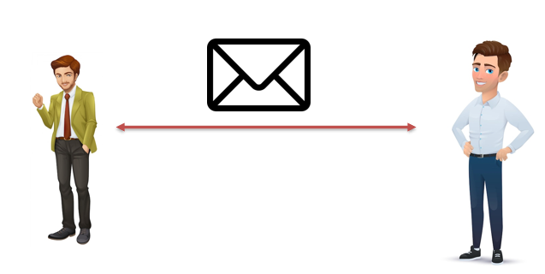


Email Basics: A Beginner's Guide to Electronic Messaging
Email Account: To send and receive emails, you need an email account. Think of it as your digital mailbox.
Compose: When you want to send an email, you click on the "compose" button. It's like starting a new letter.
Recipient: You enter the email address of the person you want to send the email to. This is similar to writing their name and address on an envelope.
Subject: You add a subject line, which is like a short summary of what your email is about. This helps the recipient understand the email's topic.
Message: In the main part of the email, you write your message. You can type anything you want, just like writing a letter. You can also attach files, like pictures or documents.
Send: When you're done, you hit the "send" button. Your email is sent through the internet to the recipient's email account.
Inbox: The recipient receives your email in their inbox, just like receiving a letter in their mailbox. They can open and read it.
Reply: If the recipient wants to respond, they can click "reply" and send an email back to you.

Slide 3
Email Basics: A Beginner's Guide to Electronic Messaging
Email is a quick and convenient way to communicate with people, whether for personal or professional reasons. It's like having a digital conversation through messages, and it's a fundamental tool for staying connected in the digital age.

