Slide 1
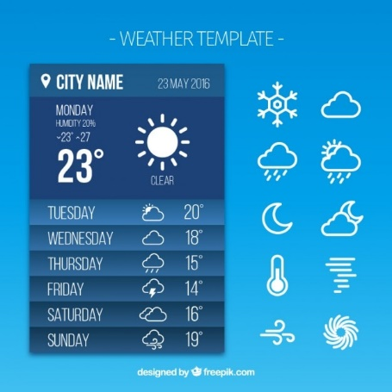
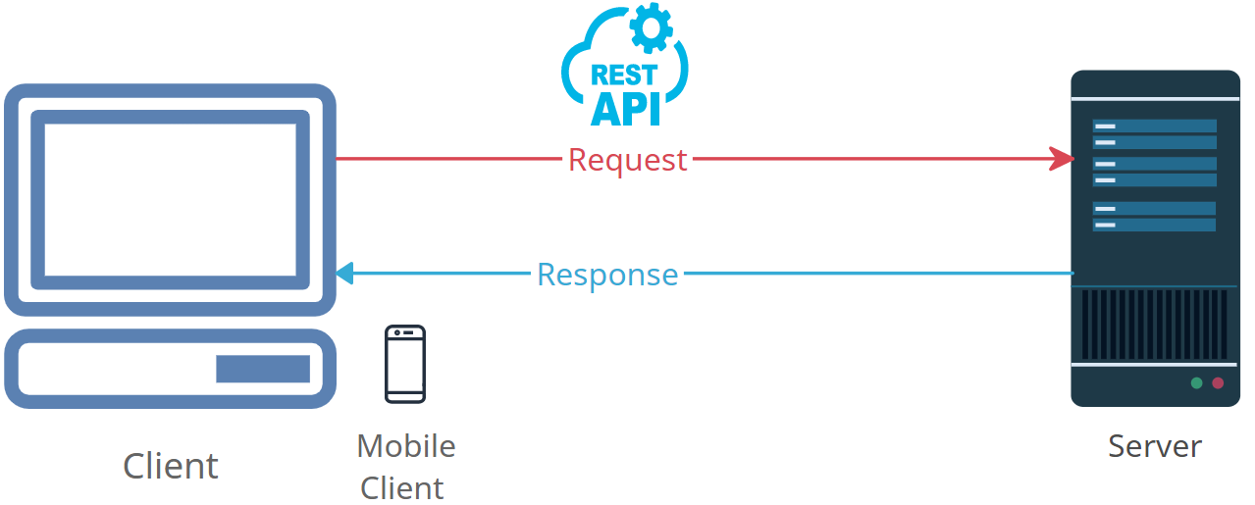


Demystifying HTTP Requests: How the Internet Fetches Web Pages
Imagine you want to get information from a website, like checking the weather or reading news. You open your web browser, type in the website's address, and hit "Enter." That's when an "HTTP Request" happens.
HTTP stands for "Hypertext Transfer Protocol." It's like a set of rules for computers to communicate over the internet. An HTTP Request is like sending a message to a website. It's your way of asking the website to give you something.

Slide 2
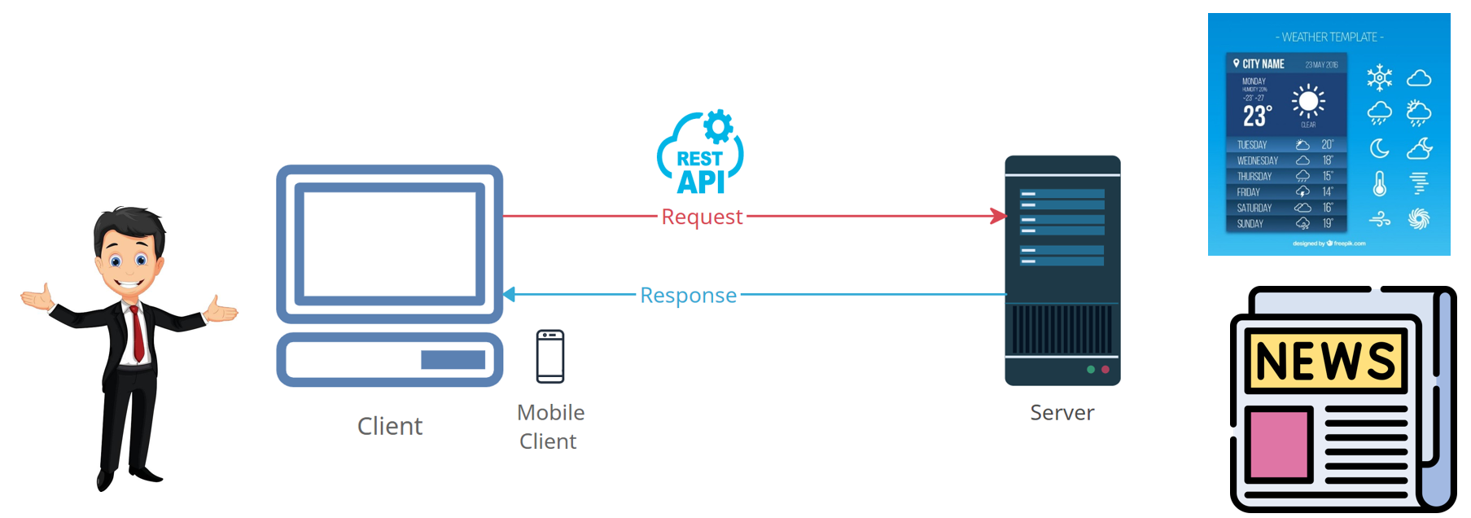
Demystifying HTTP Requests: How the Internet Fetches Web Pages
Here's how it works:
You tell your web browser what website you want to visit (e.g., www.weather.com).
Your browser puts together a message, which is the HTTP Request. This message contains information about what you want from the website. For example, you might ask for the weather in your city.
Your browser sends this message to the website's server. Think of the server as a super-smart computer that stores all the website's information.
The server gets your message and understands what you're asking for. It looks up the weather in your city and prepares a response.
The server sends back another message, which is the "HTTP Response." This message contains the weather information you wanted.
Your browser receives this message, reads the weather info, and displays it on your screen.

Slide 3
Demystifying HTTP Requests: How the Internet Fetches Web Pages
So, an "HTTP Request" is like asking a website for something, and the "HTTP Response" is the website's way of giving you what you asked for. It's how we get all the cool stuff from the internet, like websites, videos, and pictures, right on our screens!

