Slide 1
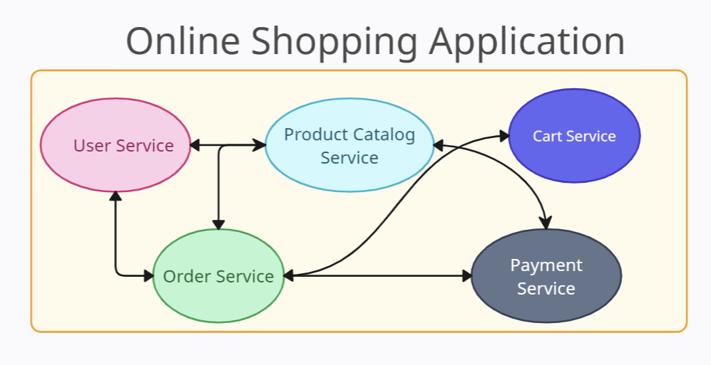


What is API gateway?

Slide 2
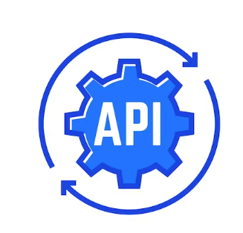
What is API gateway?
API Gateway
Edge Microservice

Slide 3
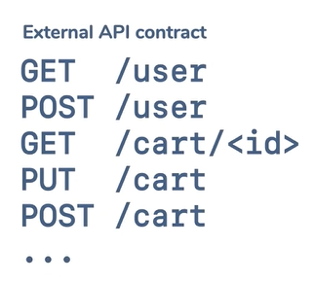
What is API gateway?
API Composition
Gateway
Microservice
Inner Microservices

Slide 4




What is API gateway?
Gateway
Microservice
Inner Microservices
1.Monitoring
2.Authentication

Slide 5

What is API gateway?
Gateway
Microservice
Load Balancer
Inner Microservices
1.Monitoring
2.Authentication

Slide 6
What is API gateway?
Web Client
Backend for Frontend Pattern
Web
API Gateway
Gateway
Microservice
Inner Microservices
IOS Client
Mobile
API Gateway
Andriod Client

