Slide 1

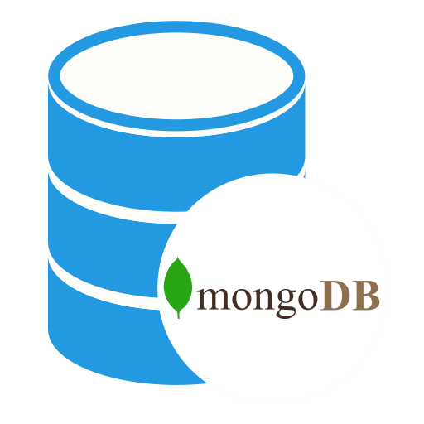
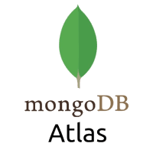
How to Connect to MongoDB Atlas Using Java
Java Program

