Slide 1

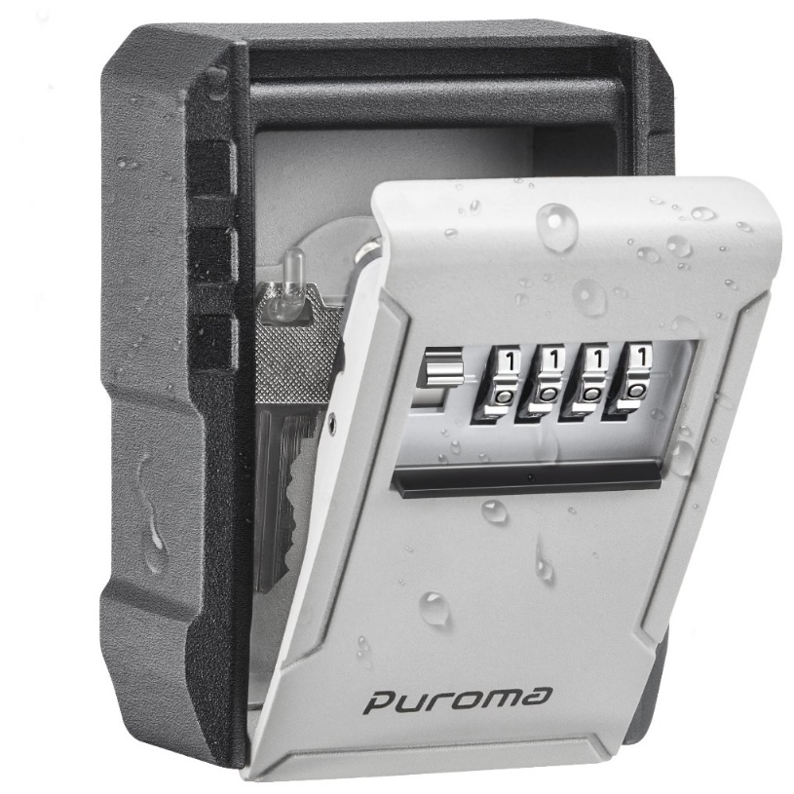
What Is Encryption at Rest, and Why Is It Important for Your Business?
Imagine your data is like a secret message written on a piece of paper that you want to keep safe in a locked box. Encryption at REST is like putting that message in a special code before you lock it away.
When data is "at rest," it means it's not actively moving from one place to another, like when it's stored on a hard drive, in a database, or on a server. Encryption at REST involves converting that information into a secret code using algorithms. This code is nearly impossible for unauthorized people to read without the special "key" that can unlock and decipher it.

Slide 2
What Is Encryption at Rest, and Why Is It Important for Your Business?
So, when your data is encrypted at rest, even if someone gains access to where it's stored, they won't be able to understand or make sense of it without the key. It adds an extra layer of security, ensuring that your information remains safe and private, even if it's not actively being used or moved around.

Slide 3
What Is Encryption at Rest, and Why Is It Important for Your Business?
Implementing "Encryption at REST" involves securing data while it's stored in databases, servers, or any other storage systems. To explain this concept in simple terms:
Understanding Encryption: Encryption is like putting your information in a locked box before storing it. Only someone with the right key can unlock and read what's inside the box.
Choosing the Right Tools: Start by selecting encryption tools or software that can scramble your data into a secret code (encrypted form) that no one can understand without the right key.
Identifying Sensitive Data: Determine which information needs protection. This could include personal details, financial records, passwords, or any confidential data that you wouldn't want unauthorized people to access.
Applying Encryption: Use the chosen encryption tool or software to convert this sensitive information into an unreadable format before storing it in databases, servers, or any storage medium.
Secure Keys: Ensure the encryption keys, which are like the secret codes to unlock the encrypted data, are kept in a secure place and only accessible to authorized individuals.

Slide 4
What Is Encryption at Rest, and Why Is It Important for Your Business?
Access Control: Limit access to the encrypted data by granting permissions only to authorized users. This helps in preventing unauthorized access.
Regular Updates: Regularly update your encryption software and security protocols to stay protected against evolving threats.
For instance, imagine your sensitive information is like a secret message. Encryption takes that message and turns it into a secret code. Even if someone finds the secret message, they can't understand it because it's in a secret code that only someone with the decoding key can decipher.
By implementing encryption at rest, you're essentially putting your sensitive data into a secure lockbox, making it unreadable to unauthorized individuals. This helps in keeping your information safe, even if someone gains access to where it's stored.
Remember, the goal of encryption at rest is to safeguard your stored data from unauthorized access or breaches, ensuring that even if someone gets their hands on your data, they can't understand or use it without the decryption key.

