Slide 1
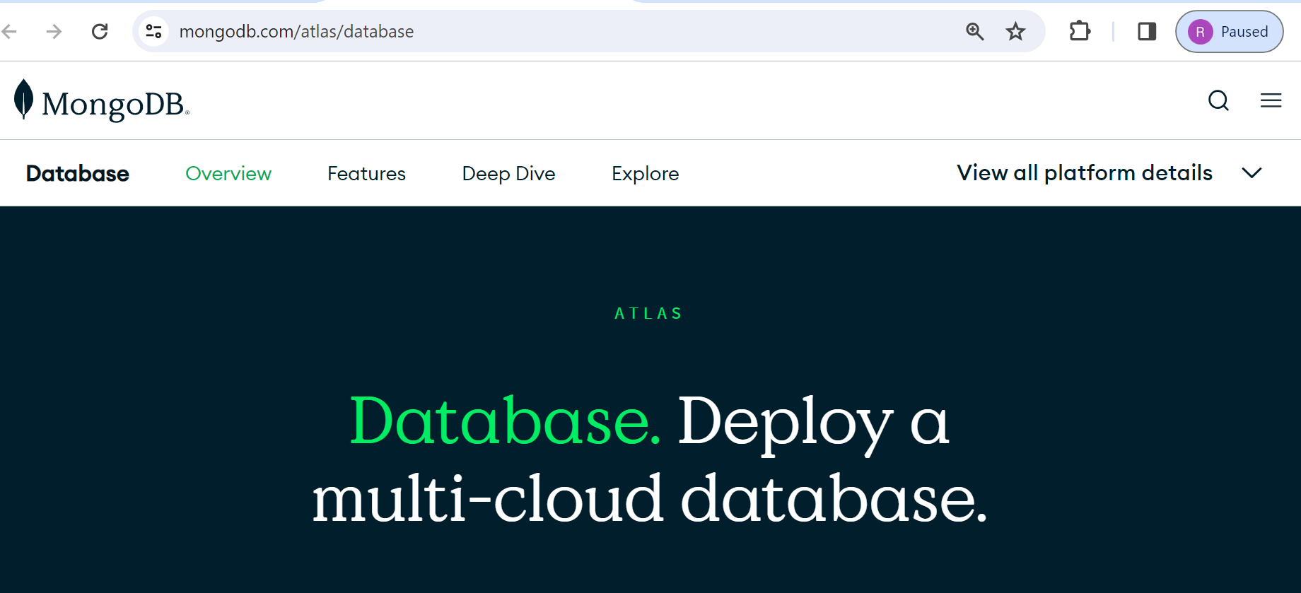
MongoDB Atlas Database | Multi-Cloud Database Service
MongoDB Atlas Database: Multi-Cloud Power at Your Fingertips
MongoDB Atlas is the leading multi-cloud database service built by the creators of MongoDB itself. It offers a robust and flexible platform for storing and managing your data across multiple cloud providers and regions, giving you unmatched control, scalability, and resilience

Slide 2
MongoDB Atlas Database | Multi-Cloud Database Service
key highlights of MongoDB Atlas:
1. Multi-Cloud Freedom:
Deploy your database on AWS, Azure, or Google Cloud based on your needs and preferences.
Easily migrate or replicate data between different cloud providers for added redundancy and disaster recovery.
2. Built-in Scalability:
Automatically scale your database resources up or down to meet fluctuating demand.
Choose from a variety of cluster configurations, including serverless options, to optimize performance and cost.
3. Global Reach:
Deploy your database in over 80 regions worldwide, ensuring low latency and high availability for your global users.
Offer consistent user experiences by distributing data across multiple regions.

Slide 3
MongoDB Atlas Database | Multi-Cloud Database Service
key highlights of MongoDB Atlas:
4. Enhanced Security:
Benefit from robust security features like encryption, access control, and intrusion detection.
Comply with strict data privacy regulations with regional deployments and built-in compliance tools.
5. Developer-Friendly:
Integrate Atlas seamlessly with your applications using various languages and frameworks.
Take advantage of a range of developer tools and utilities to streamline your workflow.

Slide 4
MongoDB Atlas Database | Multi-Cloud Database Service
key highlights of MongoDB Atlas:
6. Additional Benefits:
Rich monitoring and analytics: Gain insights into your database performance and resource utilization.
Automated backups and disaster recovery: Ensure your data is always safe and accessible.
Dedicated support: Get expert assistance from the MongoDB team whenever you need it.

Slide 5
MongoDB Atlas Database | Multi-Cloud Database Service
Conclusion
Whether you're building a global application, migrating to the cloud, or simply seeking a more reliable and scalable database solution, MongoDB Atlas is a powerful choice.

