Slide 1
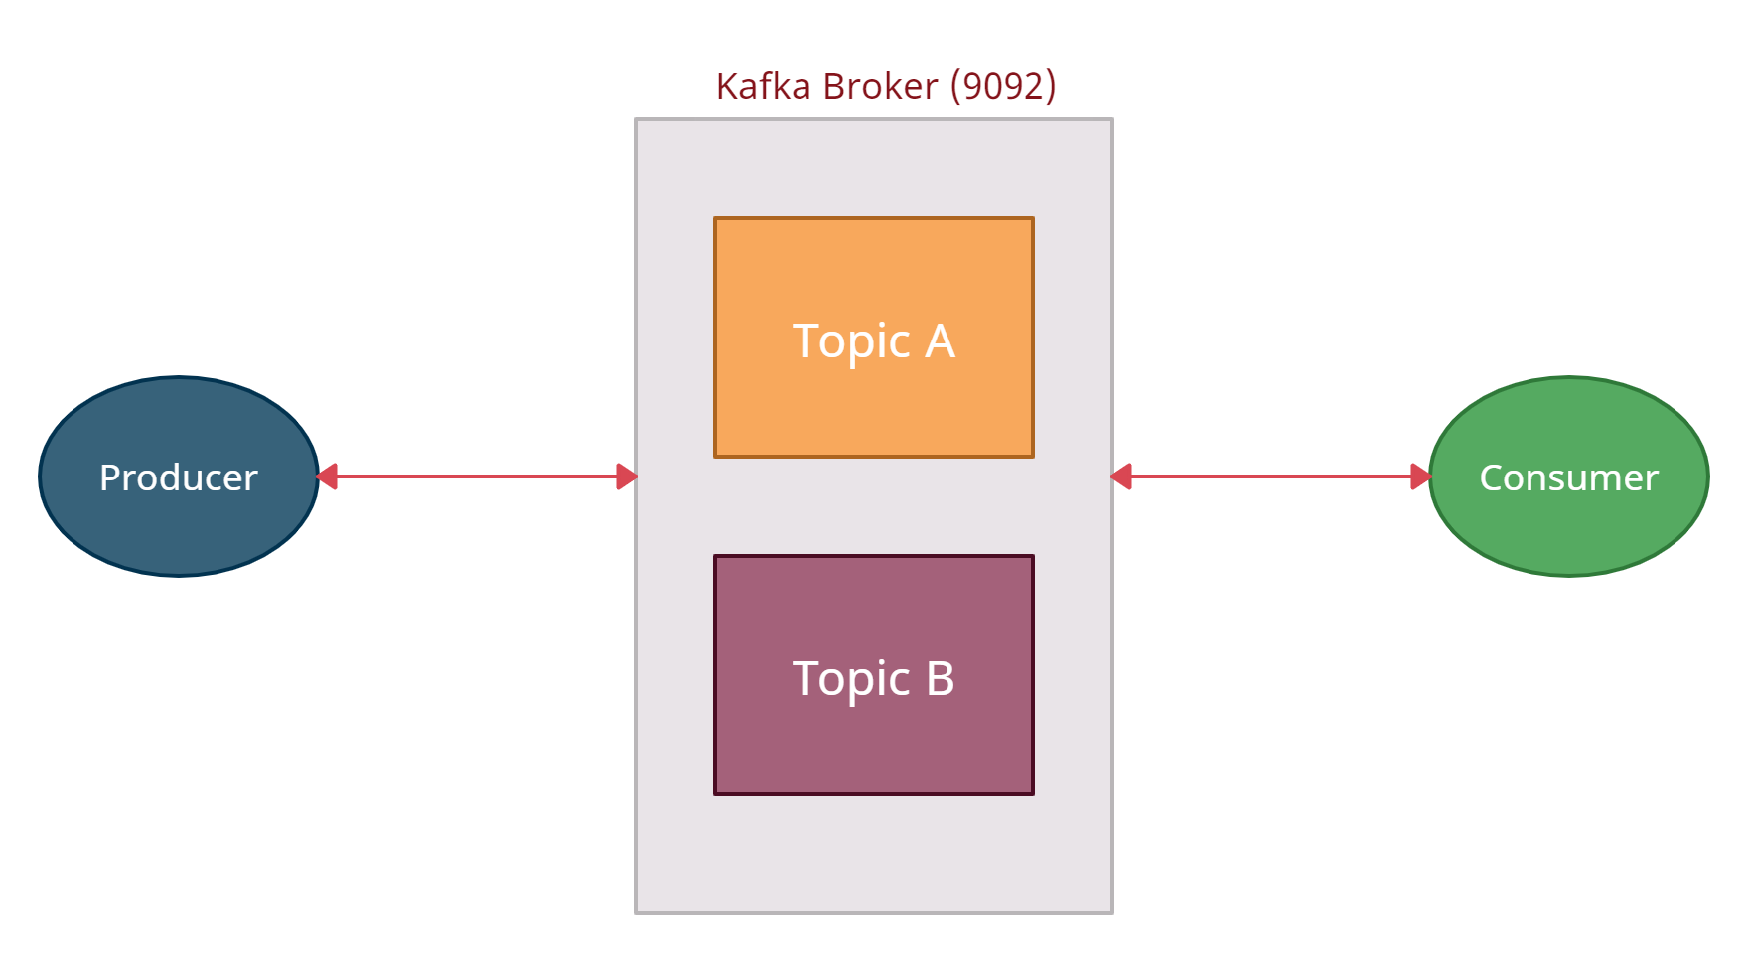
What is Kafka and How does it work?
Apache Kafka is a distributed stream-processing software developed by LinkedIn and written in Scala and Java.
The first component of Kafka is what we call this Kafka server or the Kafka broker and the default port for Kafka broker is 9092
The producer produces content and publishes content to the broker then the consumer consumes content from the broker.
The producer connects to the broker using a TCP connection and that's a raw TCP connection so it's bi-directional so the broker can send information to the producer and the producer can send information to the broker

Slide 2
What is Kafka and How does it work?
The consumer connects to the broker using a TCP connection, so the broker can send information to the consumer.
Topics are basically a logical partition where you write content to.
When the producer writes, the producer has to specify which topic to write.
The consumer has to specify from which Topic the consumer wants to consume the messages.

Slide 3
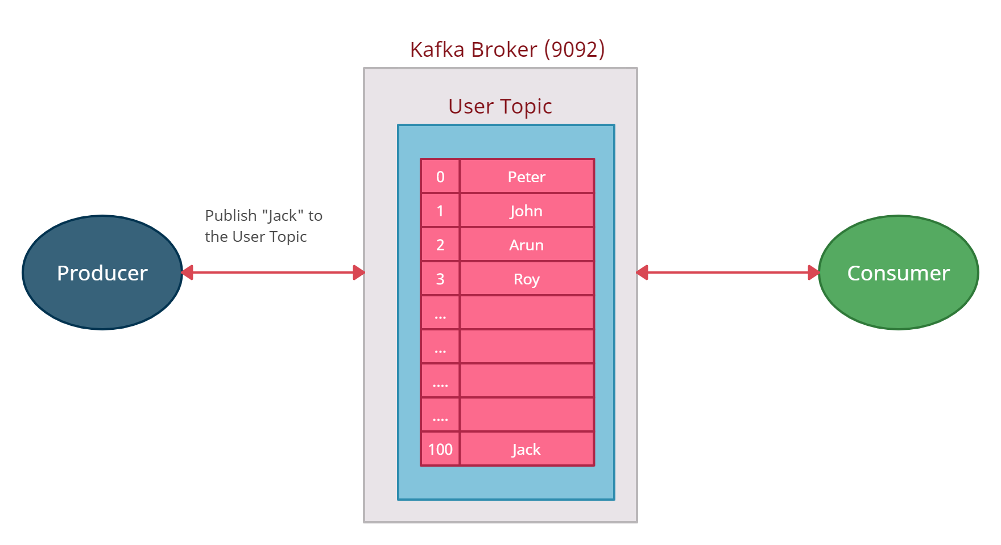
What is Kafka and How does it work?

Slide 4
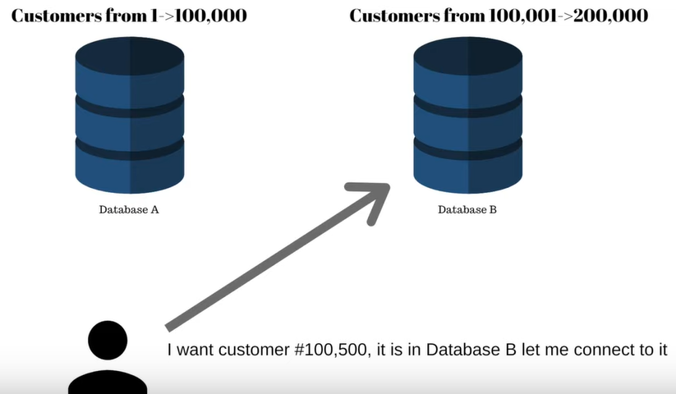
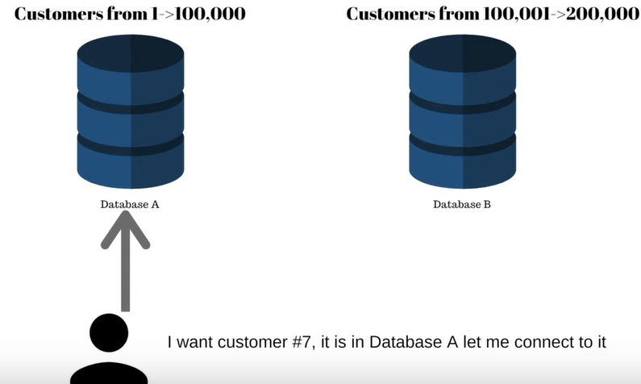
What is Kafka and How does it work?

Slide 5
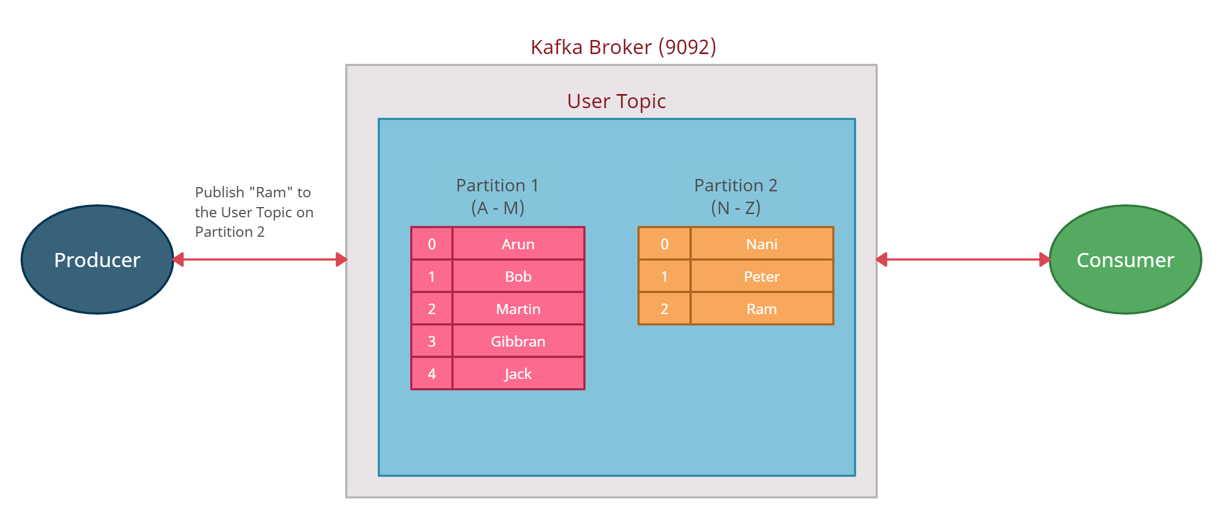
What is Kafka and How does it work?

Slide 6
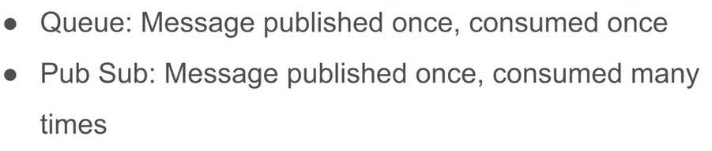
What is Kafka and How does it work?
Queue Vs Pub Sub
Kafka supports both Queue and Pub Sub using “Consumer Group” Concept

Slide 7
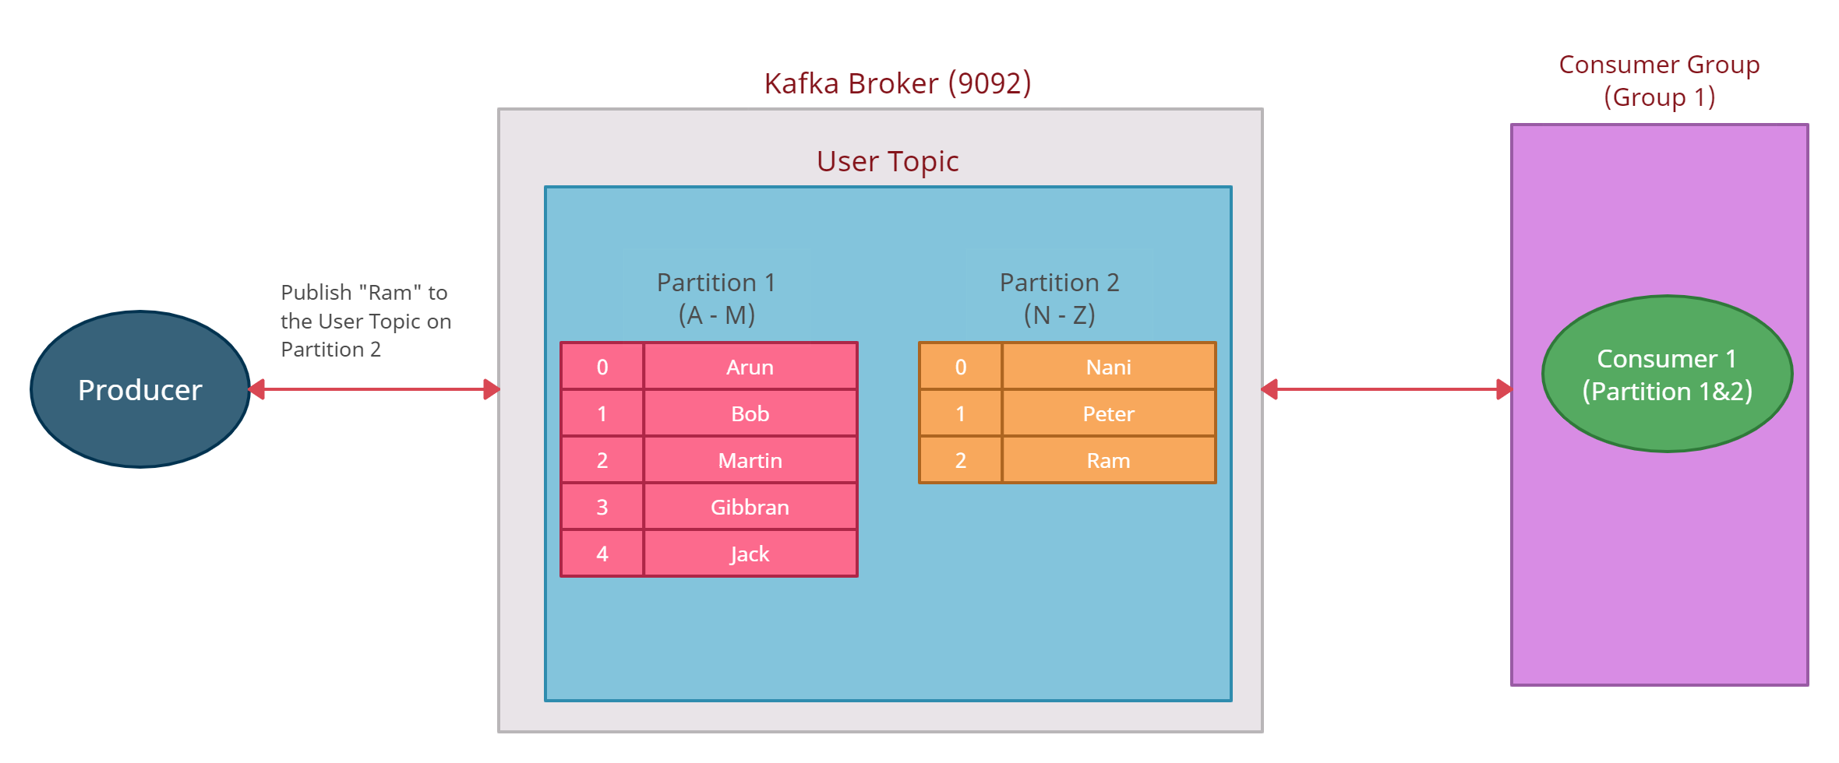
What is Kafka and How does it work?

Slide 8
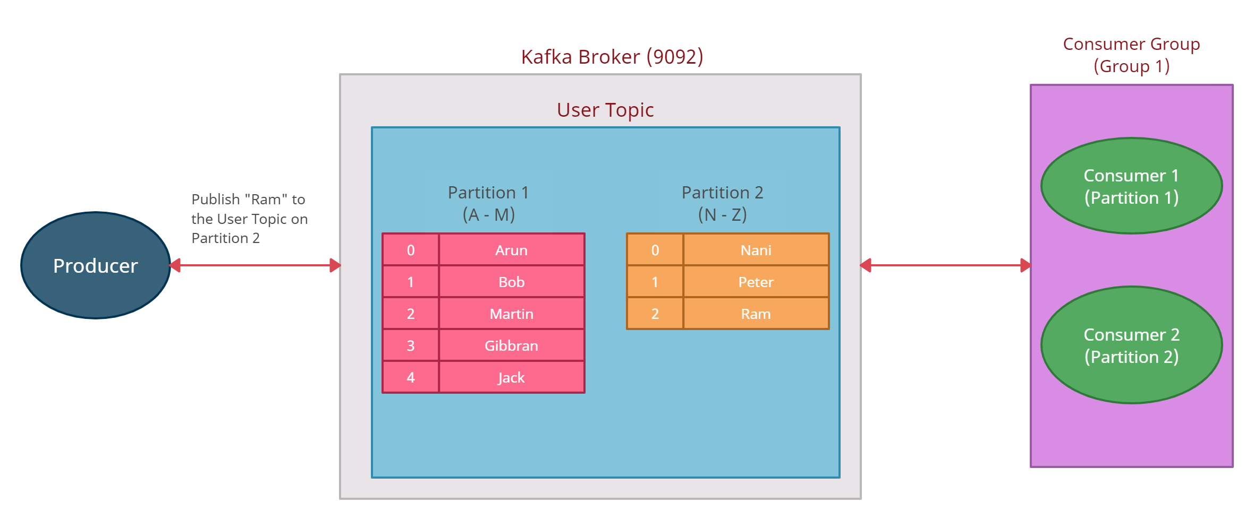
What is Kafka and How does it work?
Each partition has to be consumed by one and only one consumer.
We can have one consumer consuming two partitions or three partitions or four partitions but one partition better be consumed with one consumer that's the rule and the consumer group makes sure of that.
To act like Queue, put all consumers in one group.

Slide 9
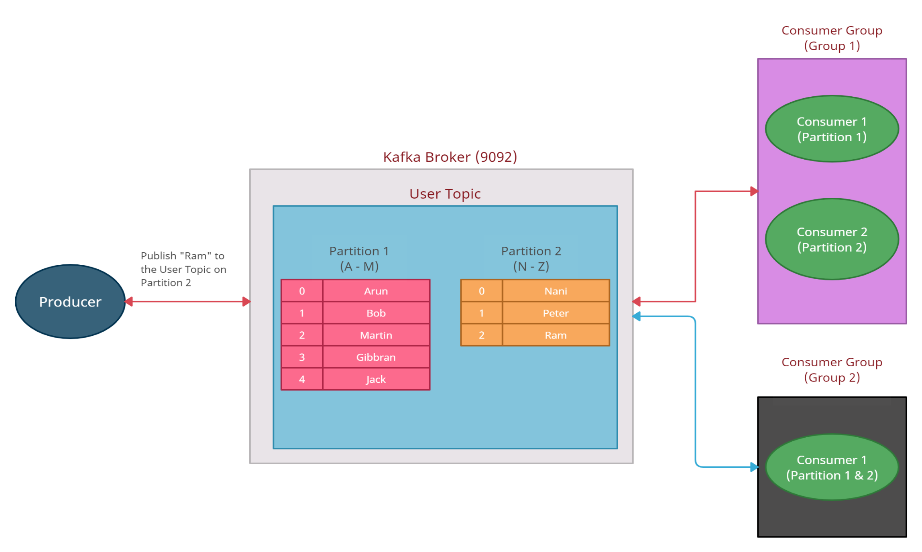
What is Kafka and How does it work?
To act like pub/sub, put each consumer in unique group

