Slide 1
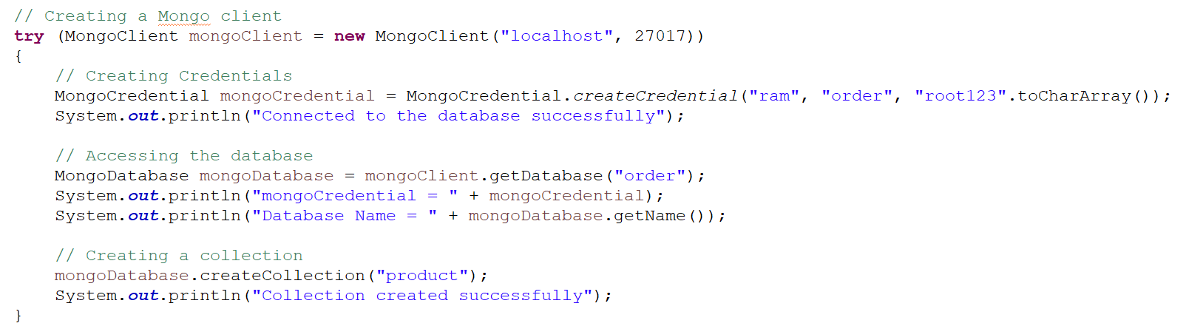
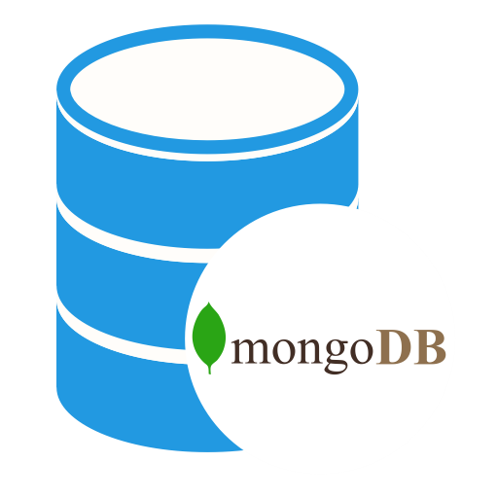
How to Connect to MongoDB using Java?
To connect database, we need to specify the database name, if the database doesn't exist then MongoDB creates it automatically
Java Program

