Slide 1
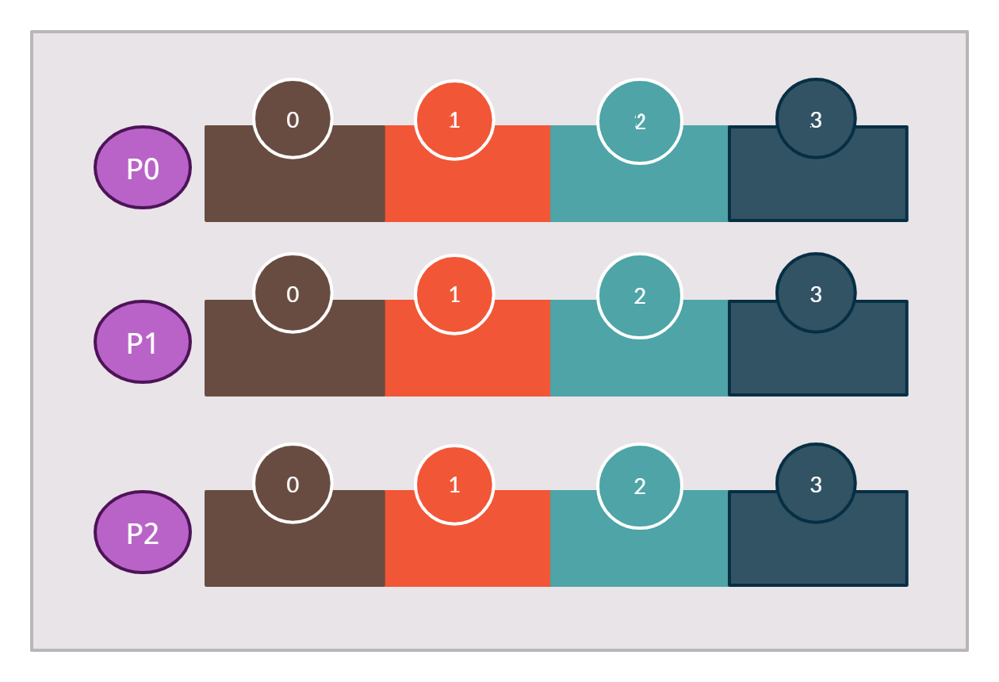

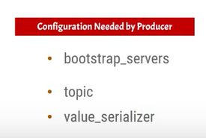
Kafka producer in Java
Producers publish a message to the topics of their choice.
In reality, messages are published to the topic partition
Topic with Three Partition and the Single Broker
Broker 1
Topic
Producer

Slide 2
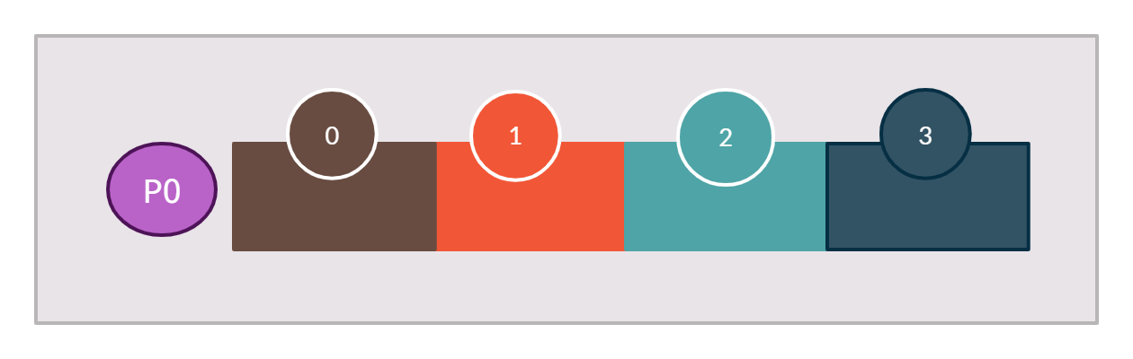
Kafka producer in Java
All the messages will be published to a single partition
Topic with One Partition and the Single Broker
Broker 1
Partition Offset
Topic
Producer

