Slide 1
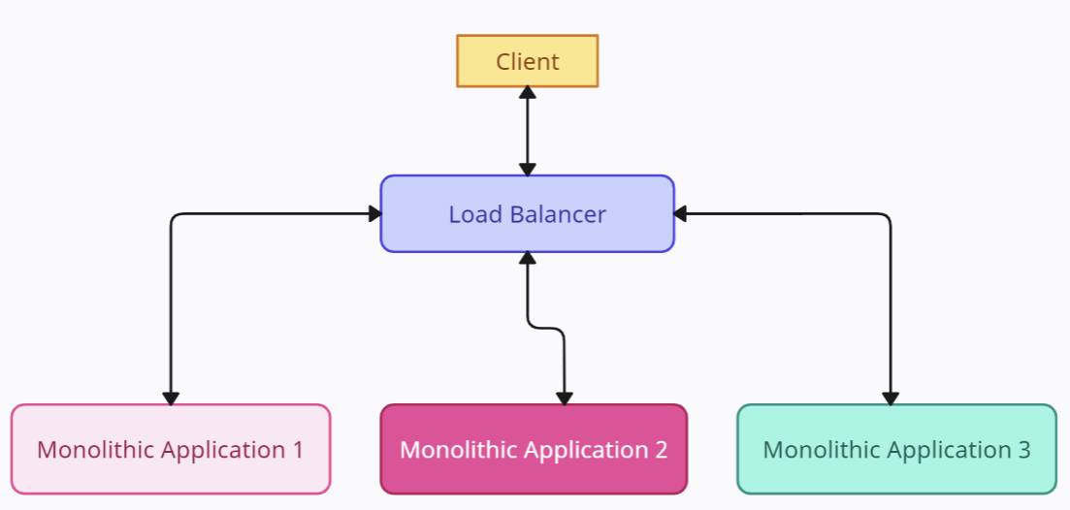
What is Service Discovery in Microservices?- Microservices Basics Tutorial
Monolith applications that runs on a physical server on-premise. It has 3 servers and all of them have
static IPs and the requests are routed to them using a load balancer.
The IP of these 3 servers is stored in a config file usually and is read by the load balancer. In this case, there is no need for a Service Registry as the IP addresses of these 3 APP servers are fixed and won't change.
Server 1
Server 2
Server 3
192.168.1.1
192.168.1.2
192.168.1.3

Slide 2
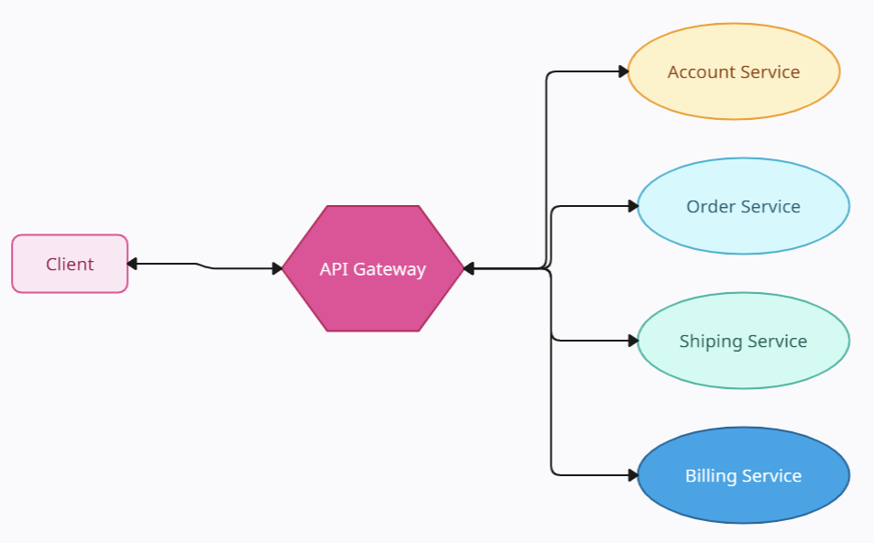
What is Service Discovery in Microservices?- Microservices Basics Tutorial
In the case of a micro-service architecture that is deployed in the cloud, there will be a lot of microservice components for different services. Every microservice can scale differently based on the demands.
The Order service might have 4 or 5 instances and Billing Service might have 2 or 3 instances running. With each instance having a dynamic network address because of multiple factors like Autoscaling, Upgrade, Failure, Deployments, etc, it is extremely difficult to locate these services and communicate with them.
This problem leads to the solution in the form of a design pattern called Service Discovery.
Locations(IP and Port) are
Dynamically changing

Slide 3
What is Service Discovery in Microservices?- Microservices Basics Tutorial
Service Discovery is a design pattern by which the Client or the API Gateways discover the network info (IP address and port) of the Server through an important component called Service Registry or Discovery Server.
The Service Registry keeps track of the entire individual microservices in the architecture and stores the IP address / Port of those in its database. Every time a service scales up or down, it will send a heartbeat to the discovery service and it will update its database accordingly. The discovery server / Registry also groups the instances of each service accordingly.
There are two types of Service Discovery
Client-Side service discovery
Server-side service discovery
Service Registry or Discovery Server
Locations(IP and Port) are
Dynamically changing

Slide 4
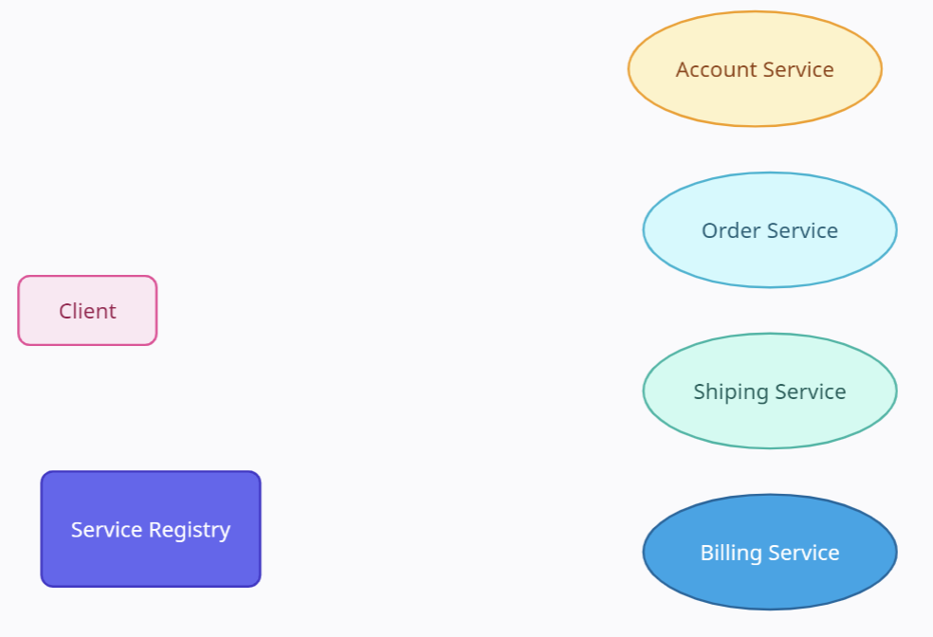
What is Service Discovery in Microservices?- Microservices Basics Tutorial
Client-Side service discovery
In the Client-side service discovery pattern, the client is responsible for discovering the network address of the service instances and load balance of the requests to the instances of the same service.
The client will query the Service Registry to get the list of available instances for the particular service and then use an efficient load balancing algorithm to select one of the instances and send a request to it.
Register

Slide 5
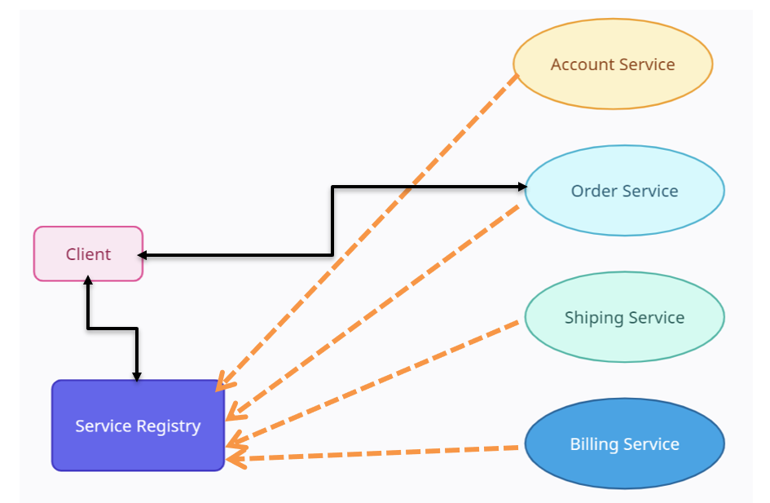
What is Service Discovery in Microservices?- Microservices Basics Tutorial
Client-Side service discovery
Netflix OSS is an example of Client Side Service Discovery. Eureka Server is the Service Registry and Netflix Ribbon is a client-side load balancer. The Netflix Ribbon is a client-side load balancer that gives you a lot of control over the behavior of HTTP and TCP clients.
When microservice A talks to microservice B using Feign Client, service A contacts Eureka to get the information about all the instances of Service B. Then the Netflix Ribbon load balancer on Service A will find the best instance of Service B to send the request.
Register

Slide 6
What is Service Discovery in Microservices?- Microservices Basics Tutorial
Client-Side service discovery
Advantages:
This pattern is quite simple and straightforward to implement as the client only needs to communicate with the Service Registry
The client can have its own Load Balancings algorithms like Round Robin or Consistent Hashing
Drawback:
The Service Discovery logic is tightly coupled with the client and hence it is difficult if we have different types of clients and frameworks
Register

Slide 7
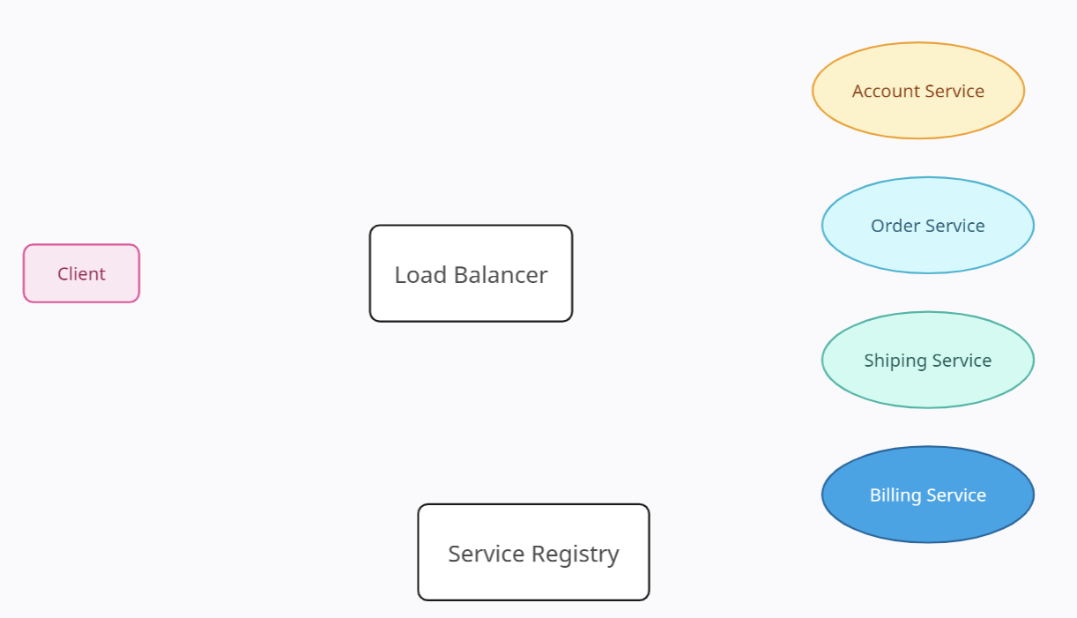
What is Service Discovery in Microservices?- Microservices Basics Tutorial
2. Server-side service discovery
Server-side service discovery is the most widely used pattern for Service Discovery. Here the client makes calls to the
Load Balancer which then queries the Service Registry to discover the instances and query one of them.
The load balancing logic now stays inside the Load Balancer component and this is common to any client or framework that requests it. Load Balancer component is the only change when compared to the Client Side Service Discovery
Load Balance
Request
Query
Register

Slide 8
What is Service Discovery in Microservices?- Microservices Basics Tutorial
2. Server-side service discovery
The AWS Elastic Load Balancer (ELB) is an example of a server-side discovery pattern.
The EC2 servers or ECS containers will register their network information to the ELB which acts as both the Router and the Service Registry. When a request reaches ELB, it can route to the specific instances after picking the best match through the algorithm
AWS Elastic Load Balancer (ELB)
Load Balance
Request
Services deployed in
EC2 Instances
Query
Register
AWS Elastic Load Balancer (ELB)

Slide 9
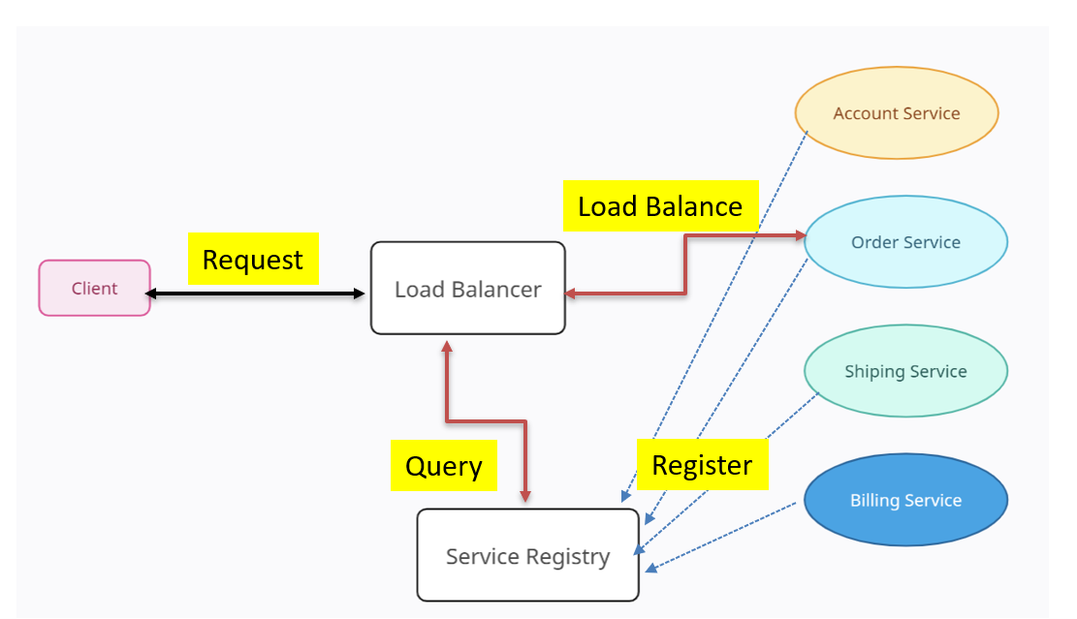
What is Service Discovery in Microservices?- Microservices Basics Tutorial
2. Server-side service discovery
Advantages:
The discovery information is abstracted de-couple from the clients
Implementation is quite simple for the client side as it just needs to call the load balancer DNS
Drawbacks:
For a non-cloud environment, the Router or Load Balancer is an extra physical component to be maintained in terms of configuration, replication, availability, etc.
More network hops are required than when using the Client Side Discovery Pattern

Slide 10
What is Service Discovery in Microservices?- Microservices Basics Tutorial
Common Service Registry / Discovery Frameworks
Netflix OSS — This is widely used for Spring framework applications that are deployed in the cloud. Eureka is the Service Registry (Discovery Server) and all other microservices components are the clients of Eureka.
etcd — This is a highly available, distributed, consistent, key‑value store that is used for shared configuration and service discovery which is used by Kubernetes and Cloud Foundry.
consul — Hashicorp consul is the one-stop solution for microservices (self) registration, discovery, health checks, key-value store, and load balancing. It is one of the most powerful frameworks

