Slide 1
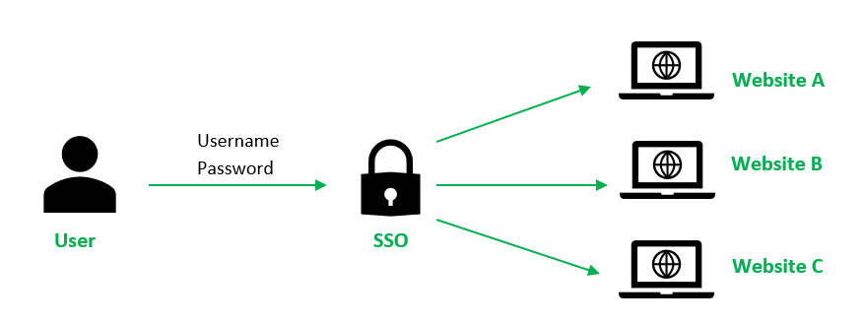
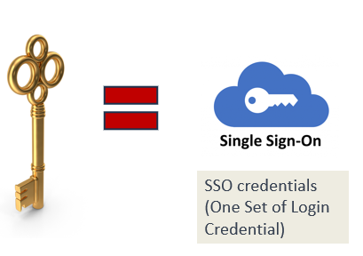
What is Single Sign-On (SSO) | Why do we need SSO?
Imagine you have a bunch of different accounts for various websites and apps. Each one has its own username and password, and it can be a hassle to remember and manage all of them.
Single Sign-On, or SSO, is like having a magical key that unlocks all these accounts with just one login.
Instead of logging in separately to each website or app, SSO lets you log in once, and then it automatically grants you access to all the other services without needing to enter your login details again. It saves you time and makes life easier!

Slide 2
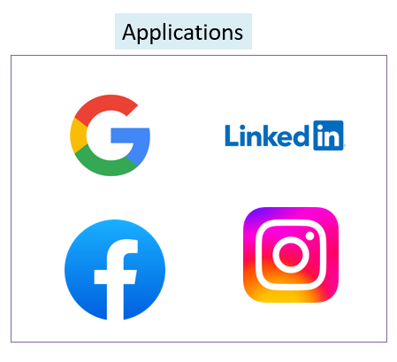
What is Single Sign-On (SSO) | Why do we need SSO?
SSO works by securely connecting all these services and storing your login information in a safe place. When you want to access any of those services, the SSO system checks if you're already authenticated (logged in) and, if so, allows you in without bothering you with additional login steps.
It's like having a master key for all your online accounts, making your digital life more convenient and secure!

