Slide 1
Demystifying XML: A Simple Guide for Beginners
XML, or eXtensible Markup Language, is a simple and widely used way to structure, store and exchange data in a format that's easy for both computers and humans to understand.
XML is like a set of rules for organizing information so that computers and software programs can understand it.
What is XML?
XML is a way to represent and organize data. It uses a set of tags (words or symbols enclosed in angle brackets) to label pieces of information. These tags provide a structure to the data, making it easy for both humans and computers to read and process.

Slide 2
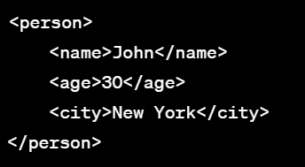
Demystifying XML: A Simple Guide for Beginners
How Does XML Work?
XML works by enclosing data within pairs of tags. These tags create a hierarchy, just like how folders and files are organized on your computer. Each piece of data is enclosed in a tag, and the relationship between tags reflects the structure of the information.
For example:
In this XML, <person> is like a container for the person's information, and within it, we have tags like <name>, <age>, and <city>, each holding specific data.
Why Use XML?
XML is a flexible and human-readable format that makes it easy to exchange data between different systems and platforms. It's used in various applications, from web services to configuration files. Its structured nature helps ensure data consistency and compatibility.

Slide 3
Demystifying XML: A Simple Guide for Beginners
Real-World Examples:
Web Services: Many web applications use XML to communicate with each other. For example, when you search for a location on a map app, the app might send an XML request to the server to fetch the map data.
Configuration Files: XML is often used to store configuration settings for software and systems. Think of it as a way to specify how a program should behave.
Data Exchange: When you export data from a database, it's often saved in an XML format. This allows you to move the data between different programs and databases easily.
Data Storage: XML can be used to store structured data, such as customer information or product details, in a way that's easy to read and manage.
In a nutshell, XML is a tool that helps organize and structure data, making it easier for different systems to understand and share information. It's an important concept in the world of computer programming and data exchange.

