Slide 1

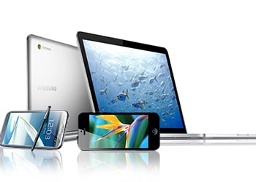
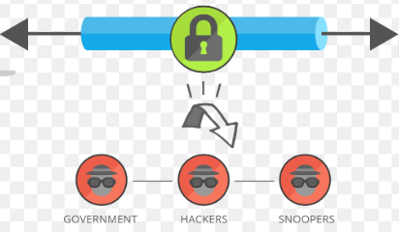
Demystifying VPNs: Your Beginner's Guide to Online Privacy and Security
What is a VPN?
Think of a VPN as a magical tunnel that makes your online activities super private and secure. It's like having your own secret path on the internet.
VPN Secures your Data
You

Slide 2
Demystifying VPNs: Your Beginner's Guide to Online Privacy and Security
How a VPN works:
Secure Connection: When you use the internet without a VPN, it's like shouting your requests in a crowded room. But with a VPN, it's like having a private conversation. Your device (computer, phone, etc.) creates a secure tunnel to a special server.
VPN Secures your Data
You

Slide 3
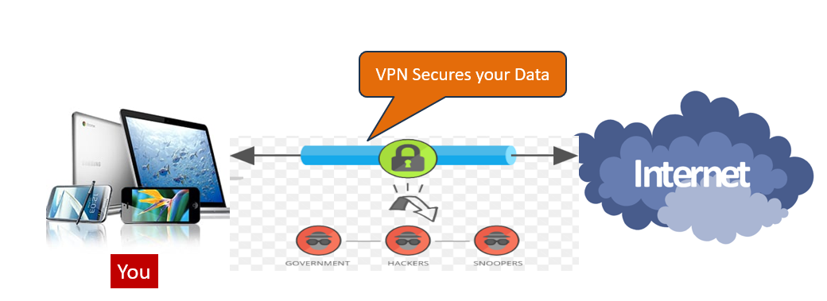
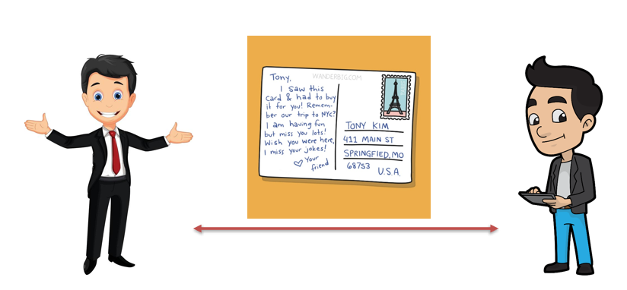
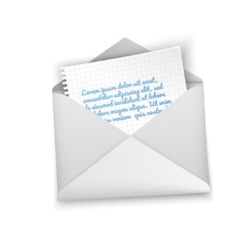
Demystifying VPNs: Your Beginner's Guide to Online Privacy and Security
How a VPN works:
Hiding Your Stuff: Imagine you're sending a letter. Without a VPN, it's like sending a postcard—everyone can see it! But with a VPN, it's like putting your letter in a magical, invisible envelope that only you and your friend (the website you're visiting) can open.

Slide 4
Demystifying VPNs: Your Beginner's Guide to Online Privacy and Security
How a VPN works:
Protecting Your Secrets: The information inside your tunnel is like a treasure chest, and the VPN locks it up with a special code only you and the other end of the tunnel know. This is called encryption, and it keeps your online treasures safe from anyone who might want to peek.
VPN Secures your Data
You

Slide 5
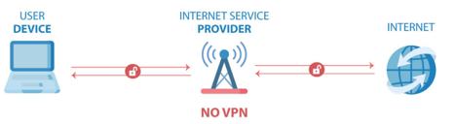
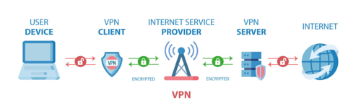
Demystifying VPNs: Your Beginner's Guide to Online Privacy and Security
How a VPN works:
Changing Your Location (Sort of): Sometimes, you might want to pretend you're in a different place on the internet. Maybe to watch a show or access a website not available in your country. With a VPN, it's like wearing a disguise—websites see the location of the server at the end of your tunnel, not your real location.
Anonymous Location: Your internet service provider (ISP) knows where you are, just like your return address on a letter. With a VPN, it's like sending your internet connection to a friend's house first. Now, websites only see your friend's address, not yours.

Slide 6
Demystifying VPNs: Your Beginner's Guide to Online Privacy and Security
How a VPN works:
Access Anywhere: If some websites are like exclusive clubs that only allow certain people in, a VPN is like having a special pass that lets you enter from anywhere in the world. You can access websites that might be restricted in your country.

Slide 7
Demystifying VPNs: Your Beginner's Guide to Online Privacy and Security
In Simple Terms:
A VPN is your online superhero cape! It makes sure your internet adventures are private, your messages are secret, and you can visit places on the web as if you were a cool spy. It's like having your own secret passage on the internet that keeps you safe and lets you go wherever you want, without anyone knowing.
Remember, it's like a magical shield for your internet travels!

