Slide 1
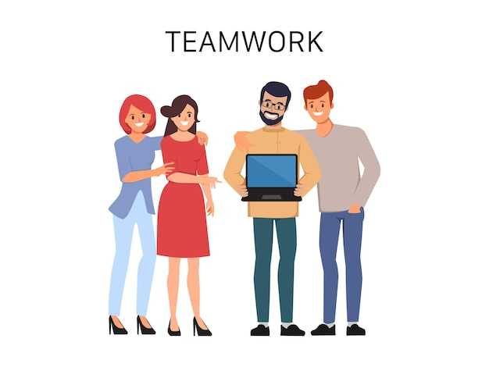
Scrum Explained Simply: What You Need to Know
Imagine you're part of a team that needs to build something, like a new product or software. Now, you want to make sure the team works efficiently and delivers the best results. That's where Scrum comes in!
Scrum is like a playbook or set of rules that helps teams work together smoothly and stay focused on their goals. It's often used in industries like software development, but its principles can be applied to many different kinds of projects.

Slide 2
Scrum Explained Simply: What You Need to Know
How Scrum works:
Team Collaboration: In Scrum, you have a team of people with different skills (like developers, designers, and testers) who work together closely. They all have a specific role to play.
Clear Goals: The team knows exactly what they need to achieve by the end of a certain period, usually a few weeks. This period is called a "sprint.“
Daily Meetings: Every day, the team has a quick meeting (often standing up, hence called a "stand-up meeting") to discuss what they did yesterday, what they're doing today, and if there are any roadblocks.
Flexible Planning: Instead of planning everything from start to finish upfront (which can be hard!), Scrum breaks the work into smaller tasks. The team plans for each sprint, and they can adjust their plans based on what they learn along the way.
Feedback and Adaptation: At the end of each sprint, the team reviews what they've done and gets feedback from others, like stakeholders or customers. They use this feedback to improve and adjust their approach for the next sprint.
Continuous Improvement: Scrum encourages teams to keep getting better. They have regular opportunities to reflect on what's working well and what needs to change.

Slide 3
Scrum Explained Simply: What You Need to Know
Summary:
Overall, Scrum helps teams be more flexible, communicate better, and deliver valuable results faster. It's all about teamwork, transparency, and adapting to make sure the team stays on track and delivers what's needed.
Think of Scrum like a sports team playbook. Just as a playbook helps a team coordinate their moves on the field to score goals, Scrum helps a team coordinate their efforts to achieve their project goals effectively and efficiently.

