Slide 1
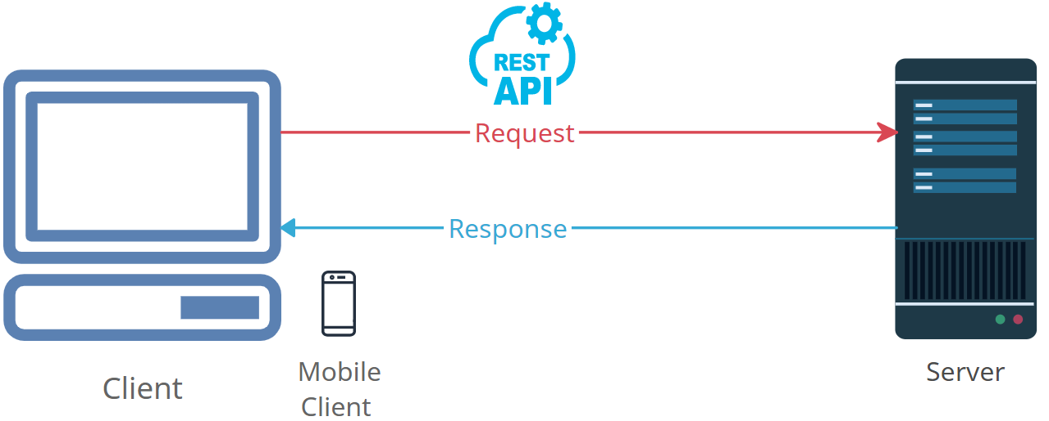
Demystifying HTTP Headers: How the Internet Talks to You
HTTP headers are an essential part of the Hypertext Transfer Protocol (HTTP), which is the foundation of data communication on the World Wide Web.
HTTP headers serve as a means of communication between the client (typically a web browser) and the server (where a website or web application is hosted).
HTTP headers are used to convey important information about the request or response being exchanged.

Slide 2
Demystifying HTTP Headers: How the Internet Talks to You
What are HTTP Headers?:
HTTP headers are pieces of data in the form of key-value pairs that are sent along with an HTTP request or response. They provide additional information about the request or response, allowing the client and server to understand each other's requirements and capabilities.

Slide 3
Demystifying HTTP Headers: How the Internet Talks to You
Types of HTTP Headers:
There are two main types of HTTP headers: request headers and response headers.
Request Headers: These are sent from the web browser (client) to the web server. They contain information about the client's request, such as the type of browser being used, the preferred language, or cookies.
Response Headers: These are sent from the web server to the web browser. They contain information about the server's response, such as the content type, caching instructions, or status codes.

Slide 4
Demystifying HTTP Headers: How the Internet Talks to You
Common Uses of HTTP Headers:
Content-Type: Indicates the type of data being sent (e.g., HTML, JSON, or images).
Content-Length: Specifies the size of the response body in bytes.
Location: Used for redirection, it instructs the client to navigate to a different URL.
User-Agent: Identifies the client making the request, often the web browser and its version.
Server: Identifies the software running on the server.
Cookie: Used for storing data on the client side, such as session information.
Caching: Response headers can instruct the browser to cache content for faster loading on future visits.
Authorization: Contains authentication information (e.g., user credentials) to access restricted resources.

Slide 5
Demystifying HTTP Headers: How the Internet Talks to You
Header Format:
HTTP headers consist of a name and a value, separated by a colon. For example:
Content-Type: text/html.
Multiple headers can be included in an HTTP request or response, each on a new line.

Slide 6
Demystifying HTTP Headers: How the Internet Talks to You
How Headers Work:
When a user enters a URL in a web browser and presses Enter, the browser sends an HTTP request to the server. This request includes various headers. The server processes the request, generates a response, and sends back an HTTP response with its headers. The browser then uses the information in the response headers to display the web page or resource.
HTTP Status Codes:
Response headers often include an HTTP status code (e.g., 200 for "OK" or 404 for "Not Found"). These codes indicate whether the request was successful or if there was an issue.

Slide 7
Demystifying HTTP Headers: How the Internet Talks to You
Custom Headers: While there are many standard HTTP headers, developers can also create custom headers for their specific needs. These headers are prefixed with "X-" to indicate that they are non-standard.
Debugging and Testing: For developers, understanding and working with HTTP headers is crucial for debugging and optimizing web applications. There are various tools and browser developer consoles that allow you to inspect and analyze the headers exchanged during web requests.

Slide 8
Demystifying HTTP Headers: How the Internet Talks to You
In summary, HTTP headers are essential for the functioning of the web, enabling communication between clients and servers by providing crucial information about the data being transferred and instructions on how to handle that data.
For beginners, it's important to grasp the basics of HTTP headers to understand how web requests and responses are processed.

