Slide 1
What is an API?
API – Application Programing Interface
API stands for Application Programming Interface.
Think of it as a way for different software applications or services to talk to each other and work together.
Software Application (Java)
Software Application (.Net)

Slide 2
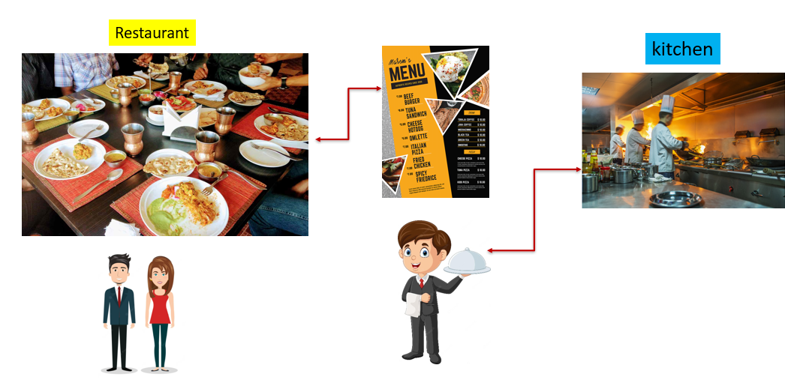
What is an API?
Imagine you're in a restaurant and you want to order some food. The menu acts as an interface between you and the kitchen. It lists all the available dishes, their descriptions, and prices. You select the dishes you want, communicate your choices to the waiter, and the waiter relays your order to the kitchen. The kitchen then prepares the food according to your specifications and gives it back to the waiter who delivers it to your table.
In this analogy, the menu is like an API. It provides a set of options (dishes) with clear descriptions (what the dishes do) and details (how to use them). You, as the user, interact with the API by making choices (ordering dishes) based on your needs.

Slide 3
What is an API?
Similarly, in the digital world, an API acts as a menu for software applications. It defines a set of rules and protocols that allow different software systems to communicate with each other. It specifies the available functions, data formats, and methods that can be used to interact with a particular service or application.
Let's say you're using a weather app on your smartphone. The app needs to fetch weather data from a remote server to provide you with accurate information. The app developer doesn't have to build the entire weather database themselves. Instead, they can use a weather API provided by a weather service. The API defines how the app can request weather data, what format the data will be in, and how to interpret it.

Slide 4
What is an API?
So, in simple terms, an API is like a bridge that enables different software applications to work together, allowing them to exchange information and perform specific tasks. It helps developers save time and effort by providing pre-built functionalities and resources that they can integrate into their own applications, just like a restaurant menu provides a convenient way to order food without having to cook it yourself.

