Slide 1
What is an API?
API is the acronym for Application Programming Interface
An Application Programming Interface (API) is a set of functions, procedures, methods, or classes used by computer programs to request services from the operating system, Software libraries, or any other service providers running on the computer.

Slide 2
What is an API?
API – Application Programing Interface
Application Programming Interface (API) is a software intermediary that allows two applications to talk to each other.
Each time you use App like Facebook, send an instant message or check the weather report on the phone, then you are using the API.
Application 1
Application 2

Slide 3
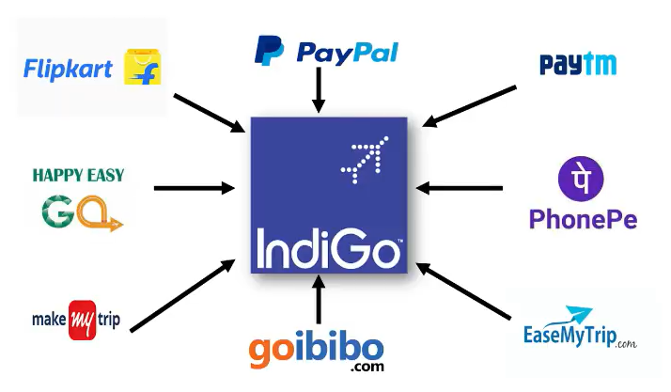
What is an API?
API

