Slide 1
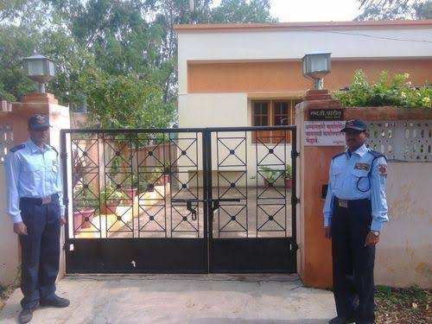
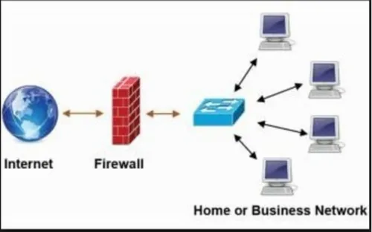
Firewall Explained: Your Digital Security Guard
Imagine your computer or network is like a house, and the internet is the outside world. A firewall is like a security guard at the entrance of your house. Its job is to decide who or what is allowed to come in and go out.
So, in computer terms, a firewall is a piece of software or hardware that acts as a barrier between your computer or network and the internet. It monitors and controls the incoming and outgoing network traffic based on predetermined security rules.
Just like a security guard checks IDs and only allows authorized people to enter your house, a firewall examines data packets traveling between your computer and the internet. It decides which packets are safe and allowed to pass through, and which ones are potentially harmful and should be blocked.
Essentially, a firewall helps protect your computer or network from unauthorized access, malicious software, and other online threats by acting as a gatekeeper, filtering out potentially dangerous traffic while allowing legitimate data to pass through safely.
House with Security Guard
Computer Network with Firewall

Slide 2
Firewall Explained: Your Digital Security Guard
Protection from Unwanted Guests: The firewall helps keep out unwanted visitors, like viruses, hackers, or other malicious software, from getting into your computer or network.
Controlled Access: It decides which apps or programs on your computer are allowed to communicate with the internet. It's like the security guard checking the credentials of everyone entering or leaving your house.
House with Security Guard
Computer Network with Firewall

Slide 3
Firewall Explained: Your Digital Security Guard
Privacy and Security: Think of the firewall as a barrier that protects your personal information. It makes sure that sensitive data, like your passwords or bank details, doesn't just leak out to the internet without your permission.
Traffic Cop: It acts like a traffic cop, directing and managing the flow of data between your computer and the internet. This ensures that everything runs smoothly and securely.
In simple terms, a firewall is your computer's guardian, keeping the bad stuff out and allowing only the good stuff in and out. It's a crucial part of your digital security, working silently in the background to keep you and your information safe.
House with Security Guard
Computer Network with Firewall

