Slide 1

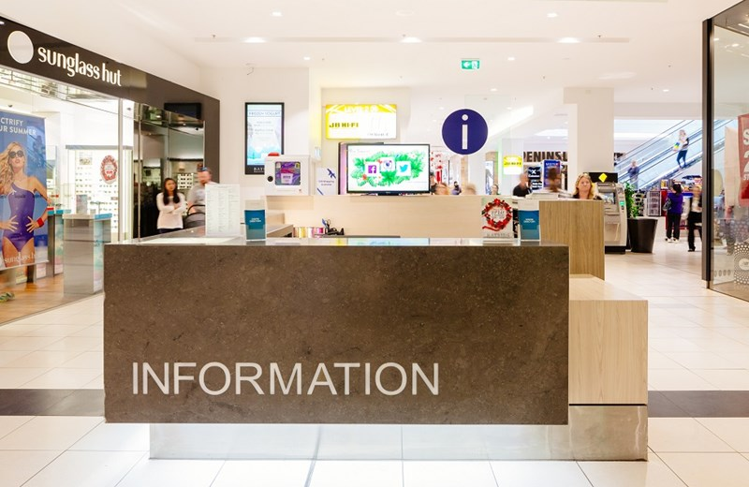
What is Service Discovery in Microservices?- Microservices Basics Tutorial
Imagine you're at a shopping mall with lots of different stores, but you're not sure where the specific store you're looking for is located. You decide to visit the information desk. In a way, that information desk is like a "Service Discovery" system.
Service Discovery
Shopping Malls
Information Desk

Slide 2
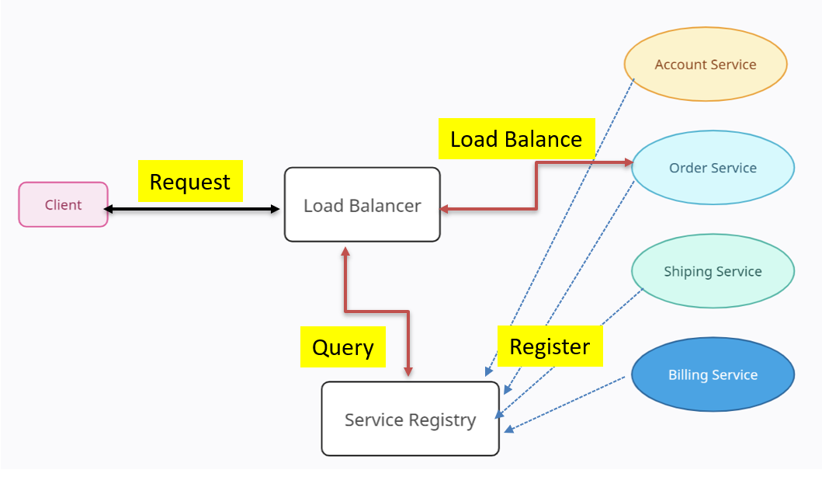
What is Service Discovery in Microservices?- Microservices Basics Tutorial
In the world of technology, "Service Discovery" is like having an automated information desk for computer programs.
When different programs (like apps or websites) need to talk to each other to get some work done, they often need to find each other on a network. Service Discovery helps them do that easily.

Slide 3
What is Service Discovery in Microservices?- Microservices Basics Tutorial
Just like the information desk knows where each store is in the mall, Service Discovery keeps track of where each program or service is on a network. So when one program needs to talk to another, it asks the Service Discovery system, "Hey, where can I find this service?" And the system gives the exact location. This way, the programs can work together smoothly without getting lost in the vast network.
In a nutshell, Service Discovery is like the GPS of the tech world, making sure different programs can find each other and work together effectively, just like you finding the right store in a big shopping mall.

