Slide 1


HTTP Status Codes
Imagine you're ordering food from a restaurant using a delivery app. After placing your order, you see different messages like "Order Confirmed," "Preparing Your Food," or "Delivered." These messages help you understand what's happening with your order, right? Well, think of these messages like HTTP status codes for websites.
HTTP status codes are like quick messages that computers use to talk to each other when you're browsing the internet. They tell your browser how things are going when you visit a website.
Food Delivery App
Order Food
"Order Confirmed,"
"Preparing Your Food,"
"Delivered."

Slide 2

HTTP Status Codes
200 OK: Imagine it as a thumbs-up. It means everything is good, and the webpage you wanted to see is there.
Food Delivery App
Order Food
"HTTP 200 OK"

Slide 3

HTTP Status Codes
404 Not Found: This is like when you search for something in the app, but it's not available. It's like saying "Sorry, we couldn't find what you're looking for."
Food Delivery App
Order Food
HTTP 404 Not Found

Slide 4
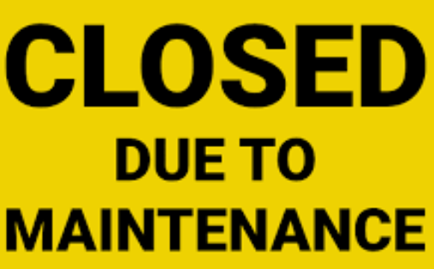
HTTP Status Codes
500 Internal Server Error: Picture a chef in a restaurant having a bad day in the kitchen. It means something went wrong on the website's side, like a technical glitch.
Food Delivery App
Order Food
HTTP 500 Internal Server Error

Slide 5

HTTP Status Codes
301 Moved Permanently: This is like when a store changes location. It tells your browser that the webpage has moved to a new address.
Food Delivery App
Order Food
301 Moved Permanently

Slide 6
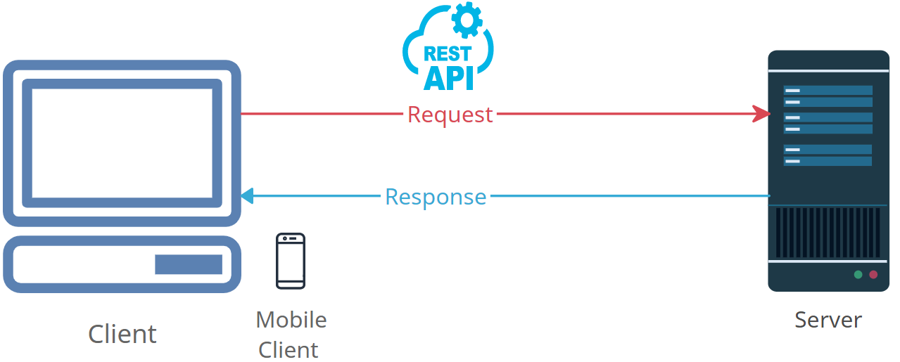
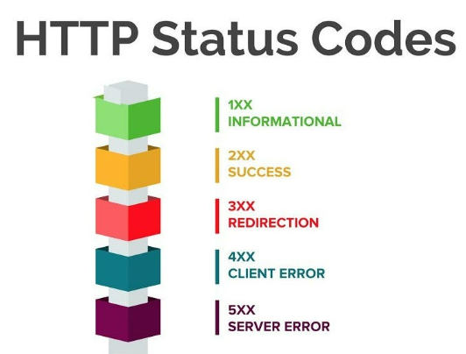
HTTP Status Codes
So, just like those food delivery messages help you know what's happening with your order, HTTP status codes help computers and your browser understand what's happening with websites. They make sure everything runs smoothly on the internet!

